Slide 1
Today we will:
Begin our Hip-Hop Poetry Unit
Learn the elements of hip-hop
Study alliteration in hip-hop
Due Tomorrow: Alliteration worksheet

Slide 2
Is Hip-Hop Poetry? Explain.
Journal

Slide 3
“Hip-Hop is poetry.”
–Jay Z

Slide 4
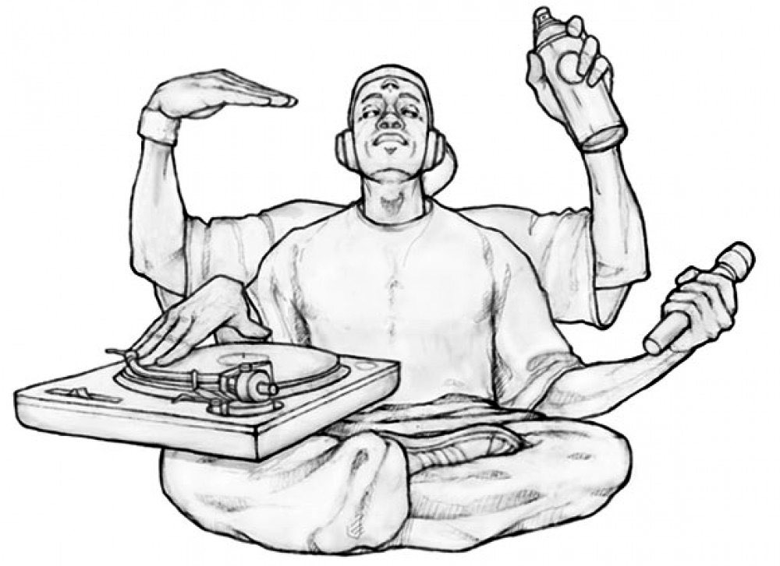
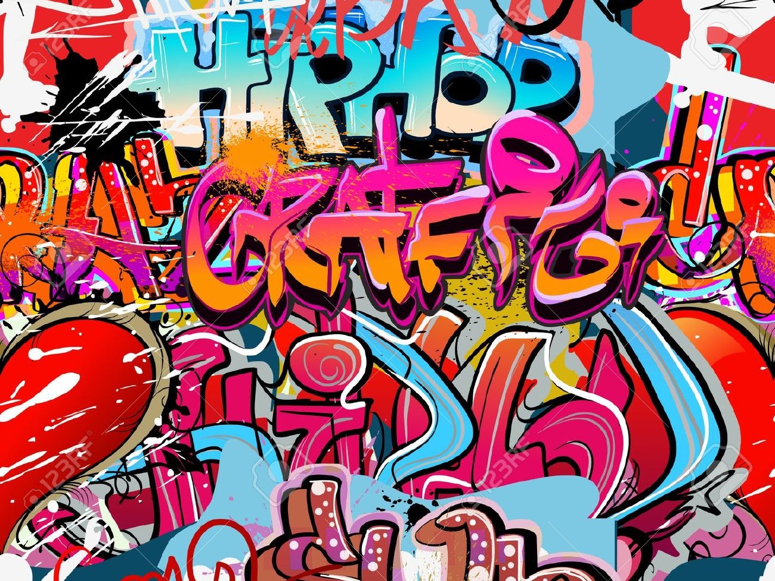
The Elements of Hip-Hop
MC
DJ
Breakdance
Graffiti Art
Knowledge

Slide 5
“The Evolution of Hip-Hop Dance”
–Jimmy Fallon & Will Smith

Slide 6
Freestyle

Slide 7
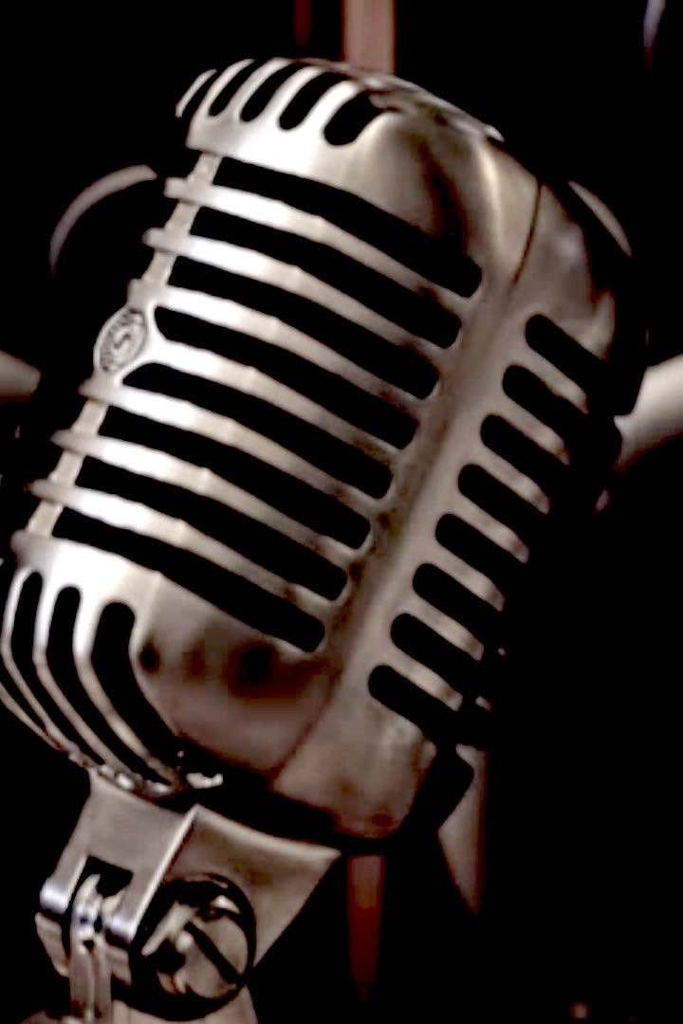
Freestyle
Style of Rap
With or without beats
Lyrics are improvised

Slide 8
Alliteration
The repetition of the same or similar consonant sounds in words that are close together.
Adds beauty and musicality
Example: "Behemoth, biggest born of earth, upheaved his vastness
- John Milton

Slide 9
Alliteration in Poetry
We passed the Fields of Gazing Grain-
We passed the Setting Sun-
(Emily Dickinson)
Brazen bells!
What a tale of terror, now, their turbulence tells!
(Edgar Allen Poe)

Slide 10
Alliteration in Hip-Hop
I’m the ladies love, legend in leather
Long and lean, and I don’t wear pleather
(LL cool j)
Peter Piper picked peppers
but Run rocked rhymes
(Run DMC)

Slide 11
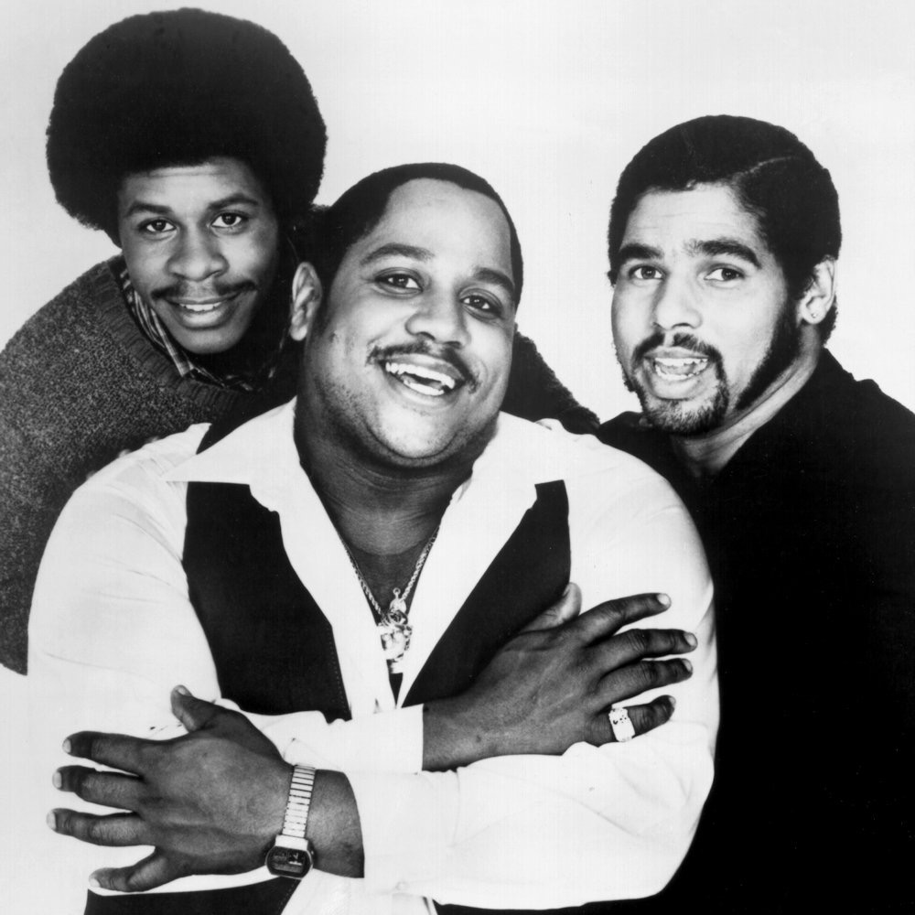
Sugar Hill Gang
American Hip-Hop
Englewood, NJ
"Rapper's Delight"
Popularized rap

Slide 12
Alliteration
I said a hip hop,
Hippie to the hippie,
The hip, hip a hop

Slide 13
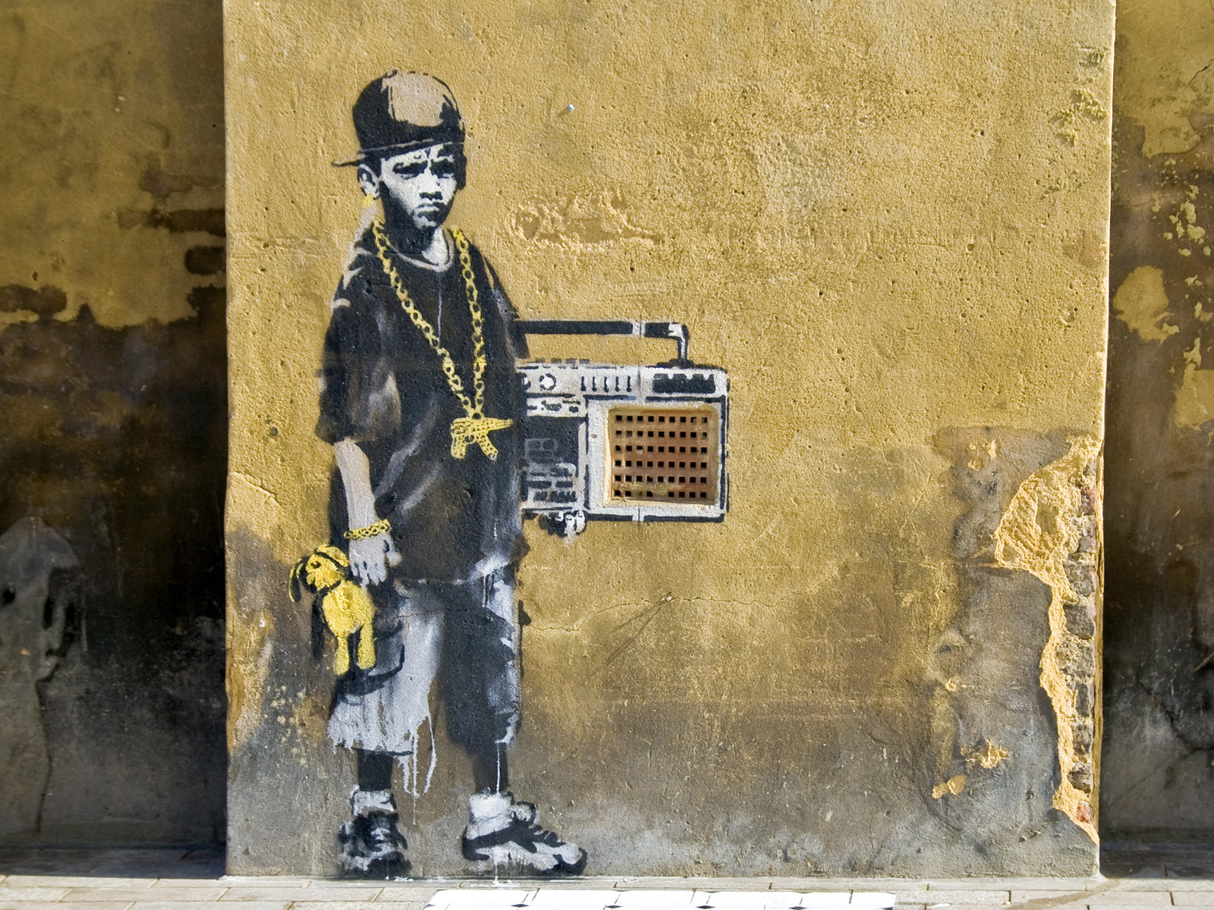
Is this art, or
is this vandalism?

