Slide 1
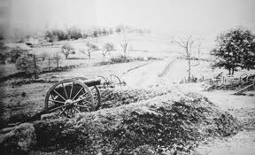
Civil War Project

Slide 2
Part I
Pink and Say

Slide 3
Where are we going?
Through Part I of this lesson the goal will be to improve skills in:
Reading comprehension
Questioning strategies
Connections with characters
Inference skills
Predictions
Drawing Conclusions
Author’s Point of View
Determining the difference between memory and history
Researching primary sources
Determining if an author’s story is based on memory or history

Slide 4
What do you know about the Civil War?
K | W | L
Know | Want to Know | Learned

Slide 5
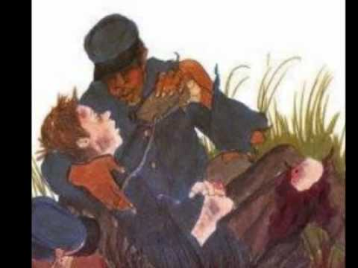
Read
Pink and Say
By Patricia Palooka

Slide 6
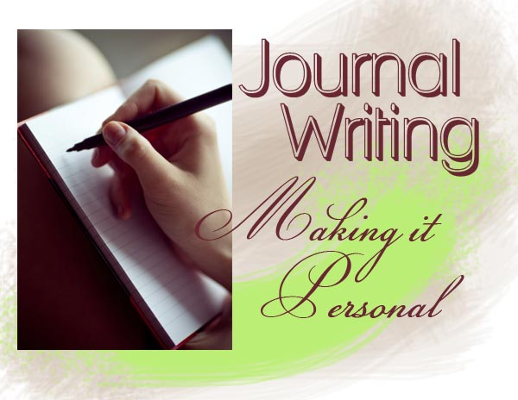
Journal Writing 1

Slide 7
After reading Pink and Say by Patricia Polacco use discussion questions and explanations for your journal entry.
What does “Not bad if it don’t go green.” mean?
Why did Pinkus help Shelton?
Who are the Marauders?
Why do Pinkus and Sheldon need to leave as soon as possible?
What is Moe Moe Bay like?
What do you learn about slave life from this story?
What do you learn about slaves in the army?
What do you learn about teens in the army?
How does the author foreshadow that something bad might happen to Pinkus?
Why is it unusual that Pinkus can read?
How does Moe Moe Bay comfort Say?
What happened to Moe Moe Bay?
What happened to Pinkus at Andersonville Prison?
What happened to Sheldon Russell Curtis?

Slide 8
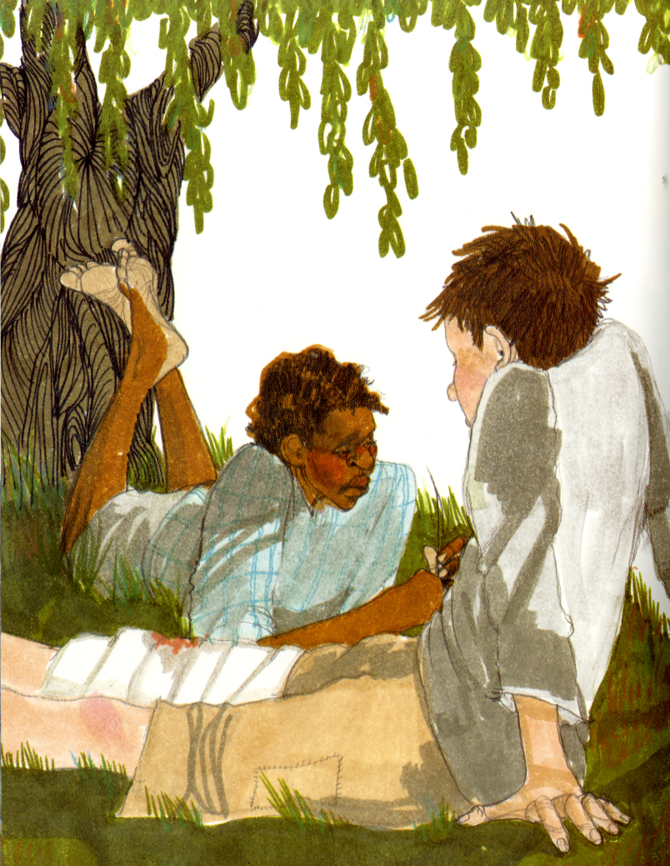
What is the relationship between history and memory?

Slide 9
How does perspective affect your memory?
How does memory affect the way you tell a story?

Slide 10
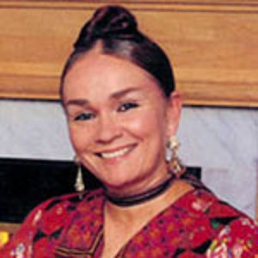
Why did Ms. Polacco write this story?

Slide 11
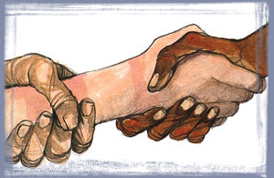
This story is written as a true account of Patricia Polacco’s great-great-grandfather.
Is this story true?

Slide 12
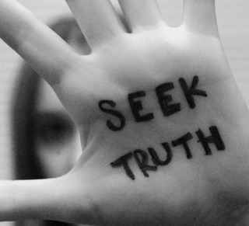
Could this story be proven?
How could this story be proven?

Slide 13
What is the relationship between history and memory?
How does perspective affect memory?
How does memory affect the way a story is told?
Why did Ms. Polacco write this story?
Is this story true?
How could you prove this story is true?
Journal Writing 2

Slide 14
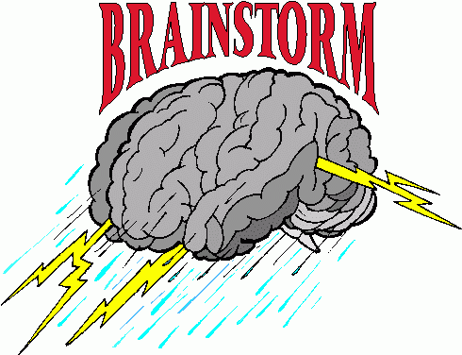
What types of sources could you use to check the information?

Slide 15
What types of sources are the most reliable to verify information?

Slide 16
Primary
Documents
Wikipedia
vs.
Which source is more reliable?

Slide 17
Just GOOGLE?
Is “GOOGLE-it” always the best answer?

Slide 18
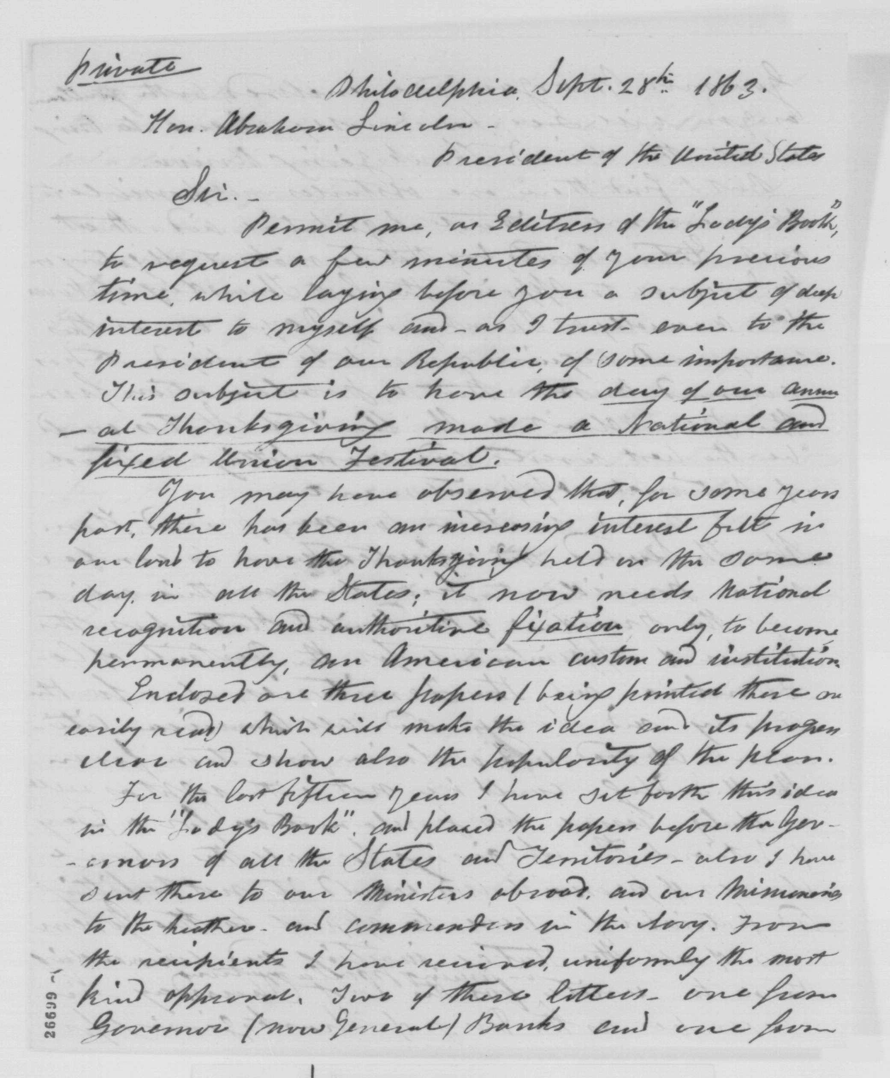
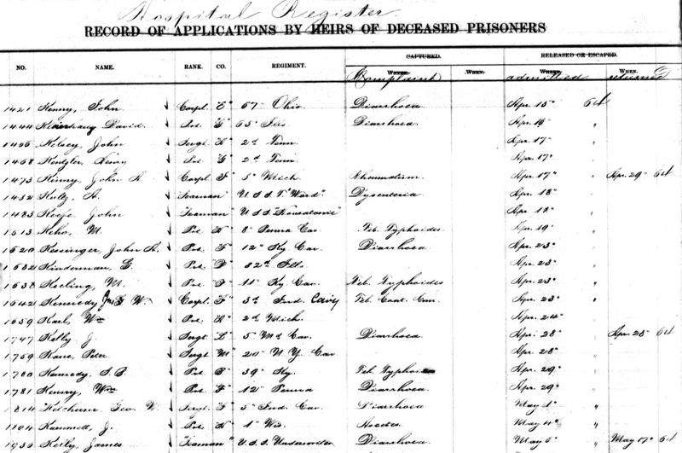
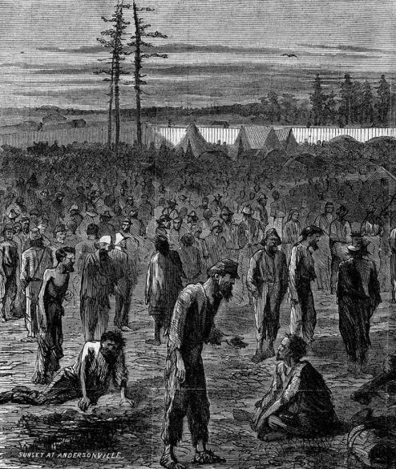
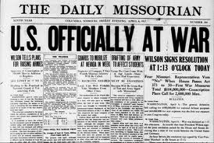
What primary sources might be available to verify Ms. Polacco’s story?

Slide 19
Letters and Diaries
Archived Newspapers
Civil War Records
Pictures and Period Sketches

Slide 20
Investigate
Was gangrene a problem during the Civil War?
Were marauders a problem in the Civil War?
Did slaves join the Union army?
Was there a Pinkus Aylee in the Union forty-eighth slave unit?
Were slaves in the army sometimes not allowed to carry guns?
Did fifteen-year-old boys carry the staff?
Did boys sometimes have to carry a gun?
Was there a Sheldon Russell Curtis in the Ohio twenty-fourth?
Was this an accurate portrayal of slave life?
Was this a realistic portrayal of life at Andersonville Prison?
Journal
Writing 3

Slide 21
Before we go to part II, let’s do a self check.
As we go through each skill, share proof with your partner that you understand the skill:
Reading comprehension
Questioning strategies
Connections with characters
Inference skills
Predictions
Drawing Conclusions
Author’s Point of View
Determining the difference between memory and history
Researching primary sources
Determining if an author’s story is based on memory or history

Slide 22
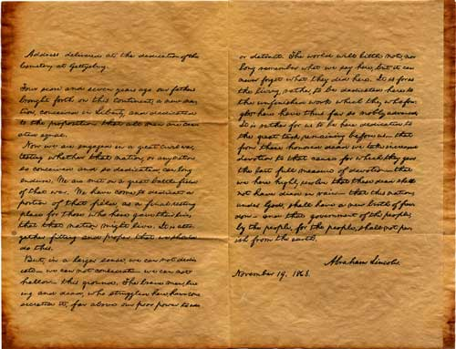
Part II
The Gettysburg Address

Slide 23
Where are we going?
Through Part II of this lesson the goal will be to improve skills in:
Reading comprehension
Setting
Context
Writing
Background information
Audience
Word choice
Mood and tone
Voice
Word choice
Writer’s craft
Word choice
Revising

Slide 24
Background

Slide 25
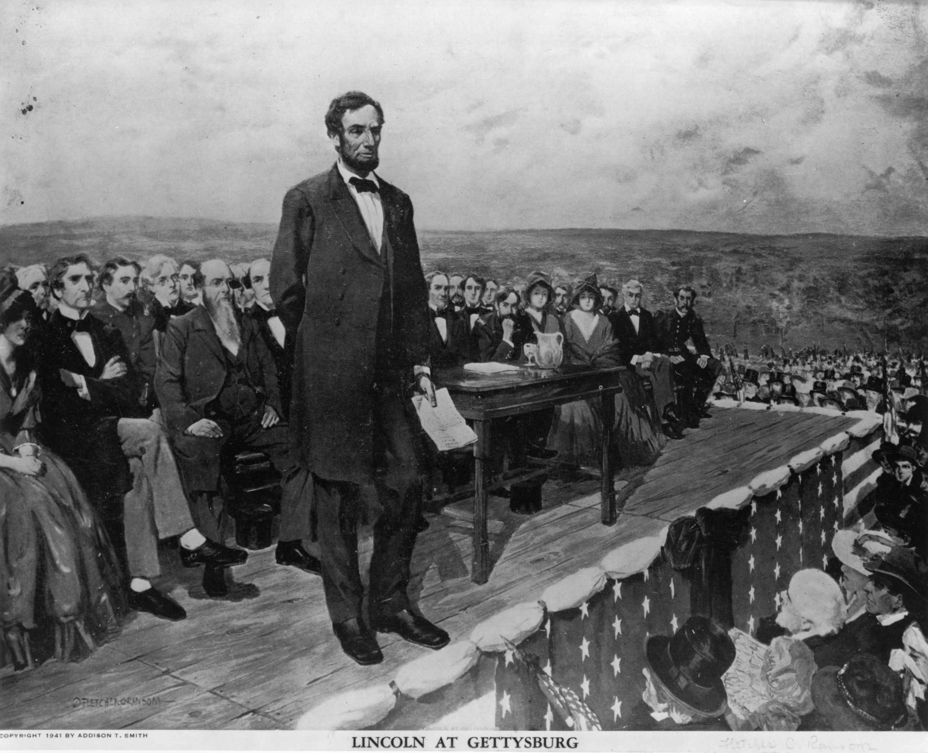
2 ½ minutes
272 Words
“A few appropriate remarks”
Never to be Forgotten
Notes:
27

Slide 26
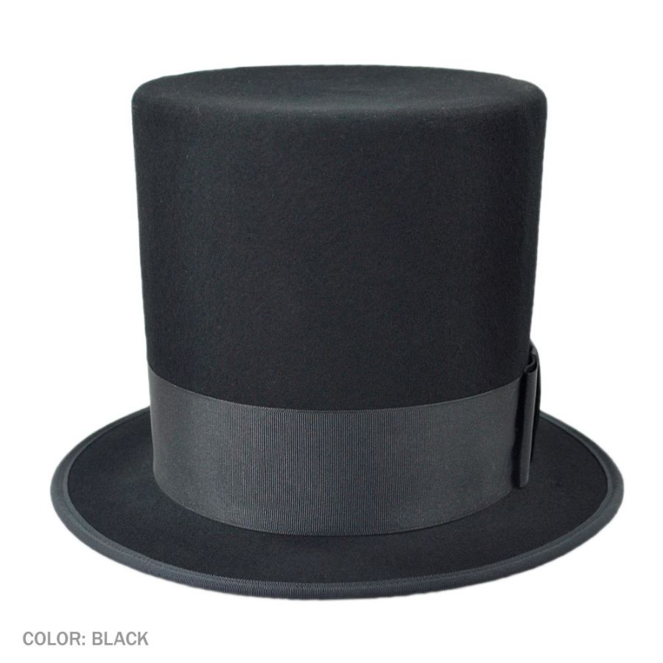
There is much to be learned about the Civil War: its battles, its people, its causes.

Slide 27
But the purpose of this lesson is to examine the famous speech called “The Gettysburg Address” that Abraham Lincoln delivered November 19, 1863.

Slide 28
What made these 272 words great?
How did he say everything that needed to be said in less than three minutes?
Why are we still talking about it today?

Slide 29
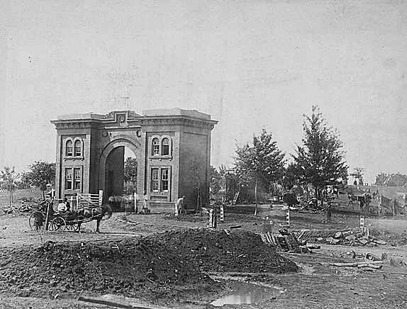
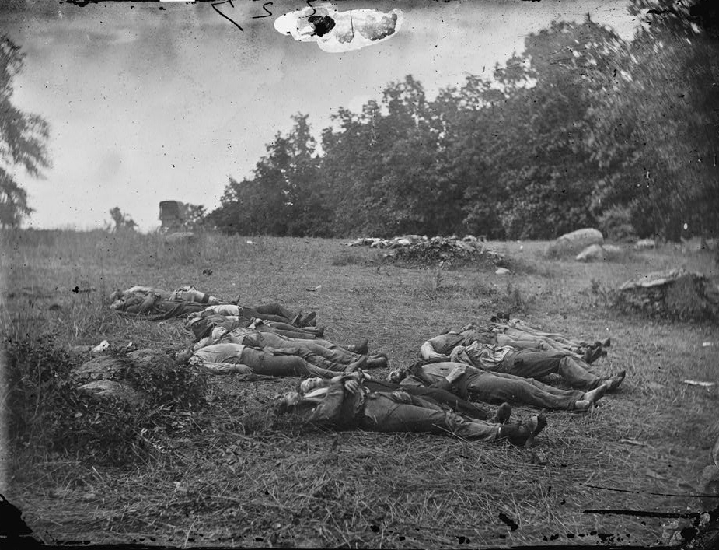
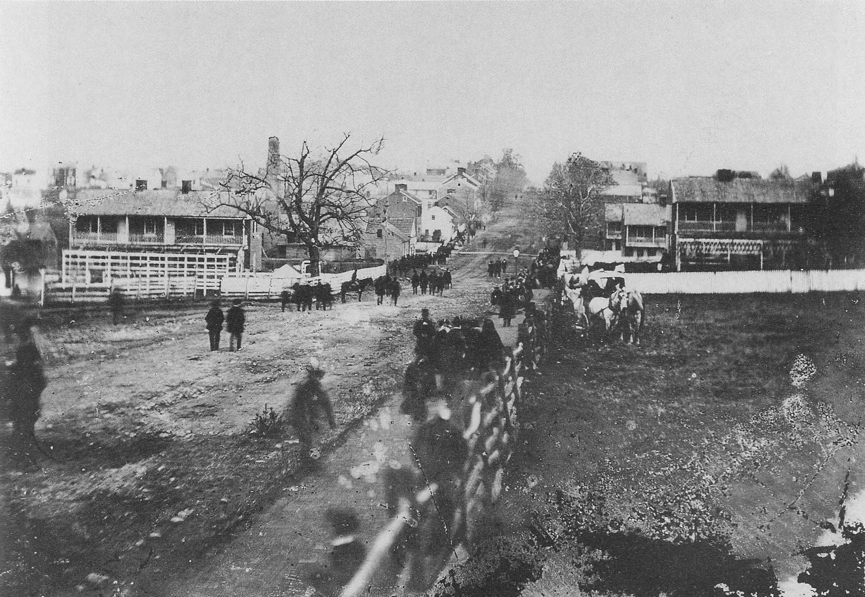
What was the setting?

Slide 30
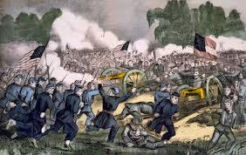
Gettysburg July 1863!

Slide 31
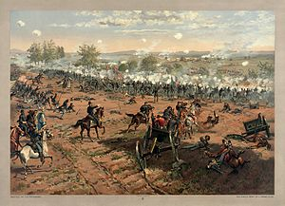
On July 1, 2, and 3, 1863, some of the greatest, deadliest series of battles of the Civil War were fought in Gettysburg, Pennsylvania.

Slide 32
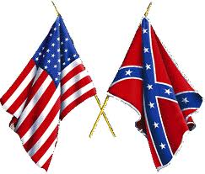
Union Casualties:
3,155 killed, 14,531 wounded, 5,369 captured or missing
Confederate Casualties:
4,708 killed, 12,693 wounded, 5,830 captured or missing
All Americans

Slide 33
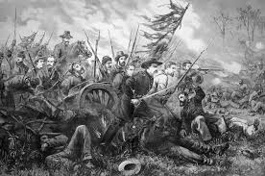
November 19, 1863, five months after the battles, the National Cemetery at Gettysburg was being dedicated, so President Abraham Lincoln was invited to speak.
"It is the desire that, after the Oration, you, as Chief Executive of the nation, formally set apart these grounds to their sacred use by a few appropriate remarks.”

Slide 34
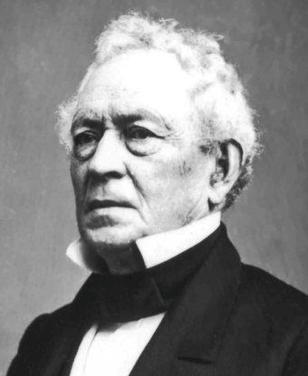
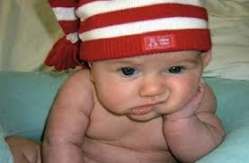
The main speaker was Edward Everett who spoke for over two hours, using over 13,000 words.

Slide 35
Finally it was time for
“a few appropriate remarks” from
President Abraham Lincoln.

Slide 36
https://www.youtube.com/watch?v=FsrDeGJUZdQ

Slide 37
Journal Writing 4

Slide 38
Group journal assignment:
What does the Gettysburg Address mean?
In four groups you will use dictionaries and computer sources to interpret the textual meaning of the Address.
You will collaborate with the people in your group and produce a PowerPoint presentation or a physical representation of your findings.
This is due _______________
Objective: Write informative/explanatory texts to examine a topic and convey ideas, concepts, and information through the selection, organization, and analysis of relevant content. (W6.1)

Slide 39
Section One: Four score and seven years ago our fathers brought forth on this continent a new nation, conceived in liberty, and dedicated to the proposition that all men are created equal.
Journal Questions:
What happened four score and seven years ago?
Is there a reference to slavery here? Explain.
Where does the quote “all men are created equal” come from?
Why did Lincoln use this quote?

Slide 40
Section 2: Now we are engaged in a great civil war, testing whether that nation, or any nation so conceived and so dedicated, can long endure. We are met on a great battlefield of that war. We have come to dedicate a portion of that field, as a final resting place for those who here gave their lives that that nation might live. It is altogether fitting and proper that we should do this.
Journal Questions:
5. How did Lincoln present the present problem?
6. What was the test?
7. What is the occasion?
8. What was the mood?
9. What was Lincoln’s purpose in this speech?

Slide 41
Section 3: But, in a larger sense, we cannot dedicate, we cannot consecrate, we cannot hallow this ground. The brave men, living and dead, who struggled here, have consecrated it, far above our poor power to add or detract. The world will little note, nor long remember what we say here, but it can never forget what they did here.
Journal Questions:
10. How did Lincoln honor the dead?
11. How does he express humility?
12. Was Lincoln’s prediction in the bolded sentence come true? Explain.

Slide 42
Section 4: It is for us the living, rather, to be dedicated here to the unfinished work which they who fought here have thus far so nobly advanced. It is rather for us to be here dedicated to the great task remaining before us—that from these honored dead we take increased devotion to that cause for which they gave the last full measure of devotion—that we here highly resolve that these dead shall not have died in vain—that this nation, under God, shall have a new birth of freedom—and that government of the people, by the people, for the people, shall not perish from the earth.
Journal Questions:
13. How does Lincoln challenge his audience?
14. What is the quote in this section? Where does it come from?
15. Why did Lincoln include this quote?

Slide 43
Now that we have a pretty good idea from your presentations about the meaning of the Gettysburg Address, let’s go deeper into the writing of this epic speech.
At the conclusion of our study you are going to be writing a similar speech.
So as we take a few days to study Lincoln’s work, be thinking of a topic you are seriously passionate about.

Slide 44
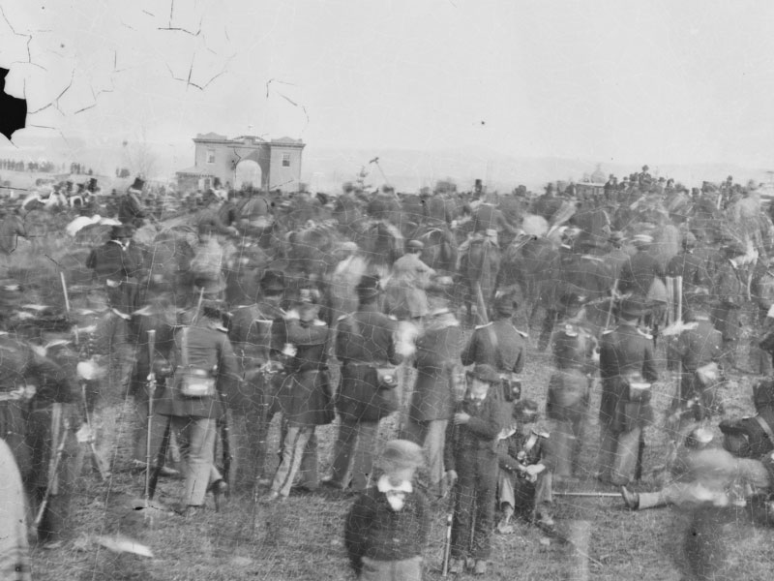
Who were the audience?

Slide 45
Soldiers
Army widows and orphans
Congressmen, governors, and other important statesmen
Townspeople
College students
Reporters
Others

Slide 46
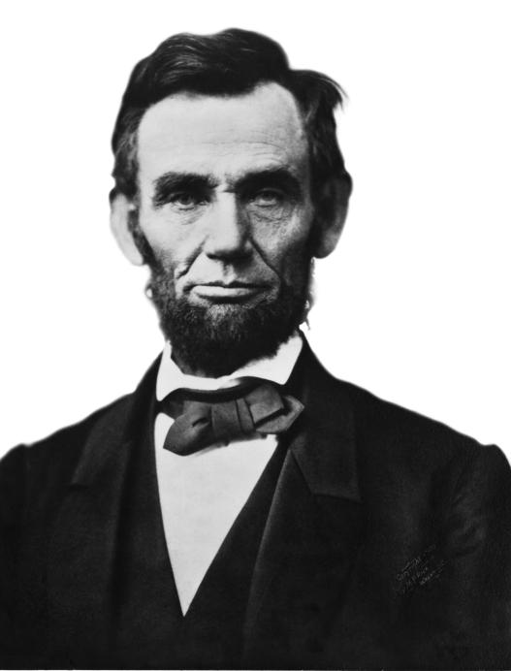
Lincoln’s language had to sound intelligent for the dignitaries, yet it had to appeal to the vernacular* of the common people, the ones who had sacrificed so much.
Word choice
*common or colloquial language

Slide 47
Lincoln chose powerful words not “fancy” words. The entire speech is only 272 words. 190 of them are single-syllables, only four are four-syllables.

Slide 48
Lincoln’s tone had to reflect the correct mood. His feelings and passion needed to be impressed on his audience. He needed to express sympathy and respect, but most of all his audience needed hope.
Tone and Mood

Slide 49
Let’s stop for a moment and review our knowledge of tone and mood.

Slide 50
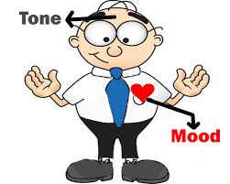
What is the mood of the circumstance?
What is the tone of the speech?
Does Lincoln’s tone reflect the mood?

Slide 51
Lincoln established the appropriate mood through his tone, not just through the words he chose, but also with the passion of his presentation.
Mood and Tone

Slide 52
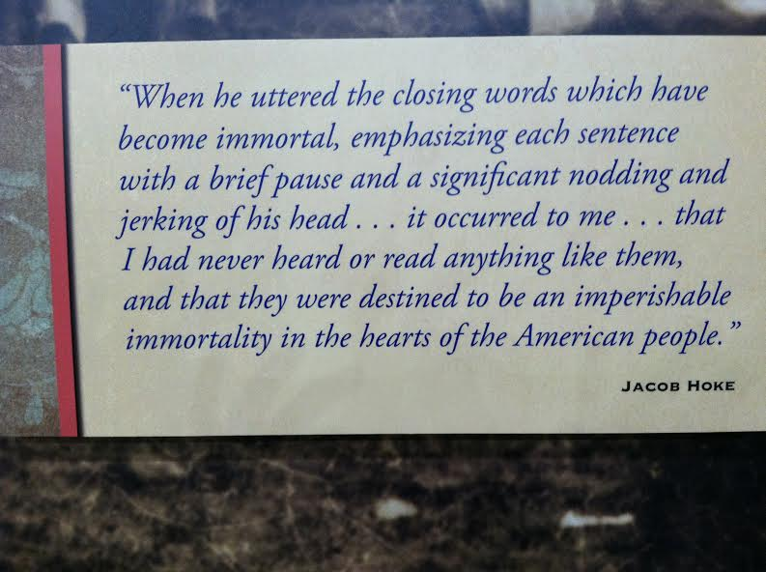
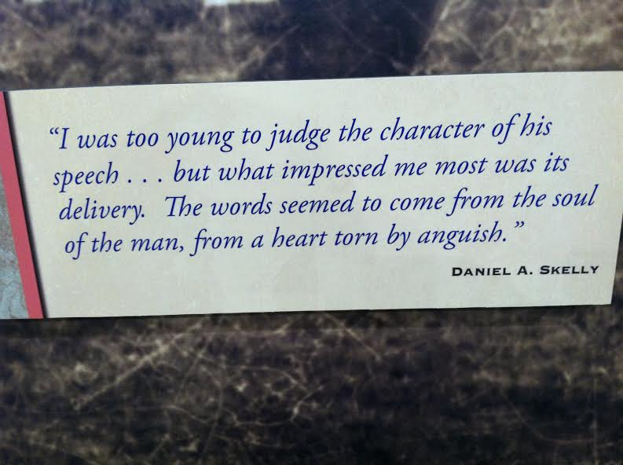
It’s not just what you say,
It’s how you say it!

Slide 53
Voice
Voice is how you make it your own.
You’ve considered the audience, you’ve considered the mood, now you must consider:
How do I feel?
What is my passion?
How do I express what needs to be said in a way that is uniquely mine?

Slide 54
Lincoln was intelligent and educated, but he never forgot his humble beginnings. His VOICE demonstrated his brilliance but showed his humility.
* Resonate - to have an effect or impact beyond that which is immediately seen

Slide 55
Journal Writing 5
Define voice, mood, and tone.
Explain how Lincoln used these three factors in the Gettysburg Address.

Slide 56
Writer’s Craft

Slide 57
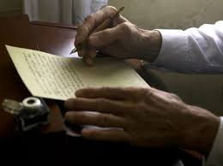
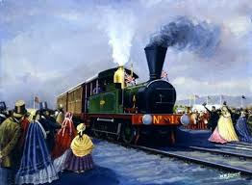
Contrary to a popular myth, Lincoln did not compose the Gettysburg Address on the back of an envelope during the train ride to Gettysburg.

Slide 58
Abraham Lincoln began formulating his thoughts as early as July 7, 1863. In that speech he stated:
“…Eighty odd years since, upon the Fourth day of July, for the first time in the world, a union body of representatives was assembled to declare as a self-evident truth that all men were created equal…”

Slide 59
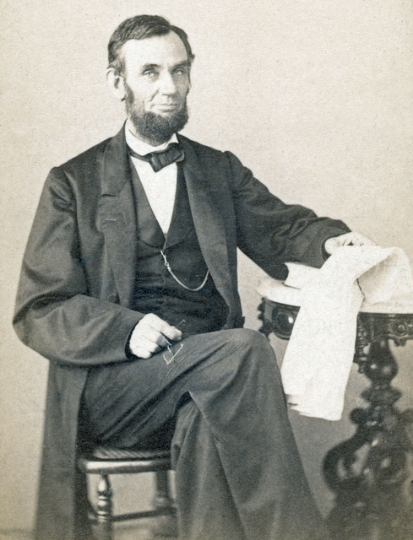
He knew what he wanted to say; the craft was figuring out how to say it best.

Slide 60
Lincoln divided the speech into three parts:
Paragraph one – past history
Paragraph two – present situation
Paragraph three – future action
(Organization)

Slide 61
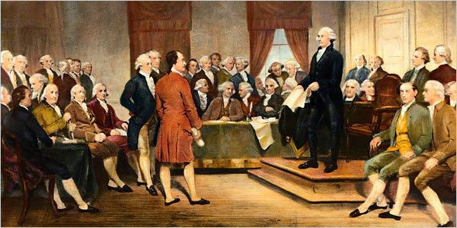
Past:
Four score and seven years ago our fathers brought forth on this continent a new nation, conceived in liberty, and dedicated to the proposition that all men are created equal.

Slide 62
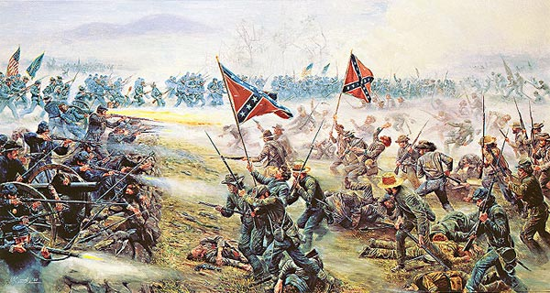
Present:
Now we are engaged in a great civil war, testing whether that nation, or any nation so conceived and so dedicated, can long endure. We are met on a great battlefield of that war. We have come to dedicate a portion of that field, as a final resting place for those who here gave their lives that that nation might live. It is altogether fitting and proper that we should do this.

Slide 63
Future action:
But, in a larger sense, we cannot dedicate, we cannot consecrate, we cannot hallow this ground. The brave men, living and dead, who struggled here, have consecrated it, far above our poor power to add or detract. The world will little note, nor long remember what we say here, but it can never forget what they did here. It is for us the living, rather, to be dedicated here to the unfinished work which they who fought here have thus far so nobly advanced.

Slide 64
Future action:
It is rather for us to be here dedicated to the great task remaining before us—that from these honored dead we take increased devotion to that cause for which they gave the last full measure of devotion—that we here highly resolve that these dead shall not have died in vain—that this nation, under God, shall have a new birth of freedom—and that government of the people, by the people, for the people, shall not perish from the earth.

Slide 65
Connecting with quotes.
We have learned in reading class that connection improves comprehension. A good speaker references familiar quotes or familiar language to connect with the audience.
Abraham Lincoln chose two sources with which people of that day would have been very familiar, and he chose two sources that would resound with positive connection.

Slide 66
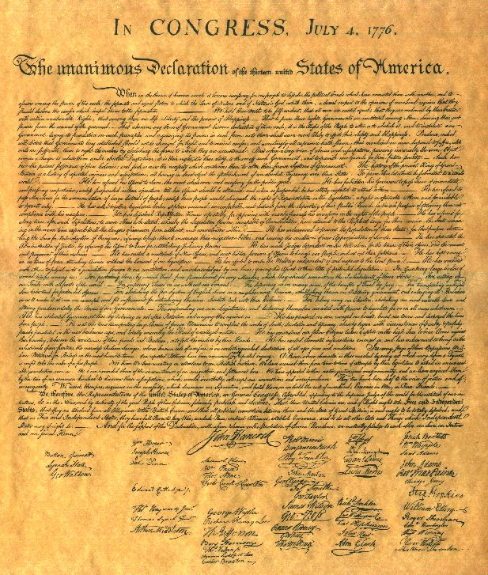
“We hold these truths to be self-evident, that all men are created equal...”

Slide 67
Lincoln chose to quote from
the Declaration of Independence.
These words were:
Well know
Patriotic
Inclusive of the entire audience
Appropriate to the slave issue
Emotional

Slide 68
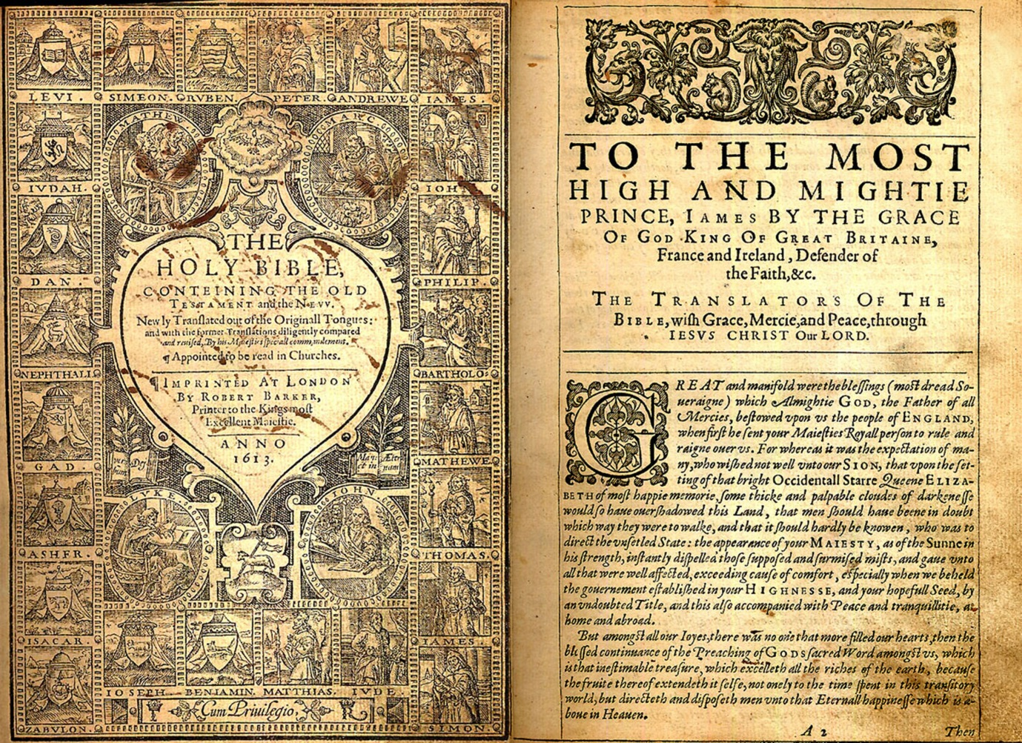
In addition, many people of that day went to church and were familiar with the authorized version of the Bible referred to as the King James Version.
So Lincoln chose words from familiar phrases in the Bible. Was this a coincidence, or did Lincoln know that these words would connect the audience to perceived truth whether consciously or subconsciously?

Slide 69
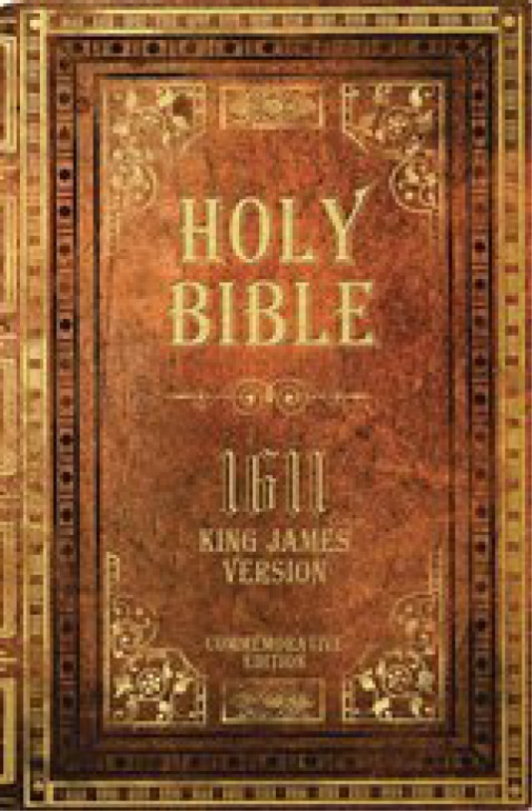
Luke 2:7 And she brought forth her firstborn son…
Psalm 90:10 The days of our years are threescore years and ten…
Matthew 6:9 Our Father which art in heaven, Hallowed be thy name…
John 3:16 . . . that whosoever believeth in him should not perish, but have everlasting life.

Slide 70
Lincoln used revision.

Slide 71
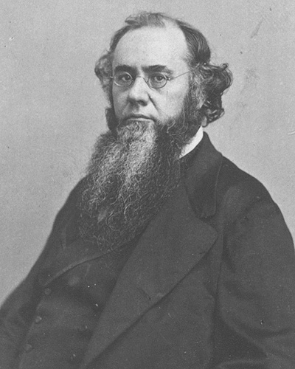
Even though Lincoln did not write the Gettysburg Address on the back of an envelope on the train to Gettysburg, he actually did revise his speech the night before he delivered it. The speech had been written out in Washington D. C., in Lincoln’s handwriting on White House stationery, but after he arrived in Gettysburg, he decided he did not like the last part of the speech. The speech was folded in half, so he cut the speech on the fold and proceeded to rewrite the last half on a tablet using a pencil.
About 9:00 that evening, Lincoln asked to meet with his friend Edwin Stanton, the Secretary of War, and they were together for about an hour.
Lincoln continued to work in his room till after midnight that night.
Did Lincoln and Stanton discuss the speech? Did Lincoln ask Stanton for advice on word choice?
Well, one clue might be that Stanton used the word perish in many
of his speeches, but this is the only time Lincoln used the word
perish in a speech.
How can collaboration with peers help in
word choice and revising in your writing?
What about perish, Abe?

Slide 72
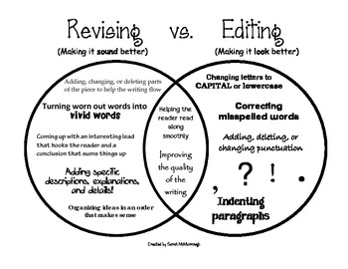

Slide 73
Revising
Revising is not the same as editing. Editing is checking for grammatical errors: spelling, capitalization, punctuation, subject verb agreement, etc.
Revising has to do with saying what you want to say in the best possible way using:
The most powerful, commanding words to make strong points, emotional words for effect, and phrases that connect your audience with your cause.
The dramatic use of contrast “The world will little note, nor long remember what we say here, but it can never forget what they did here.”
The flow of sentences that emphasizes the meaning.

Slide 74
Describe the difference between revising and editing.
Explain why each is important to the final publication.
Journal Writing 6

Slide 75
THE ASSIGNMENT
Choose a topic you feel passionately about. It must have:
A history
A present problem
A viable solution
Research your topic for background information.
Write a speech that is exactly 272 words long and takes approximately 2 ½ minutes to present.
Consider
Your audience
Word choice
Mood
Tone
Voice
Word choice
Evaluating your writer’s craft
Use appropriate quotes
Revise with a responsible peer. Document this.
Edit and proofread
Practice reading with the voice that expresses your VOICE.
Memorize it, or learn it well enough that you are not bound to your reading.

Slide 76
Rubric for Speech
 | 4 | 3 | 2 | 1
Content | Obvious passion for subject, extensive research, past, present, future well –presented. | Passion for subject, obvious research, past, present, future adequately presented. | Clear subject, some research, past, present, future presented. | Clear subject, little research, past, present, future undefined.
Consideration of audience, mood, tone, and voice. | Excellent job demonstrating all four qualities in writing and speech. | Demonstrates all four qualities in writing or speech. | Demonstrates three of the qualities in writing or speech. | Demonstrates two of the qualities in writing or speech.
Word choice | Many examples of excellent word choices. | Several examples of excellent word choices. | Some examples of excellent word choices. | A few examples of excellent word choices.
Use of Quotes | Several quotes placed appropriately to connect with the audience or to emphasize a point. | Some quotes placed appropriately to connect with the audience or to emphasize a point. | One or two quotes used to connect with the . audience or to emphasize a point. | One quote that needs work to connect or to emphasize.
Revision | Presents documentation of revision, superior, thoughtful content that is persuasive, and flows well throughout the speech. | Presents documentation of revision, thoughtful content that flows well throughout the speech. | Some evidence of revision, most content is orderly throughout the speech. | Little evidence of revision, sentence are choppy or run-on. Lacks order.
Clarity of Speech | Speaker has clear intonation and is completely audible; uses volume, word speed control, and pauses to express VOICE; does not ‘read’ the speech. | Speaker has mostly clear intonation and is mostly audible; mostly uses volume, word speed control, and pauses to express VOICE. Student mostly looks up. | Speaker attempts clear intonation and proper volume, attempts to express VOICE. Student reads speech with confidence and few mistakes. | Speaker has much unclear intonation and volume, some attempt to express VOICE. Student reads speech with several mistakes.
Editing/Proofreading Spelling Capitalization Punctuation Grammar Complete sentences | 4 or less mistakes | Between 5-8 mistakes | Between 9 and 12 mistakes | 13 or more mistakes

