Slide 1
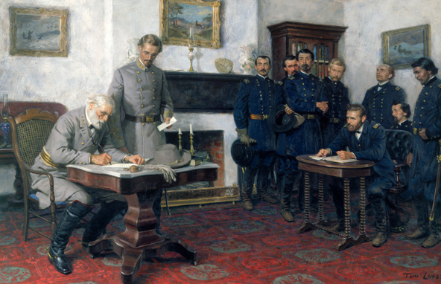
After the Civil War

Slide 2
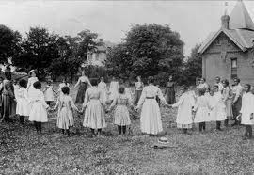
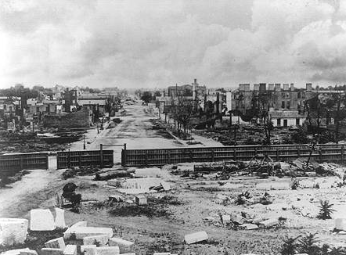
Slaves Freed
The South must be reconstructed.

Slide 3
The end of the Civil War did not bring immediate peace. Animosity existed on both sides, and the South had been physically destroyed.

Slide 4
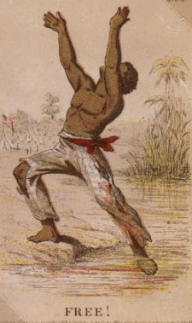
The Slaves were free!

Slide 5
However Emancipation did not mean
Equality

Slide 6
Laws were passed and the Constitution was amended, but two-hundred years of slavery and prejudice were not easily ended.

Slide 7
Timeline of the History of Slavery in the United States

Slide 10
The first step toward the emancipation of slaves was the Emancipation Proclamation, but it only freed slaves in the “rebellious states.”

Slide 11
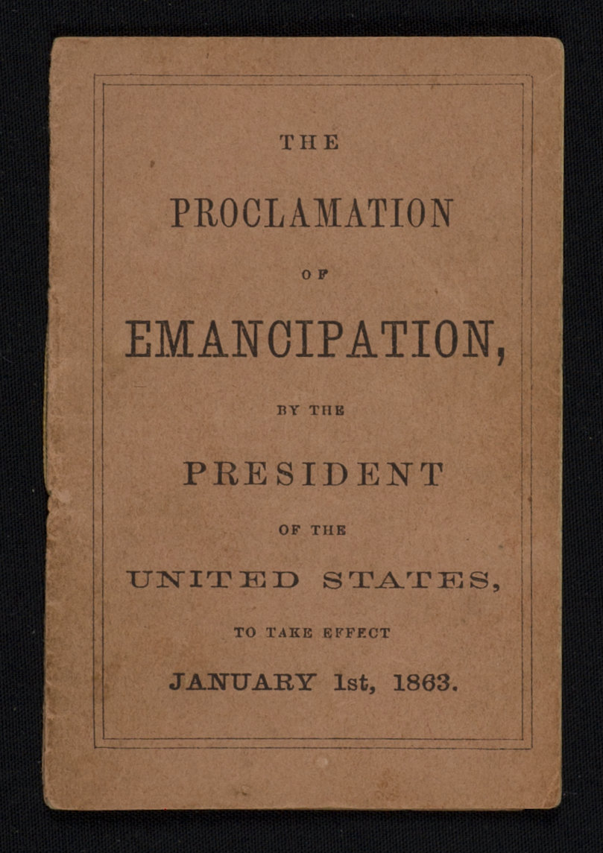
The proclamation declared "that all persons held as slaves" within the rebellious states "are, and henceforward shall be free."

Slide 12
After the Civil War, the Thirteenth Amendment freed the slaves, but equality took more than a century.

Slide 13
AMENDMENT XIII
Section 1. Neither slavery nor involuntary servitude, except as a punishment for crime whereof the party shall have been duly convicted, shall exist within the United States, or any place subject to their jurisdiction.
Section 2. Congress shall have power to enforce this article by appropriate legislation.

Slide 14
Because the Thirteenth Amendment was not providing the freed slaves appropriate freedom, the Fourteenth Amendment was passed in 1868.

Slide 15
Equal Protection
The Fourteenth Amendment
All persons born or naturalized in the United States and subject to the jurisdiction thereof, are citizens of the United States and of the State wherein they reside. No State shall make or enforce any law which shall abridge the privileges or immunities of citizens of the United States; nor shall any State deprive any person of life, liberty, or property, without due process of law; nor deny to any person within its jurisdiction the equal protection of the laws.

Slide 16
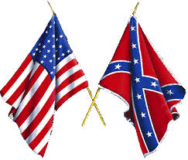
But prejudice and discrimination continued in the South and the North into the 20th Century.

Slide 17
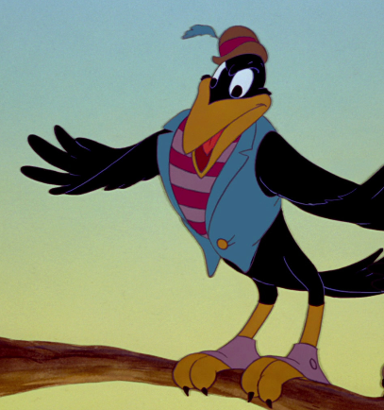
Jim Crow
Laws
https://www.youtube.com/watch?v=ij6DWZ-W-KA

Slide 18
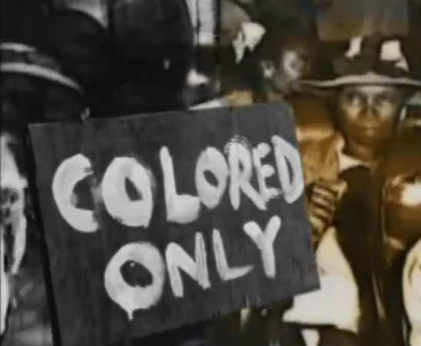
https://www.youtube.com/watch?v=ChWXyeUTKg8

Slide 19
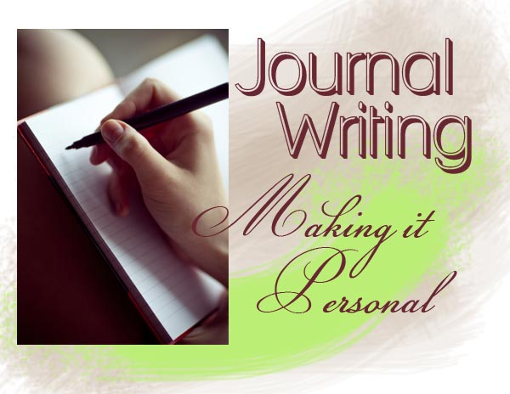
Describe a day in the life of an African American during the days of Jim Crow.
Make a list of your feelings about Jim Crow laws. Use descriptive words. Use a thesaurus if you need.
Journal Writing 1

Slide 21
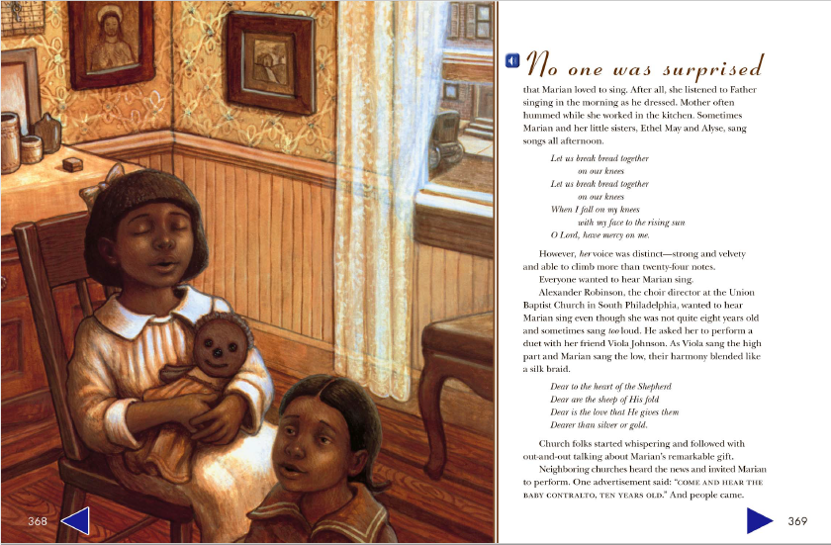

Slide 22
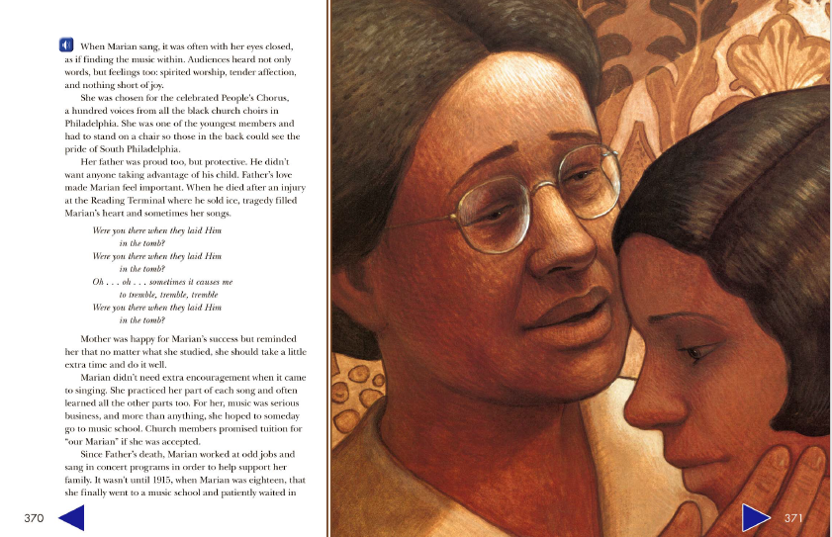

Slide 23
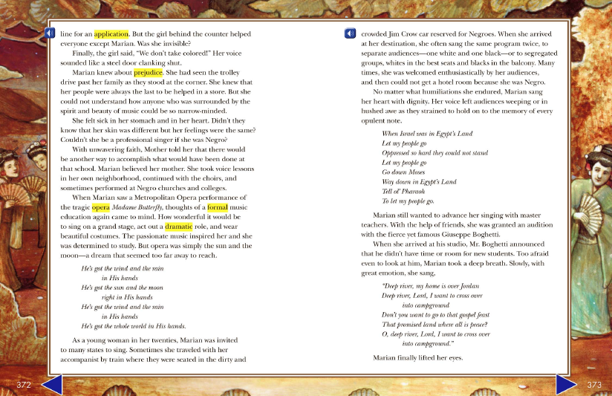

Slide 24
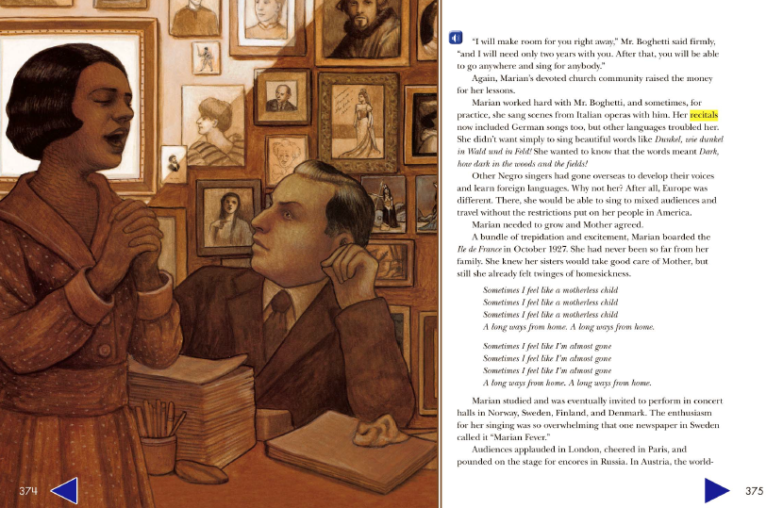

Slide 25
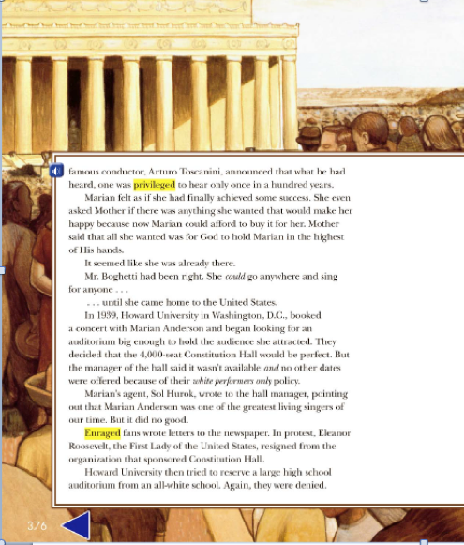

Slide 26
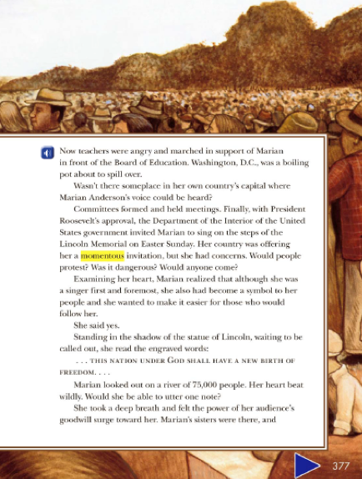

Slide 27
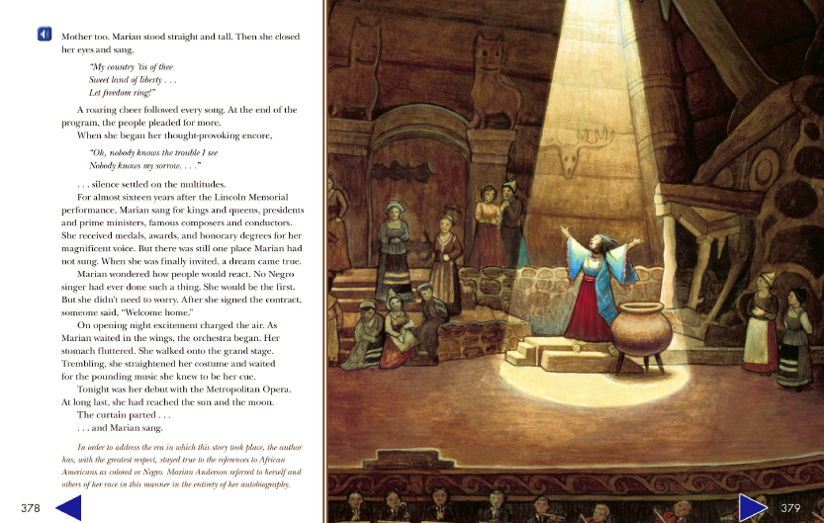

Slide 28
What were two examples of Jim Crow laws that Marian Anderson faced?
Why do you think so many people showed up to see Marian Anderson's concert at the Lincoln Memorial?
If you could ask Marian Anderson one question about her life and experiences, what would your question be?
Journal Writing 2

Slide 29
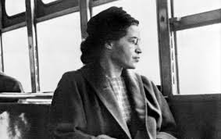
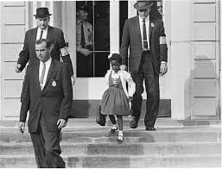
The Civil Rights Movement

Slide 30
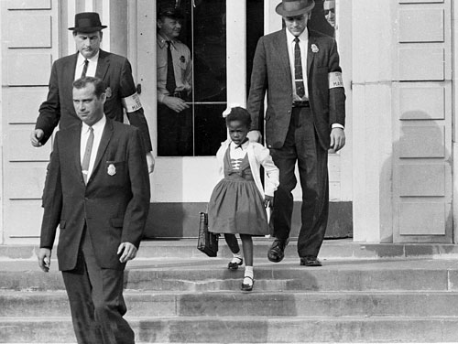
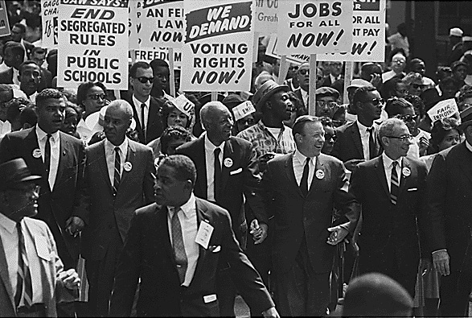
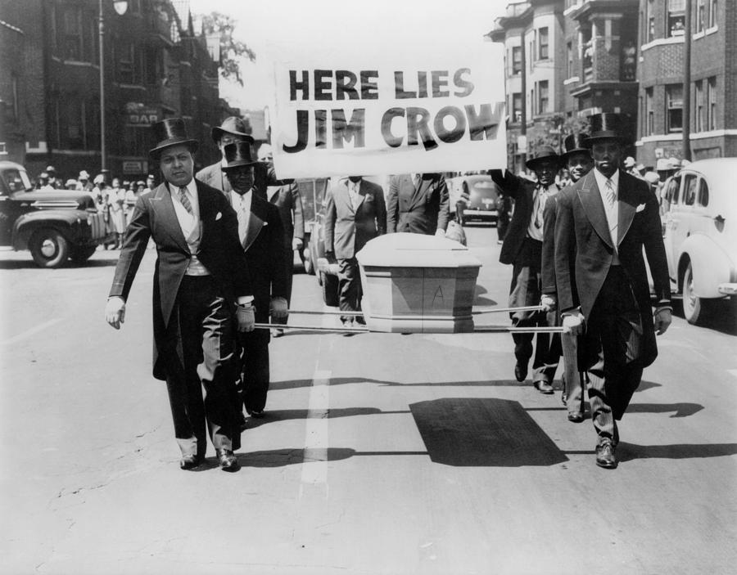
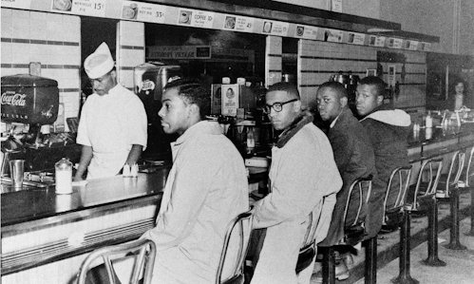

Slide 31
Rosa Parks

Slide 32
On December 1, 1955, Rosa Parks, a 42-year-old African American woman who worked as a seamstress, boarded this Montgomery City bus to go home from work. On this bus on that day, Rosa Parks initiated a new era in the American quest for freedom and equality.
She sat near the middle of the bus, just behind the 10 seats reserved for whites. Soon all of the seats in the bus were filled. When a white man entered the bus, the driver (following the standard practice of segregation) insisted that all four blacks sitting just behind the white section give up their seats so that the man could sit there. Mrs. Parks, who was an active member of the local NAACP, quietly refused to give up her seat.
Her action was spontaneous and not pre-meditated, although her previous civil rights involvement and strong sense of justice were obvious influences. "When I made that decision," she said later, “I knew that I had the strength of my ancestors with me.”

Slide 33
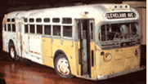
She was arrested and convicted of violating the laws of segregation, known as “Jim Crow laws.”
At the same time, local civil rights activists initiated a boycott of the Montgomery bus system.. Since African Americans made up about 75 percent of the riders in Montgomery, the boycott posed a serious economic threat to the company and a social threat to white rule in the city.
A group named the Montgomery Improvement Association organized the boycott. As their leader, they chose a young Baptist minister who was new to Montgomery: Martin Luther King, Jr. Sparked by Mrs. Parks’ action, the boycott lasted 381 days. In December 1956 the U.S. Supreme Court ruled that the segregation law was unconstitutional and the Montgomery buses were integrated. The Montgomery Bus Boycott was the beginning of a revolutionary era of non-violent mass protests in support of civil rights in the United States.

Slide 34
Make a list of words that would describe Rosa Parks.
Why did she do what she did?
Did Rosa Parks do the right thing? Explain your answer.
Journal Writing 3

Slide 35
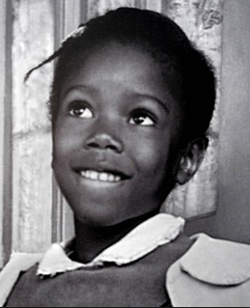
Ruby Bridges

Slide 36
I was born in Mississippi in 1954, the oldest child of Abon and Lucille Bridges. That year the United States handed down its landmark decision ordering the integration of public schools. Not that I knew anything about school at the time. What I knew and loved was growing up on the farm my paternal grandparents sharecropped.
It was a very hard life, though. My parents heard there were better opportunities in the city. We moved to New Orleans, where my father found work as a service station attendant, and my mother took night jobs to help support our growing family.
As I got a bit older, my job was to keep an eye on my younger brothers and sister, which wasn't too difficult. Except for church and the long walk to the all-black school where I went to kindergarten, our world didn't extend beyond our block. But that was all about to change.

Slide 37
Under federal court order, New Orleans public schools were finally forced to desegregate. In the spring of 1960 I took a test, along with other black kindergarteners in the city, to see who would go to an integrated school come September. That summer my parents learned I'd passed the test and had been selected to start first grade at William Frantz Public School. My mother was all for it. My father wasn't. "We're just asking for trouble," he said. He thought things weren't going to change, and blacks and whites would never be treated as equals. Mama thought I would have an opportunity to get a better education if I went to the new school - and a chance for a good job later in life. My parents argued about it and prayed about it. Eventually my mother convinced my father that despite the risks, they had to take this step forward, not just for their own children, but for all black children.
A federal judge decreed that Monday, November 14, 1960 would be the day black children in New Orleans would go to school with white children. There were six of us chosen to integrate the city's public school system. Two decided to stay in their old schools. The other three were assigned to McDonough. I would be going to William Frantz alone.

Slide 38
The morning of November 14 federal marshals drove my mother and me the five blocks to William Frantz. In the car one of the men explained that when we arrived at the school two marshals would walk in front of us and two behind, so we'd be protected on both sides.
That reminded me of what Mama had taught us about God, that he is always there to protect us. "Ruby Nell," she said as we pulled up to my new school, "don't be afraid. There might be some people upset outside, but I'll be with you."

Slide 39
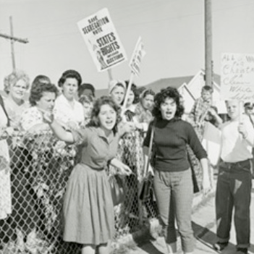
Sure enough, people shouted and shook their fist when we got out of the car, but to me it wasn't any noisier than Mardi Gras, I held my mother's hand and followed the marshals through the crowd, up the steps into the school.
We spent that whole day sitting in the principal's office. Through the window, I saw white parents pointing at us and yelling, then rushing their children out of the school. In the uproar I never got to my classroom.
The marshals drove my mother and me to school again the next day. I tried not to pay attention to the mob. Someone had a black doll in a coffin, and that scared me more than the nasty things people screamed at us.

Slide 40
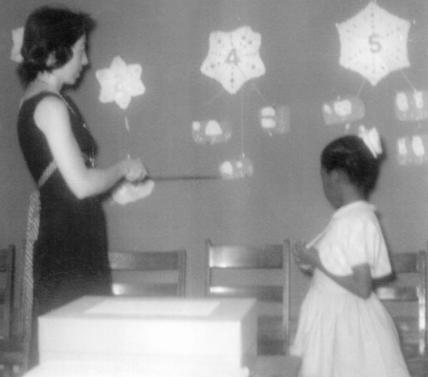
A young white woman met us inside the building. She smiled at me. "Good morning, Ruby Nell," she said, just like Mama except with what I later learned was a Boston accent. "Welcome, I'm your new teacher, Mrs. Henry." She seemed nice, but I wasn't sure how to feel about her. I'd never been taught by a white teacher before.
Mrs. Henry took my mother and me to her second-floor classroom. All the desks were empty and she asked me to choose a seat. I picked one up front, and Mrs. Henry started teaching me the letters of the alphabet.

Slide 41
The next morning my mother told me she couldn't go to school with me. She had to work and look after my brothers and sister. "The marshals will take good car of you, Ruby Nell," Mama assured me. "Remember, if you get afraid, say your prayers. You can pray to God anytime, anywhere. He will always hear you."
That was how I started praying on the way to school. The things people yelled at me didn't seem to touch me. Prayer was my protection. After walking up the steps past the angry crowd, though, I was glad to see Mrs. Henry. She gave me a hug, and she sat right by my side instead of at the big teacher's desk in the front of the room. Day after day, it was just Mrs. Henry and I, working on my lessons.

Slide 42
At the same time, there were a few white families who braved the protests and kept their children in school. But they weren't in my class, so I didn't see them. People from around the country who'd heard about me on the news sent letters and donations. A neighbor gave my dad a job painting houses. Other folks baby-sat for us, watched our house to keep away troublemakers, even walked behind the marshal's car on my way to school. My family couldn't have made it without our friends' and neighbors' help.
And me, I couldn't have gotten through that year without Mrs. Henry. Sitting next to her in our classroom, just the two of us, I was able to forget the world outside. She made school fun. We did everything together. I couldn't go out in the schoolyard for recess, so right in that room we played games and for exercise we did jumping jacks to music.

Slide 43
I remember her explaining integration to me and why some people were against it. "It's not easy for people to change once they have gotten used to living a certain way," Mrs. Henry said. "Some of them don't know any better and they're afraid. But not everyone is like that."
Even though I was only six, I knew what she meant. The people I passed every morning as I walked up the schools steps were full of hate. They were white, but so was my teacher, who couldn't have been more different from them. She was one of the most loving people I had ever known. The greatest lesson I learned that year in Mrs. Henry's class was the lesson Dr. Martin Luther King Jr., tried to teach us all. Never judge people by the color of their skin. God makes each of us unique in ways that go much deeper. From her window, Mrs. Henry always watched me walk into school. One morning when I got to our classroom, she said she'd been surprised to see me talk to the mob. "I saw your lips moving," she said, "but I couldn't make out what you were saying to those people."

Slide 44
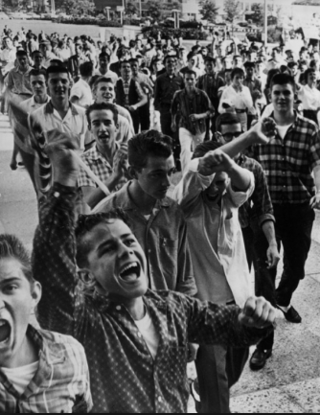
Militant segregationists, as the news called them, took to the streets in protest, and riots erupted all over the city. My parents shielded me as best they could, but I knew problems had come to our family because I was going to the white school. My father was fired from his job. The white owners of a grocery store told us not to shop there anymore. Even my grandparents in Mississippi suffered. The owner of the land they'd sharecropped for 25 years said everyone knew it was their granddaughter causing trouble in New Orleans, and asked them to move.

Slide 45
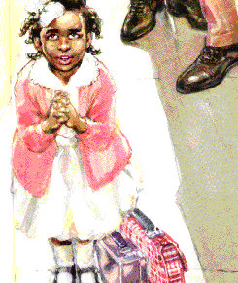
I wasn't talking to them," I told her. "I was praying for them." Usually I prayed in the car on the way to school, but that day I'd forgotten until I was in the crowd. Please be with me, I'd asked God, and be with those people too. Forgive them because they don't know what they're doing.
"Ruby Nell, you are truly someone special," Mrs. Henry whispered, giving me an even bigger hug than usual. She had this look on her face like my mother would get when I'd done something to make her proud.
Another person who helped me was Dr. Robert Coles, a child psychiatrist who happened to see me being escorted through the crowd outside my school. Dr. Coles volunteered to work with me through this ordeal. Soon he was coming to our house every week to talk with me about how I was doing in school.

Slide 46
Really, I was doing fine. I was always with people who wanted the best for me: my family, friends, and in school, my teacher. The more time I spent with Mrs. Henry, the more I grew to love her. I wanted to be like her. Soon, without realizing it, I had picked up her Boston accent.
Neither of us missed a single day of school that year. The crowd outside dwindled to just a few protestors, and before I knew it, it was June. For me, first grade ended much more quietly than it began. I said good-bye to Mrs. Henry, fully expecting her to be my teacher again in the fall. But when I went back to school in September, everything was different. There were no marshals, no protestors. There were other kids - even some other black students - in my second-grade class. And Mrs. Henry was gone. I was devastated. Years later I found out she hadn't been invited to return to William Frantz, and she and her husband had moved back to Boston. It was almost as if that first year of school integration had never happened. No one talked about it. Everyone seemed to have put that difficult time behind them.

Slide 47
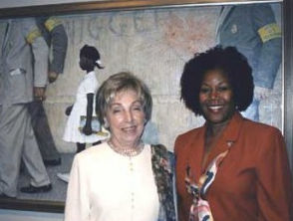
One of the best parts of the story is that I was finally reunited with my favorite teacher, Barbara Henry. She reached me through the publisher of Dr. Coles’ book, and in 1995 we saw each other in person for the first time in more than three decades. The second she laid eyes on me, she cried, "Ruby Nell!" No one had called me that since I was a little girl. Then we were hugging each other, just like we used to every morning in first grade.

Slide 48
What was it like for Ruby Bridges?
Describe her courage.
Journal Writing 4

Slide 49
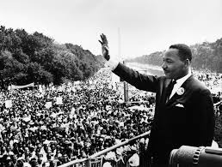
The most influential leader of the Civil Rights Movement was Martin Luther King, Jr.

Slide 50
On August 23, 1963, he delivered the “I Have a Dream” speech on the steps of the Lincoln Memorial.
https://www.youtube.com/watch?v=smEqnnklfYs#t=
25

Slide 51
15 Little Known Facts about Martin Luther King, Jr.’s “I Have a Dream” Speech

Slide 52
King had previously used his "dream" rhetoric before —as he acknowledged — in lesser-known speeches.
2. King may have taken the "dream" language from then 22-year old Prathia Hall, who used it during a speech at the burnt remains of the Mount Olive Baptist Church in 1962.
3. The night before the speech, King's adviser Wyatt Walker suggested he not use any of that "dream" stuff during the March on Washington speech, calling it “trite and “cliché.”

Slide 53
4. King didn't write the speech entirely by himself. The first draft was written by his advisers Stanley Levison and Clarence Jones, and the final speech included input from many others.
5. The day before, King and his advisers met to discuss the speech in the lobby of the Willard Hotel because it would be harder to wiretap than a suite.
6. King was up until 4 a.m. the night before working on the speech.

Slide 54
7. The original draft was entitled "Normalcy - Never Again" and didn't contain any references to King's dreams.
8. Before the speech, King told an aide that he wanted to deliver, “a sort of a Gettysburg Address." (Nailed it.)
9. King was the final speaker of the day, and some attendees — hot, tired, and anticipating a long trip home — had already left before he took the podium. (Sound familiar?)

Slide 55
10. King put aside his prepared remarks and went right to the "dream" section of the speech after his friend Mahalia Jackson, a gospel singer, shouted out to him: "Tell 'em about the dream, Martin.”
11. King borrowed a long passage about freedom ringing from various mountains across the country from a 1952 speech by Rev. Archibald
12. Watching the speech from the White House, President Kennedy remarked, “That guy is really good."

Slide 56
13. The head of the FBI's domestic intelligence division, William Sullivan, was not as happy. Two days later, he wrote a memo that the speech solidified King "as the most dangerous Negro of the future in this Nation from the standpoint of communism, the Negro and national security.”
14. Many of the next day's newspaper reporters overlooked not only the "dream" section of the speech, but even the speeches in general, focusing instead “on the extraordinary spectacle of the march itself. "
15. Though celebrated now, the speech had “nearly vanished from public view" by the time of King's death in 1968.

Slide 57
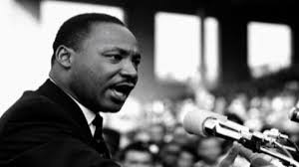
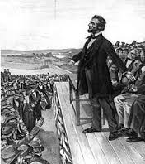
How is the “I Have a Dream” Speech like the Gettysburg Address?
http://abcnews.go.com/US/things-make-dream-famous-speeches-history/story?id=20068795

Slide 58
Make a Venn Diagram to compare and contrast the content of the “I Have a Dream” speech to the Gettysburg Address.
Journal Writing 5

Slide 59
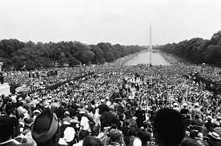
Who were the audience?

Slide 60
King’s language had to sound intelligent for the dignitaries, yet it had to relate to the vernacular* of the ‘colored’ people, the majority of the crowd.
Word Choice

Slide 61
King chose words powerful words. He used words such as “five score years” to relate to the Gettysburg address. As Lincoln did, King referred to the Bible and the Constitution.
Word Choice

Slide 62
King’s tone had to reflect the correct mood of the day. His feelings and passion needed to be impressed on his audience so that they would realize that they had the right to be respected as equals.
Tone and Mood

Slide 63
King established the appropriate mood through his tone, not just through the words he chose, but also with the passion of his presentation.
Tone and Mood

Slide 64
Like Lincoln, King divided the speech into three parts:
Part One: past history
Part two: the present situation
Part three: future action
Organization

Slide 65
The Past
I am happy to join with you today in what will go down in history as the greatest demonstration for freedom in the history of our nation.
Five score years ago, a great American, in whose symbolic shadow we stand today, signed the Emancipation Proclamation. This momentous decree came as a great beacon light of hope to millions of Negro slaves who had been seared in the flames of withering injustice. It came as a joyous daybreak to end the long night of their captivity.

Slide 66
The Present
But one hundred years later, the Negro still is not free. One hundred years later, the life of the Negro is still sadly crippled by the manacles of segregation and the chains of discrimination. One hundred years later, the Negro lives on a lonely island of poverty in the midst of a vast ocean of material prosperity. One hundred years later, the Negro is still languished in the corners of American society and finds himself an exile in his own land. And so we've come here today to dramatize a shameful condition.

Slide 67
The Present
In a sense we've come to our nation's capital to cash a check. When the architects of our republic wrote the magnificent words of the Constitution and the Declaration of Independence, they were signing a promissory note to which every American was to fall heir. This note was a promise that all men, yes, black men as well as white men, would be guaranteed the "unalienable Rights" of "Life, Liberty and the pursuit of Happiness." It is obvious today that America has defaulted on this promissory note, insofar as her citizens of color are concerned. Instead of honoring this sacred obligation, America has given the Negro people a bad check, a check which has come back marked "insufficient funds."

Slide 68
The Present
But we refuse to believe that the bank of justice is bankrupt. We refuse to believe that there are insufficient funds in the great vaults of opportunity of this nation. And so, we've come to cash this check, a check that will give us upon demand the riches of freedom and the security of justice.
We have also come to this hallowed spot to remind America of the fierce urgency of Now. This is no time to engage in the luxury of cooling off or to take the tranquilizing drug of gradualism. Now is the time to make real the promises of democracy. Now is the time to rise from the dark and desolate valley of segregation to the sunlit path of racial justice. Now is the time to lift our nation from the quicksands of racial injustice to the solid rock of brotherhood. Now is the time to make justice a reality for all of God's children.

Slide 69
Future Action
But there is something that I must say to my people, who stand on the warm threshold which leads into the palace of justice: In the process of gaining our rightful place, we must not be guilty of wrongful deeds. Let us not seek to satisfy our thirst for freedom by drinking from the cup of bitterness and hatred. We must forever conduct our struggle on the high plane of dignity and discipline. We must not allow our creative protest to degenerate into physical violence. Again and again, we must rise to the majestic heights of meeting physical force with soul force.

Slide 70
Future Action
The marvelous new militancy which has engulfed the Negro community must not lead us to a distrust of all white people, for many of our white brothers, as evidenced by their presence here today, have come to realize that their destiny is tied up with our destiny. And they have come to realize that their freedom is inextricably bound to our freedom.

Slide 71
Future Action
We cannot walk alone.
And as we walk, we must make the pledge that we shall always march ahead.
We cannot turn back.

Slide 72
Future Action
There are those who are asking the devotees of civil rights, "When will you be satisfied?" We can never be satisfied as long as the Negro is the victim of the unspeakable horrors of police brutality. We can never be satisfied as long as our bodies, heavy with the fatigue of travel, cannot gain lodging in the motels of the highways and the hotels of the cities. We cannot be satisfied as long as the negro's basic mobility is from a smaller ghetto to a larger one. We can never be satisfied as long as our children are stripped of their self-hood and robbed of their dignity by signs stating: "For Whites Only." We cannot be satisfied as long as a Negro in Mississippi cannot vote and a Negro in New York believes he has nothing for which to vote. No, no, we are not satisfied, and we will not be satisfied until "justice rolls down like waters, and righteousness like a mighty stream."

Slide 73
Future Action
I am not unmindful that some of you have come here out of great trials and tribulations. Some of you have come fresh from narrow jail cells. And some of you have come from areas where your quest -- quest for freedom left you battered by the storms of persecution and staggered by the winds of police brutality. You have been the veterans of creative suffering. Continue to work with the faith that unearned suffering is redemptive. Go back to Mississippi, go back to Alabama, go back to South Carolina, go back to Georgia, go back to Louisiana, go back to the slums and ghettos of our northern cities, knowing that somehow this situation can and will be changed.

Slide 74
Future Action
Let us not wallow in the valley of despair, I say to you today, my friends.
And so even though we face the difficulties of today and tomorrow, I still have a dream. It is a dream deeply rooted in the American dream.
I have a dream that one day this nation will rise up and live out the true meaning of its creed: "We hold these truths to be self-evident, that all men are created equal."

Slide 75
Future Action
I have a dream that one day on the red hills of Georgia, the sons of former slaves and the sons of former slave owners will be able to sit down together at the table of brotherhood.
I have a dream that one day even the state of Mississippi, a state sweltering with the heat of injustice, sweltering with the heat of oppression, will be transformed into an oasis of freedom and justice.
I have a dream that my four little children will one day live in a nation where they will not be judged by the color of their skin but by the content of their character.

Slide 76
Future Action
I have a dream today!
I have a dream that one day, down in Alabama, with its vicious racists, with its governor having his lips dripping with the words of "interposition" and "nullification" -- one day right there in Alabama little black boys and black girls will be able to join hands with little white boys and white girls as sisters and brothers.
I have a dream today!
I have a dream that one day every valley shall be exalted, and every hill and mountain shall be made low, the rough places will be made plain, and the crooked places will be made straight; "and the glory of the Lord shall be revealed and all flesh shall see it together."

Slide 77
Future Action
This is our hope, and this is the faith that I go back to the South with.
With this faith, we will be able to hew out of the mountain of despair a stone of hope. With this faith, we will be able to transform the jangling discords of our nation into a beautiful symphony of brotherhood. With this faith, we will be able to work together, to pray together, to struggle together, to go to jail together, to stand up for freedom together, knowing that we will be free one day.

Slide 78
Future Action
And this will be the day -- this will be the day when all of God's children will be able to sing with new meaning:
My country 'tis of thee, sweet land of liberty, of thee I sing.
Land where my fathers died, land of the Pilgrim's pride,
From every mountainside, let freedom ring!
And if America is to be a great nation, this must become true.
And so let freedom ring from the prodigious hilltops of New Hampshire.
Let freedom ring from the mighty mountains of New York.

Slide 79
Future Action
Let freedom ring from the heightening Alleghenies of Pennsylvania.
Let freedom ring from the snow-capped Rockies of Colorado.
Let freedom ring from the curvaceous slopes of California.
But not only that:
Let freedom ring from Stone Mountain of Georgia.
Let freedom ring from Lookout Mountain of Tennessee.
Let freedom ring from every hill and molehill of Mississippi.
From every mountainside, let freedom ring.
s

Slide 80
Future Action
And when this happens, and when we allow freedom ring, when we let it ring from every village and every hamlet, from every state and every city, we will be able to speed up that day when all of God's children, black men and white men, Jews and Gentiles, Protestants and Catholics, will be able to join hands and sing in the words of the old Negro spiritual:
Free at last! Free at last!
Thank God Almighty, we are free at last!

Slide 81
Look back through this information and find evidence that King relied on collaboration.

Slide 82
Use a graphic organizer to demonstrate the similarities between the tone, mood, voice and organization between the “I Have a Dream” speech and the Gettysburg Address.
Include evidence of collaboration.
Journal Writing 6

Slide 83
THE ASSIGNMENT
Choose a topic you feel passionately about. It must have:
A history
A present problem
A viable solution
Research your topic for background information.
Write a speech that is exactly 272 words long and takes approximately 2 ½ minutes to present.
Consider
Your audience
Word choice
Mood
Tone
Voice
Word choice
Evaluating your writer’s craft
Use appropriate quotes
Revise with a responsible peer. Document this.
Edit and proofread
Practice reading with the voice that expresses your VOICE.
Memorize it, or learn it well enough that you are not bound to your reading.

Slide 84
Rubric for Speech
 | 4 | 3 | 2 | 1
Content | Obvious passion for subject, extensive research, past, present, future well –presented. | Passion for subject, obvious research, past, present, future adequately presented. | Clear subject, some research, past, present, future presented. | Clear subject, little research, past, present, future undefined.
Consideration of audience, mood, tone, and voice. | Excellent job demonstrating all four qualities in writing and speech. | Demonstrates all four qualities in writing or speech. | Demonstrates three of the qualities in writing or speech. | Demonstrates two of the qualities in writing or speech.
Word choice | Many examples of excellent word choices. | Several examples of excellent word choices. | Some examples of excellent word choices. | A few examples of excellent word choices.
Use of Quotes | Several quotes placed appropriately to connect with the audience or to emphasize a point. | Some quotes placed appropriately to connect with the audience or to emphasize a point. | One or two quotes used to connect with the . audience or to emphasize a point. | One quote that needs work to connect or to emphasize.
Revision | Presents documentation of revision, superior, thoughtful content that is persuasive, and flows well throughout the speech. | Presents documentation of revision, thoughtful content that flows well throughout the speech. | Some evidence of revision, most content is orderly throughout the speech. | Little evidence of revision, sentence are choppy or run-on. Lacks order.
Clarity of Speech | Speaker has clear intonation and is completely audible; uses volume, word speed control, and pauses to express VOICE; does not ‘read’ the speech. | Speaker has mostly clear intonation and is mostly audible; mostly uses volume, word speed control, and pauses to express VOICE. Student mostly looks up. | Speaker attempts clear intonation and proper volume, attempts to express VOICE. Student reads speech with confidence and few mistakes. | Speaker has much unclear intonation and volume, some attempt to express VOICE. Student reads speech with several mistakes.
Editing/Proofreading Spelling Capitalization Punctuation Grammar Complete sentences | 4 or less mistakes | Between 5-8 mistakes | Between 9 and 12 mistakes | 13 or more mistakes

