Slide 1
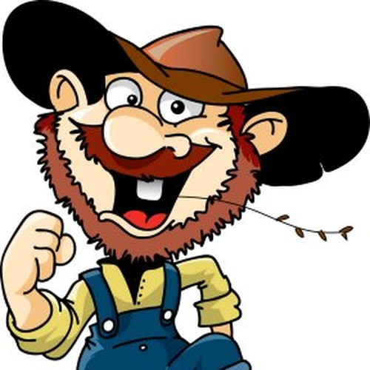
Is correct speech
important?
Lesson #1 Using the proper verb tense.

Slide 2
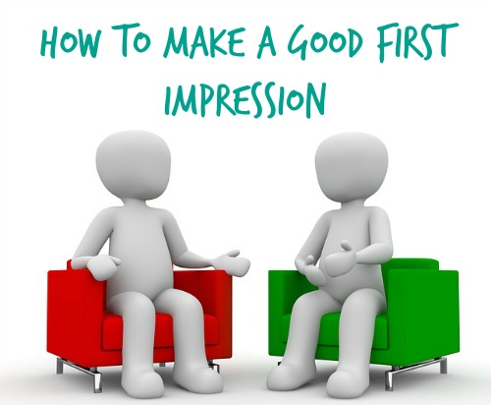

Slide 3
How you speak is the first thing people notice about you.
(Other than how you look, so put on a clean shirt and brush your hair.)

Slide 4
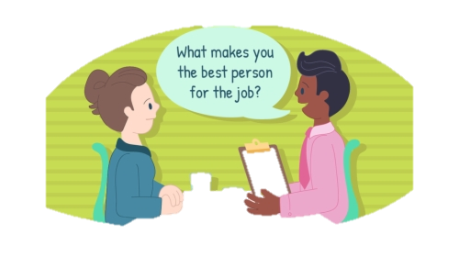
Say you are going for a job interview; how do you want to be perceived or identified?

Slide 5
Will the interviewer think,
“ Is this person only able to do low-level jobs, or does this person have manager potential?”

Slide 6
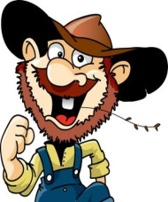
Do you realize how you speak could influence a job interview, and even if you get the job, you might have to work twice as hard to convince the boss that you are intelligent.

Slide 7
You see, it might not be fair, but many times how intelligent you are is judged by how you speak and your use of language.

Slide 8
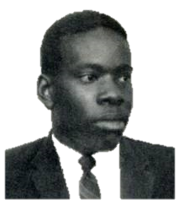
Clarence Thomas
Clarence Thomas was born in Pin Point, Georgia, a community settled by former slaves on the coast of Georgia. The language of this community was Gullah, a combination of English and West African language.
When Clarence was two, Clarence’s father left the family, and his mother was not able to provide for her family, so at the age of seven Clarence and his brother moved to Savannah to live with grandparents.
Thomas’ grandfather taught Thomas to work hard, but he also provided him with a good education.

Slide 9
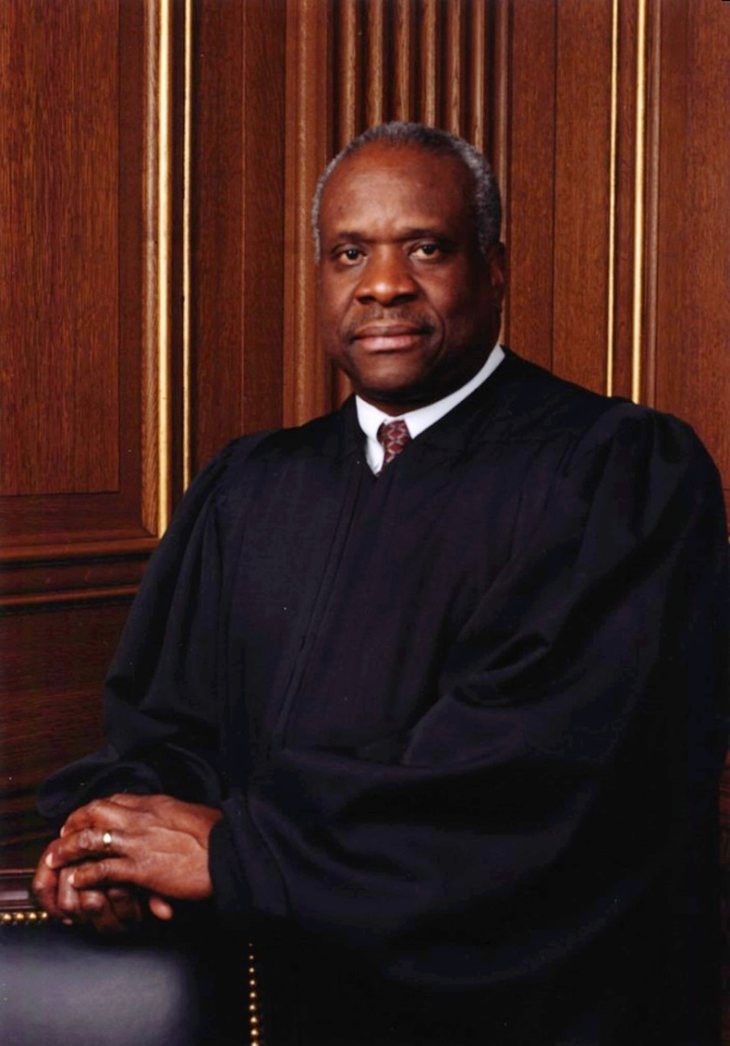
Justice Clarence Thomas
When Thomas was in seminary, a religious college, his teacher suggested he take speech lessons to improve his language skills and make him sound more intelligent. He took these lessons and learned to speak as he speaks today. These language skills have helped lead him to a very successful career.
He graduated from Yale Law School, and he has been an assistant attorney general, a federal judge, and presently he is a Justice on the Supreme Court of the United States.

Slide 10
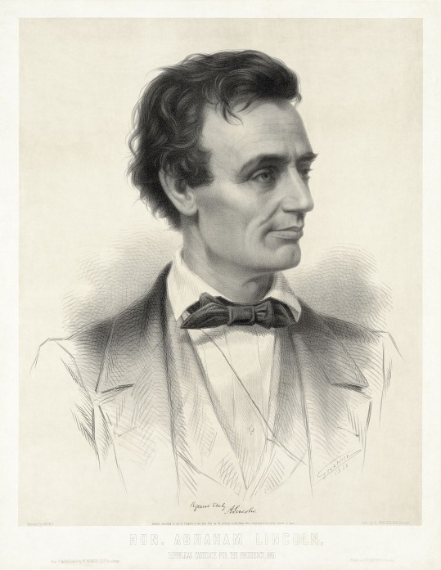
Abraham Lincoln
Born in a log cabin in the backwoods of Kentucky, Abraham Lincoln had very little schooling. Mostly self-educated, he had to study to learn how to speak correctly.
He was proud of his hardworking, country heritage, but when he needed to speak as a lawyer or as a statesman, he needed to speak correctly and intelligently.
Sorry, this is the best I could do.
His mom didn’t have Facebook.

Slide 11
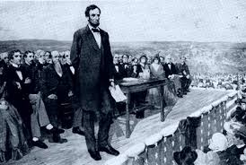
Gettysburg, November 1863
Four score and seven years ago our fathers brought forth on this continent, a new nation, conceived in Liberty, and dedicated to the proposition that all men are created equal.
Could have been …
Y’all be remembering back yonder when our fathers brung forth this here nation. They has went and seen to it that it was ran on liberty and made sure that all them there men wuz done created equal.
yikes

Slide 12
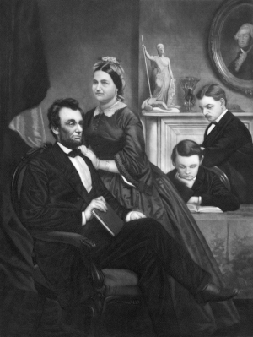
Of course there is a time to speak formally and a time to loosen up.
I don’t think Lincoln asked his boys if they finished their homework four score and seven hours ago.

Slide 13
Nor did he ask his wife to bring forth his dinner conceived in gravy and dedicated to heartburn.
But he knew how to use English properly, and he knew when to speak formally.

Slide 14
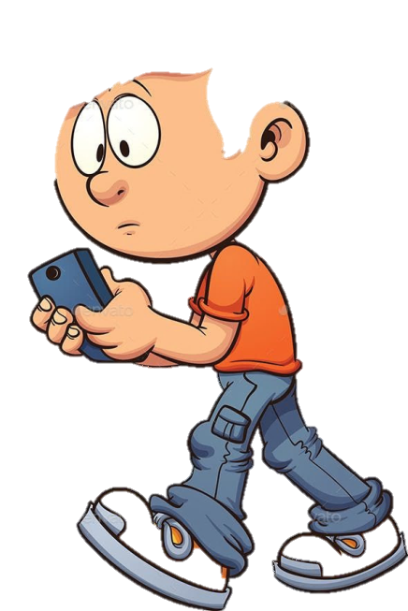
In the same way, you might use slang, emoji’s, jk, or lol when texting or speaking with your friends,

Slide 15
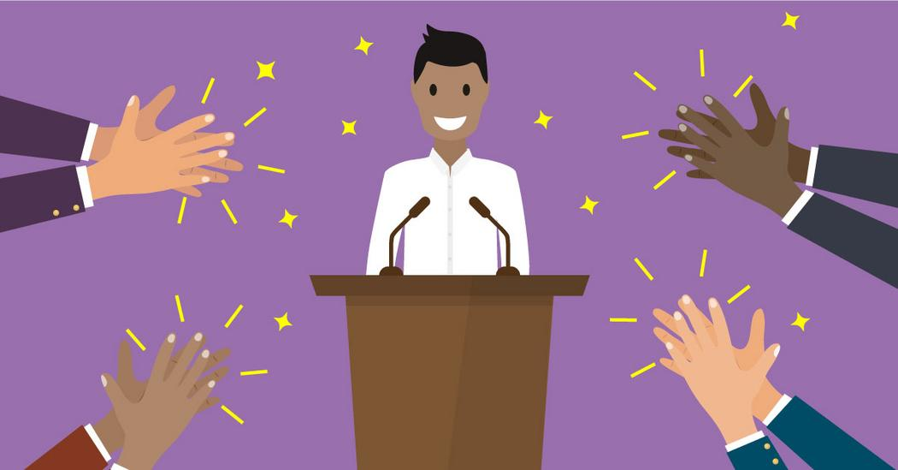
But when you are writing a paper or speaking formally, you need to know how to utilize correct language.

Slide 16
So is knowing correct language important?

Slide 18
Too tense?

Slide 19
Not that kind of tense.
Verb Tense!
Using the correct verb tense says, “I’m intelligence, I’m confident, I care about details.”

Slide 20
Using incorrect verb tenses is a problem I have observed among some middle school students, so let’s explore this first.
(Please watch the first five minutes of this video )
https://www.youtube.com/watch?v=ljKhIxcrhwk

Slide 21
Basic Forms of Verbs
Base/Present form
Past
Past perfect

Slide 22
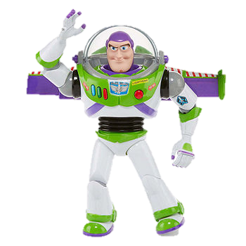
The basic form of a verb is usually represented in the form of an infinitive.
To go
To walk
To run
To study
To “infinitive” and beyond!

Slide 23
The present tense uses this form.
Singular Plural
I walk We walk
You walk You walk
He walks They walk

Slide 24
The confusing part comes with past and past perfect tenses.

Slide 25
The past tense:
The past tense refers to an event that has happened in the past. (Duh?) The basic way to form the past tense in English is to take the present tense of the word and add the suffix -ed. For example, to turn the verb "walk" into the past tense, add -ed to form "walked."
Present Past
walk walked
bake baked
sip sipped
jump jumped

Slide 26
It would be so easy except-
it’s English and there are always exceptions to every rule.

Slide 27
The Irregular Verb Past Tense
Some verbs do not form the past tense by adding –ed.
Examples:
Present Wrong Right
see seed (seen) saw
do doed (done) did
run runned ran
have haved had
go goed went
eat eated ate

Slide 28
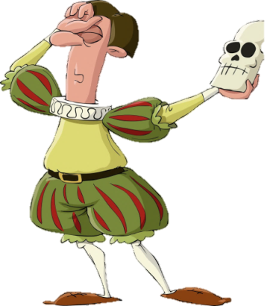
The Irregular Verb Past Tense
And the all important: TO BE
Present Wrong Right
I am was
You are was were
She is was
To be or not to be,
that is the question.

Slide 29
The Past Perfect Tense
We use the past perfect tense to talk about something that happened before another action in the past. It is formed by using the verb to have and the past participle of the verb.
Regular Verbs
Noun + Have + Past Participle
I have walked
He has baked
We have jumped

Slide 30
The Past Perfect Tense for Irregular Verbs
Pronoun + To Have + Past Participle
I have seen …
He has done …
We have run …
I have eaten …
He has been …

Slide 31
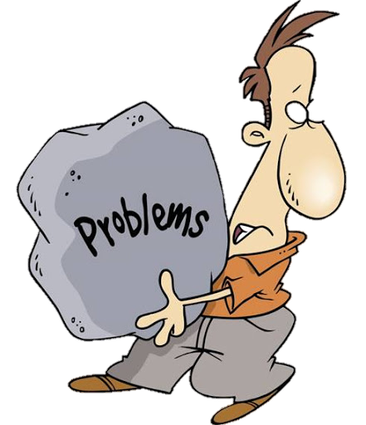
Problems occur in language when the past and past perfect tenses are mixed.
I seen you do it.
He done it.
OR
I have went there.
He has ran to the store.
They have ate lunch.

Slide 32
It sounds like fingernails
down a chalkboard.

Slide 33
Sometimes problems occur when there is a contraction, and it is not as obvious that the perfect past tense is required.
WRONG
I’ve saw that.
He’d went to the store.
They’ve did it before.

Slide 34
For some of you, this is easy, and you have mastered this. For others, it will require intentionality and practice.
RIGHT
I saw that movie.
I’ve seen that movie.
He went to the store.
He’d gone to the store.

Slide 35
I ran to the playground.
I have run there before.
He ate lunch.
He had eaten his lunch.

Slide 36
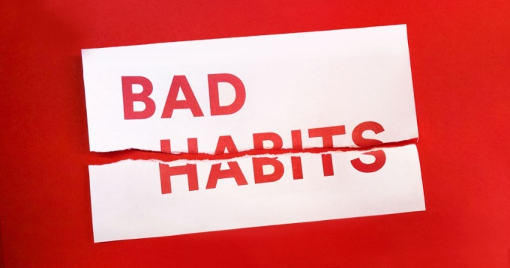
A lot of this is just bad habits.
But it is time to break
bad habits, speak
correctly, and
prove to the
world that you
ARE intelligent!

Slide 37
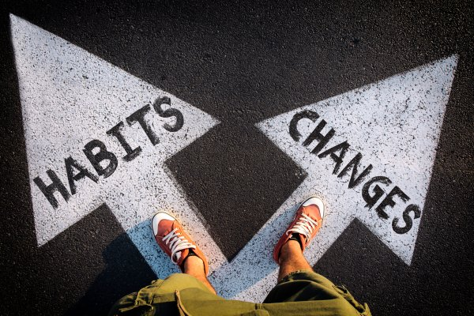
Make an effort to speak correctly!

