Slide 1
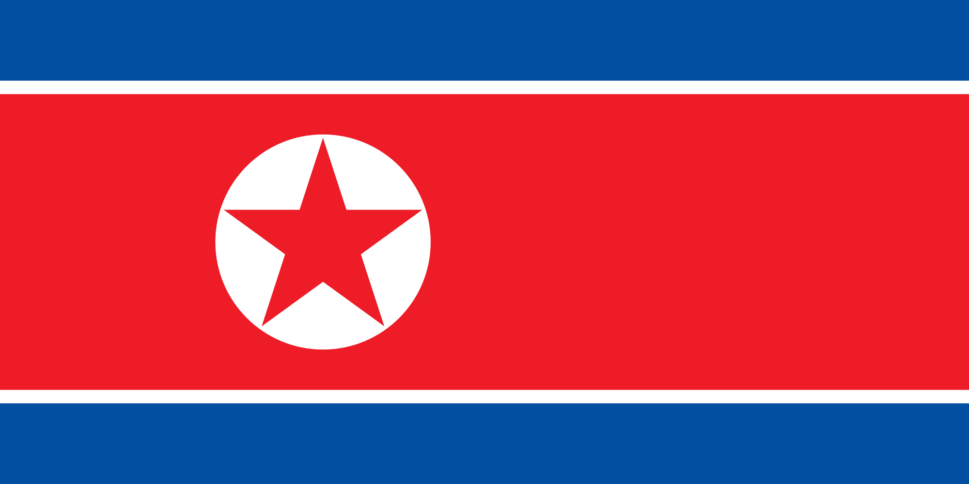
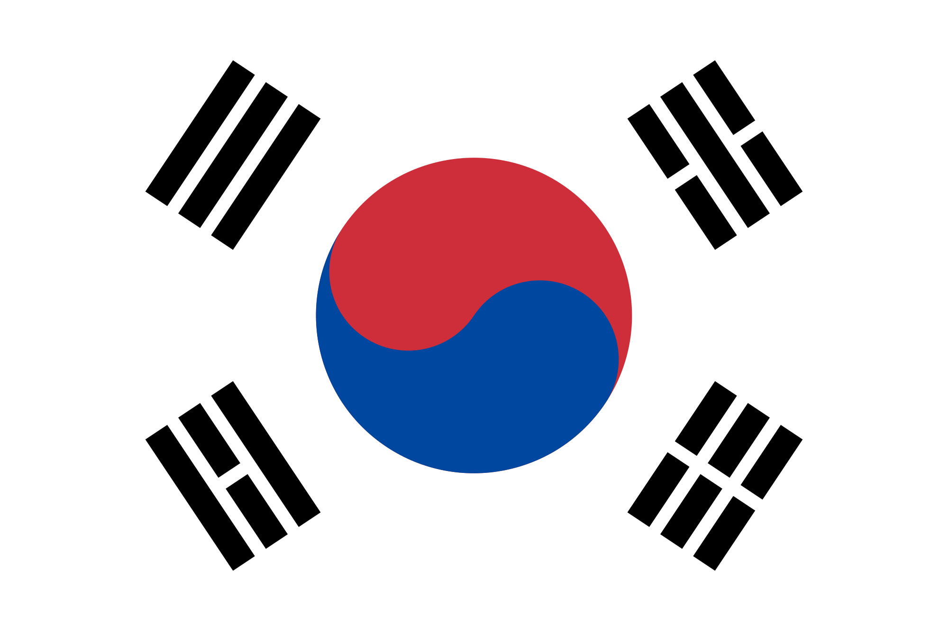
Korean History
Early Ages - Modern Ages
By Makenna, Lexi, Hannah, and Audrey.

Slide 2
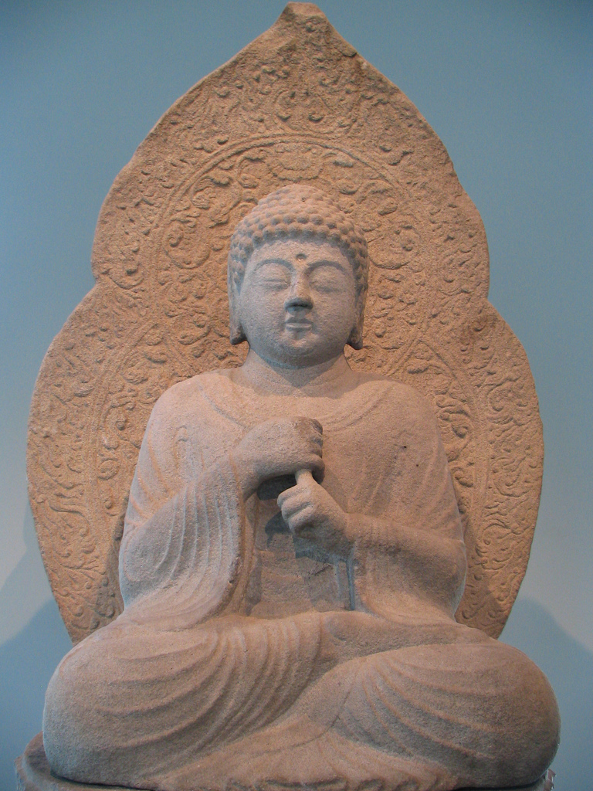
Korean language, art, music, and literature + what was life like for the wealthy and the poor?
The language that was developed during the Goryeo dynasty is a form of Korean spoken Goryeo language.
During this dynasty, pottery, paintings, and sculptures was an art.
The music was mostly folk, vocal, religious, and poetic.
They did poetry and religious based literature.
The life for the wealthy and poor was different.
The wealthy had luxury while the poor lived in one
house / apartment with other families.
Notes:
#6 #7

Slide 3
How did Leaders and foreign countries influence Korea during the Goryeo Dynasty.
Influential leaders in Korea during Goryeo were “Kyon Hwon attacked Gyeongju, the Silla capital. Gung Ye”s unpopular and fanatical tyranny led to his death[...] he was succeeded by his first minister, the able Wang Geon in 918CE who attacked later Baekje, now be set by leadership in fighting..”
They shaped the time by conquering and making allies.
China influenced the development of Korea. One of Korea’s main three kingdoms , named the Goguryeo, was very influenced by China.
Another named the Silla openly teamed up, or allied with Tang against their opponents.
Korea also embraced new studies from China. Buddhism was first, then Confucianism. <<< those are religions. Korea was a monarchy.
Notes:
#2 #3

Slide 4
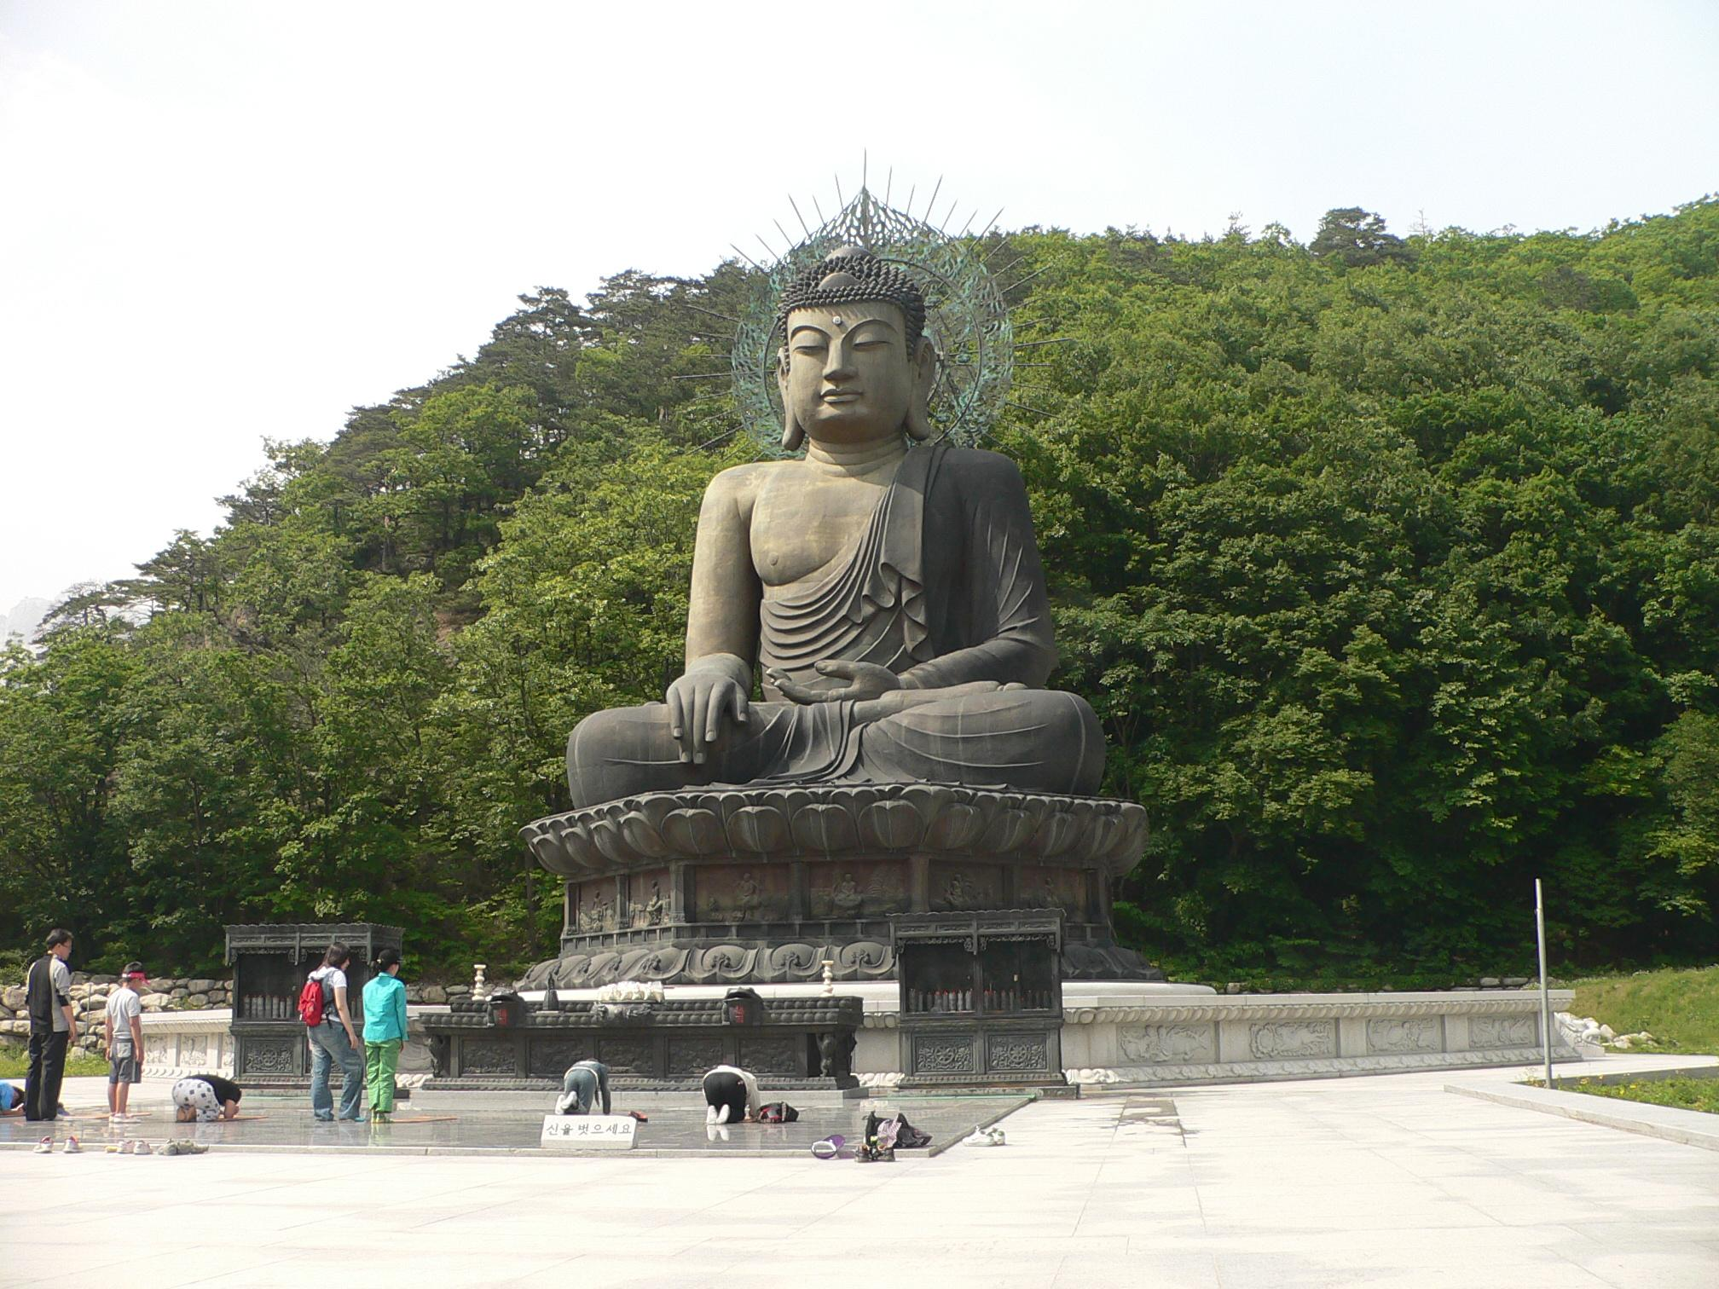
Korean religion and social structure
The Religion during the Goryeo Dynasty was Buddhism. From the people, to the rulers, to their lowest subjects, were believing in Buddhism. They adopted this religion from China.
During the Goryeo Dynasty the social classes were a free class. They were obliged to pay taxes, serve in the Korean army, and take on unpaid labor. Artisans, peasants, merchants, and fisherman made this class up, but merchants were regarded lowly by Yangban.
매혹적인
Notes:
#8 #9

Slide 5
How did the Goryeo Dynasty lead to the overall development of Korea.
Letting other countries influence and help with ideas of culture. China was a big factor in things such as religion.
Allies - join forces with
Growth
Getting stronger and learning from mistakes of protection
Conquering and spreading land
.

Slide 6
What problems did North Korea have to overcome?
No freedom of speech. This means they do not have the right to say what they would like to, or what they believe in.
No religious freedom. This means they do not have the right to worship and follow the religion that they choose.
No freedom of movement. This means that they do not have the right to travel to different places and then return to North Korea.
Food shortages. This means lack of food, which can lead to starvation or severe hunger.

Slide 7
What was North Korea like during these periods?
a- Freedoms or lacks or freedoms?
North Korea had, if any, very little freedoms. Many things like freedom of speech and freedom of religion are not allowed.
b- Industrial or agrarian?
North Korea’s economy is agrarian, very isolated, and strictly controlled.
c- The arts: 2D and 3D art, literature, and music?
-Different arts done in North Korea are calligraphy, music, painting and pottery, often marked by the use of natural forms, surface decoration, and bold colors or sound.

Slide 8
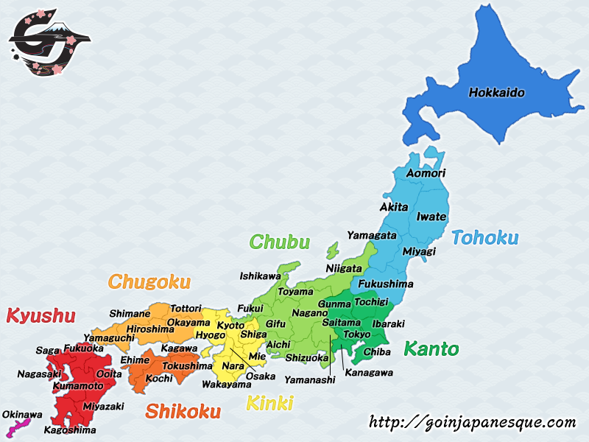
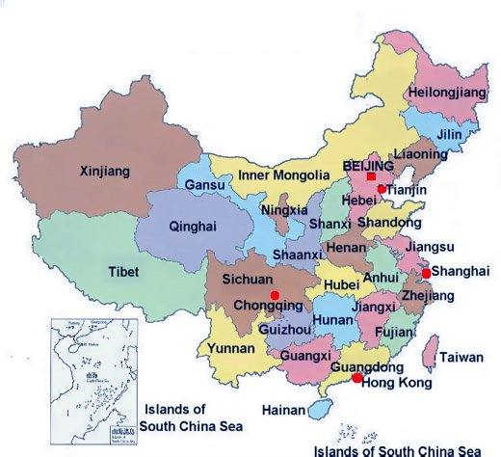
How did other countries affect North Korea?
The impact China and Japan had on North Korea was that these countries influenced North Korea by them trying to change their government into a monarchy (Japan) and a communist country (China). This has made a huge impact in Korea’s politics and there was also a big effect of safety and strength on the country.
Japan
China

Slide 9
How did Korea manage to keep its autonomy in the face of other nations’ influences?
North Korea kept its autonomy by staying very isolated. Foreign media is not allowed, interaction with tourists is controlled strictly, and you can not get on the internet. By them doing this their autonomy stays how they want it.

Slide 10
The End!
That is our presentation on North Korea and Goryeo. North Korea is a country in Asia that is a communist country. Goryeo was a dynasty and had a monarchy. They both studied the religion of Buddhism. I hope you enjoyed our presentation, have a great day!
좋은 하루 되세요.

Slide 11
Where we got our information from.
“Korean history in Maps” book
https://www.libertyinnorthkorea.org/learn-north-korea-history/
https://www.wikipedia.org/
https://www.ancient.eu/Goryeo/
https://en.wikipedia.org/wiki/Three_Kingdoms_of_Korea
https://www.libertyinnorthkorea.org/learn-nk-challenges/
https://en.wikipedia.org/wiki/Korean_art

