Slide 1
The History of Korea
By: Taryn, Melanie, Caitlin, Gracelyn
Notes:
caitlin - names
Melanie - title

Slide 2
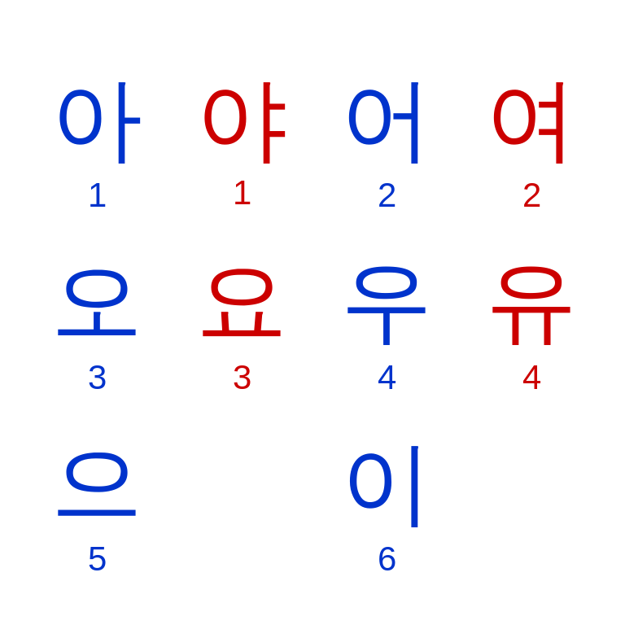
Introduction to Korea
Today you are going to be learning about modern history of Korea, and early history of Korea. For the modern history you will be learning about the Japanese Occupation, and for the early history of Korea we will be talking about the Three Kingdoms.
Notes:
Gracelyn

Slide 3
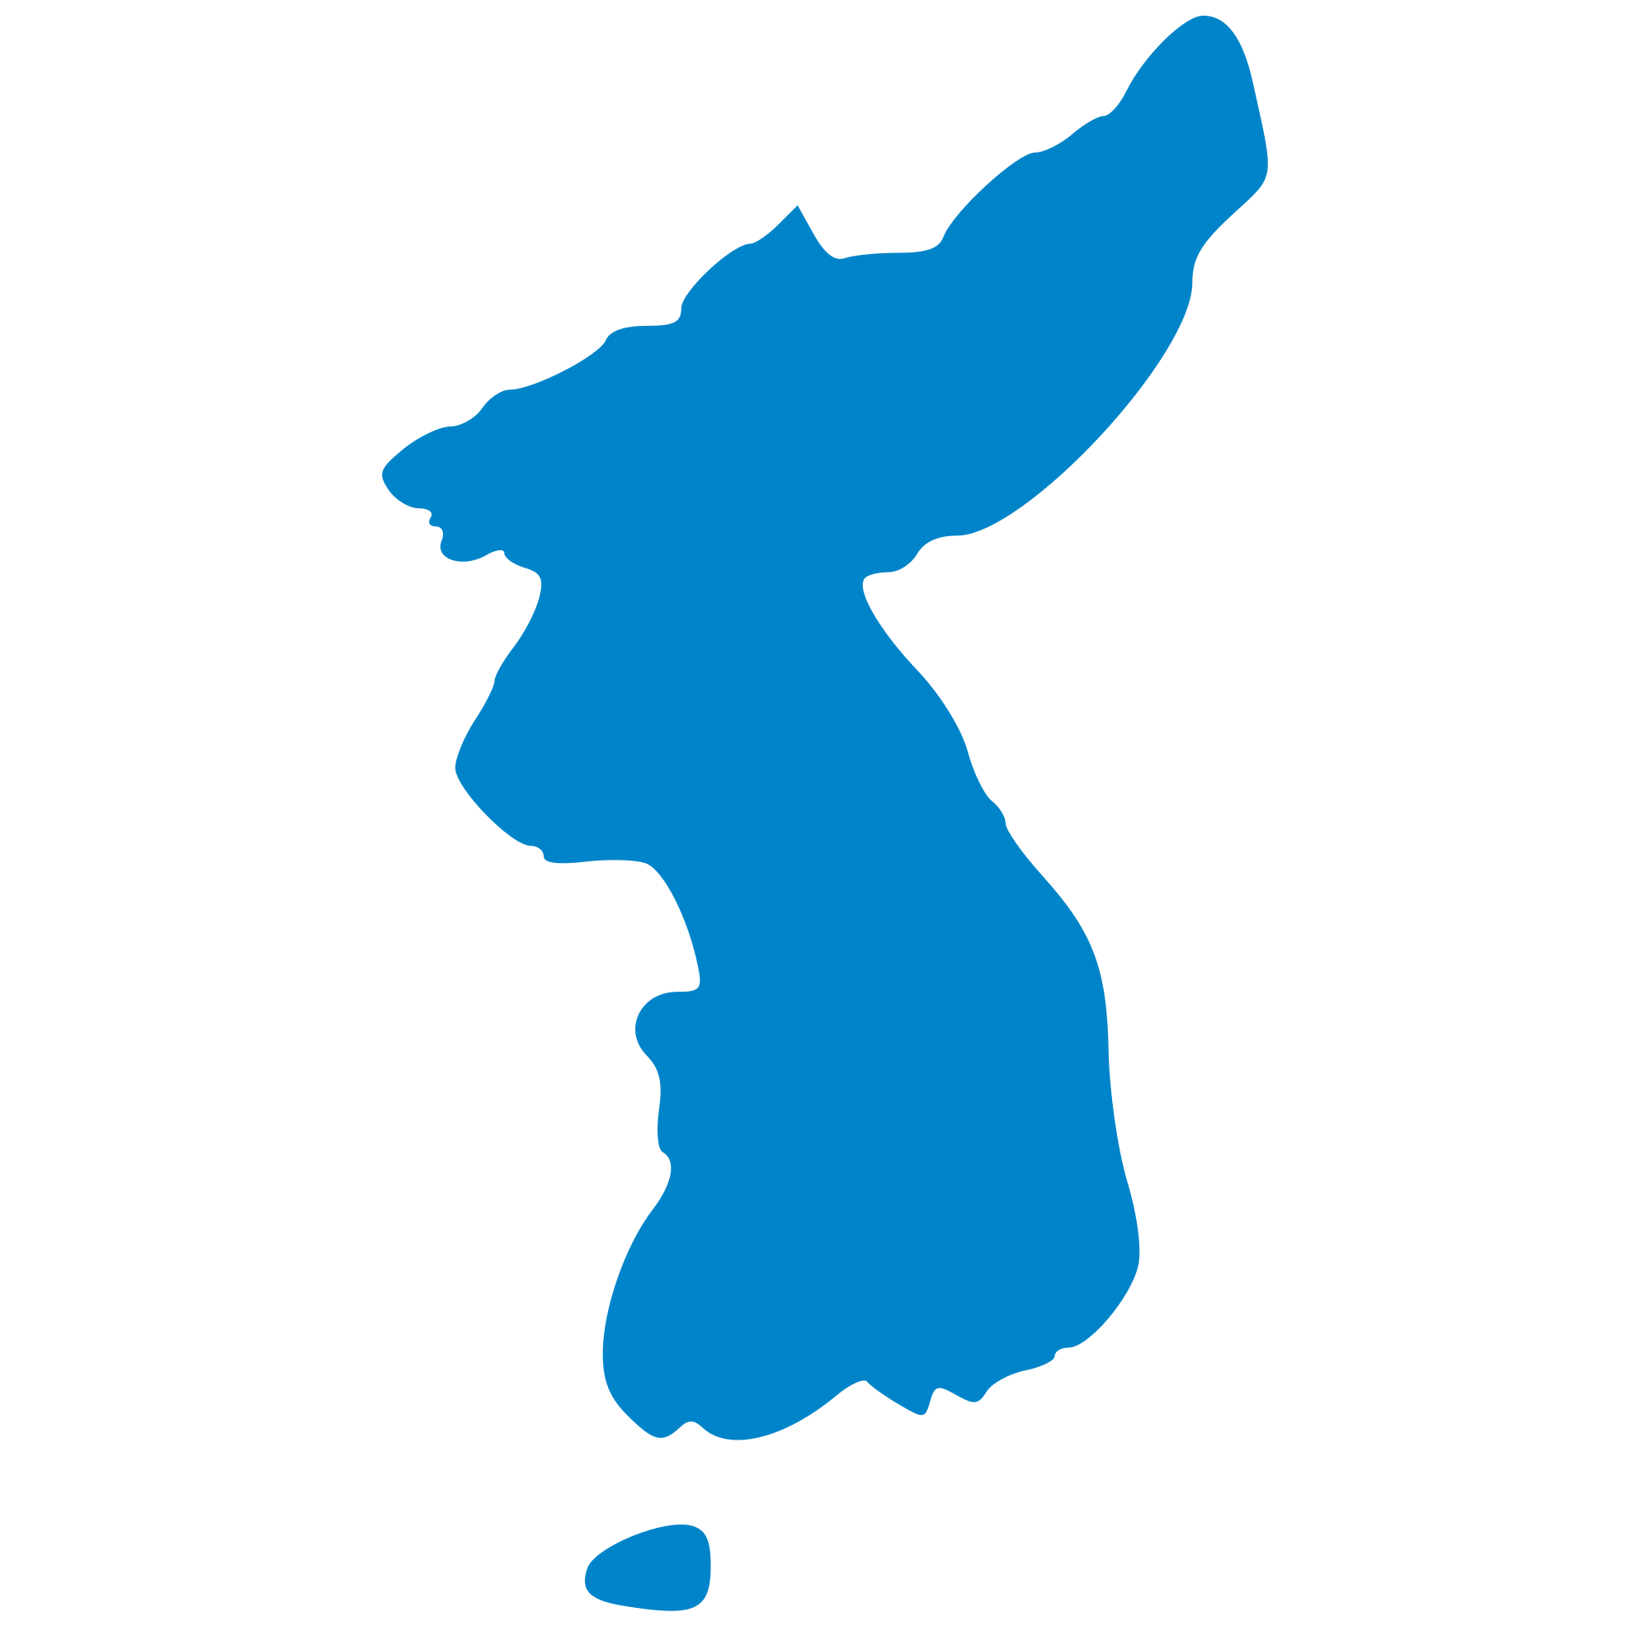
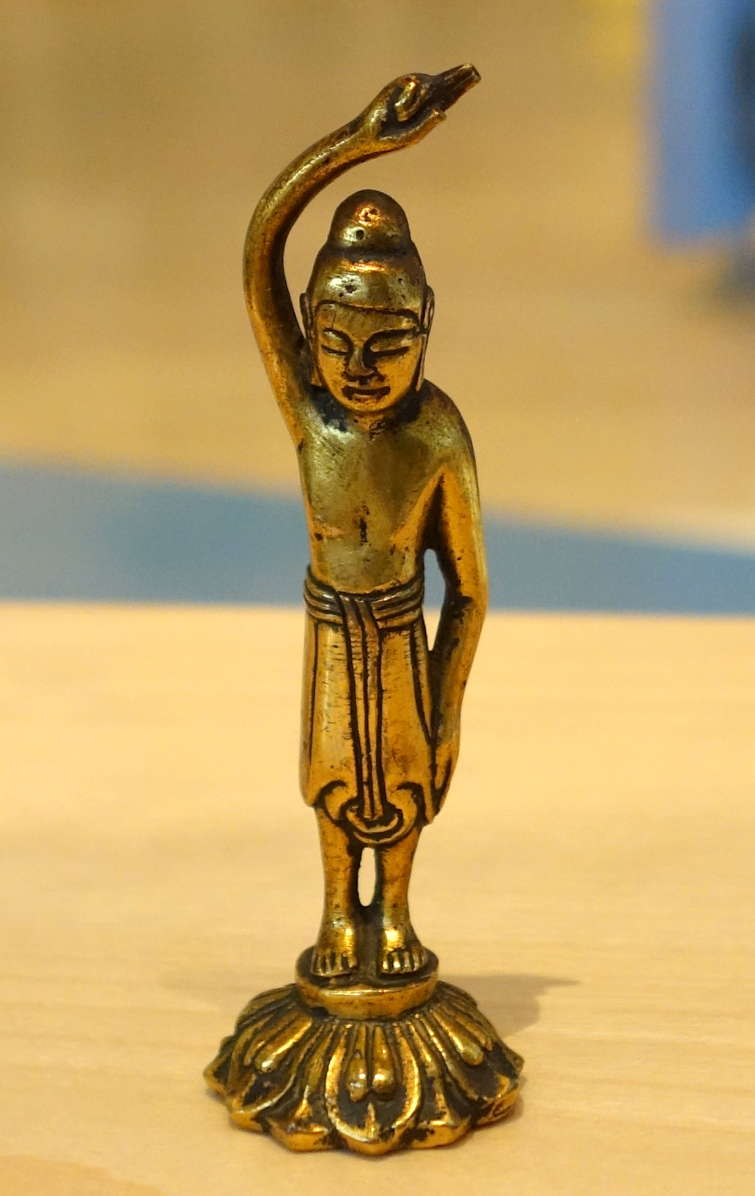
The Development of Korea.
The Three Kingdoms adopted the chinese writing system, religion, and coinage during trade.
A scientist named Jang Yeong-sil, in Joseon, invented the first water gauge in A.D 1441. This invention was called the supyo.
The Three Kingdoms Influenced art, literature, and architecture in what is now modern Korea. The rulers also expanded Korean land into China.
Notes:
Melanie

Slide 4
Government
Bureaucratic government. (A bureaucratic government is a large group of people split up into smaller groups.)
Gwanggaeto the Great was a very powerful leader of Goguryeo.
He took over two thirds of the Korean peninsula.
He also took over the most powerful kingdom at the time, which was Baekje.
Notes:
Gracelyn

Slide 5
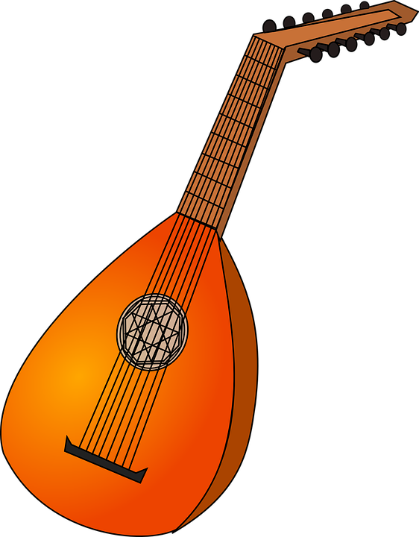
Arts, Literature, Music, and Language
The Three Kingdoms influenced Korean arts. Some are the grey-fixed stoneware, tomb painting, and gilt-bronze work.
Music was also influenced by the Three Kingdoms:
Goguryeo- an oboe that’s called piri, a lute called a bipa, and a zither called a geomungo.
Baekje- a song called a Jeongeup Si
Silla- local music called hyangak, and an instrument called a gayageum
Notes:
Melanie

Slide 6
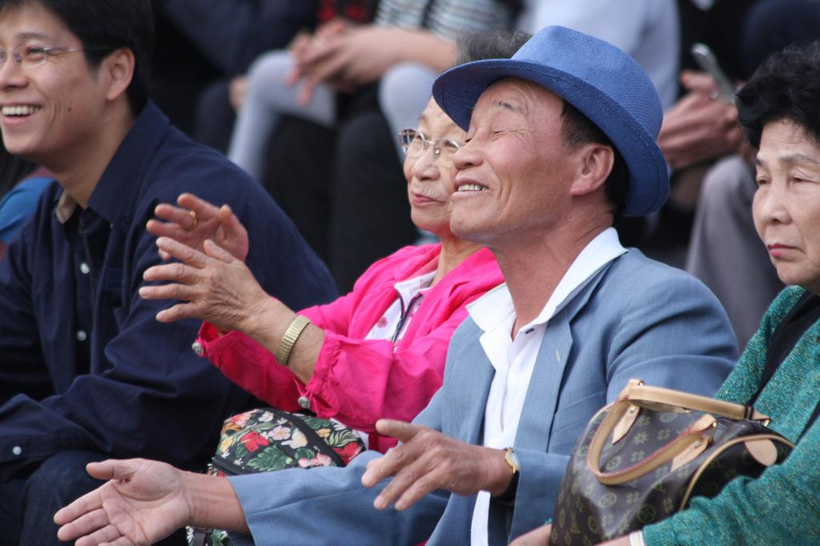
People of Korea
Their major religion is Buddhism
They all are divided into 4 social classes, which consist of:
*Goguryeo: King, aristocrats, commoners, & slaves
*Baekje : King, aristocrats, commoners, & slaves
*Silla : King, aristocrats, commoners, and slaves.
Silla has a bone rank system which separates the aristocrats into different groups.
The wealthy spend their money on lavish pieces of clothing and unnecessary items, while the poor (if they had any) spent their money on items that they needed, like food and shelter. The wealthy also had very nice clothing, but the poor had grungy, dirty clothes.
Notes:
Gracelyn

Slide 7
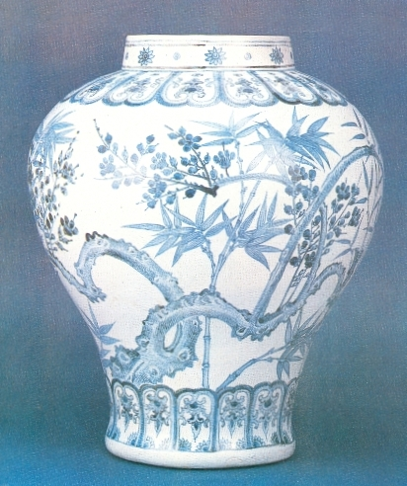
What was Korea like during this period?
During the Japanese occupation Korea had a lack of freedom.
During this time period Korea was agrarian.
During the occupation of Korea their art was heavily influenced by the Japanese because of their rule over Korea. Korea also used the art forms of calligraphy, pottery, painting, sculpture and lacquerware.
Notes:
Caitlin

Slide 8
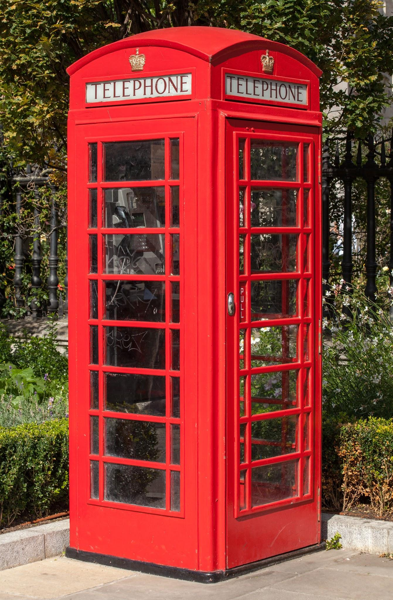
How did other countries affect Korea?
Japan affected Korea by leaving behind their culture.
They also left their ideas like telephone booths, running water, radios and more.
Notes:
Taryn

Slide 9
How did Korea manage to keep its autonomy in the face of other nations’ influences?
The Koreans kept their autonomy by forming a resistance called the Independence Movement against Japan. The independence movement was a armed campaign to help Korea gain their freedom from Japan. The movement was unsuccessful and it only caused the leaders of Korea to flee to China.
Independence
Notes:
Caitlin

Slide 10
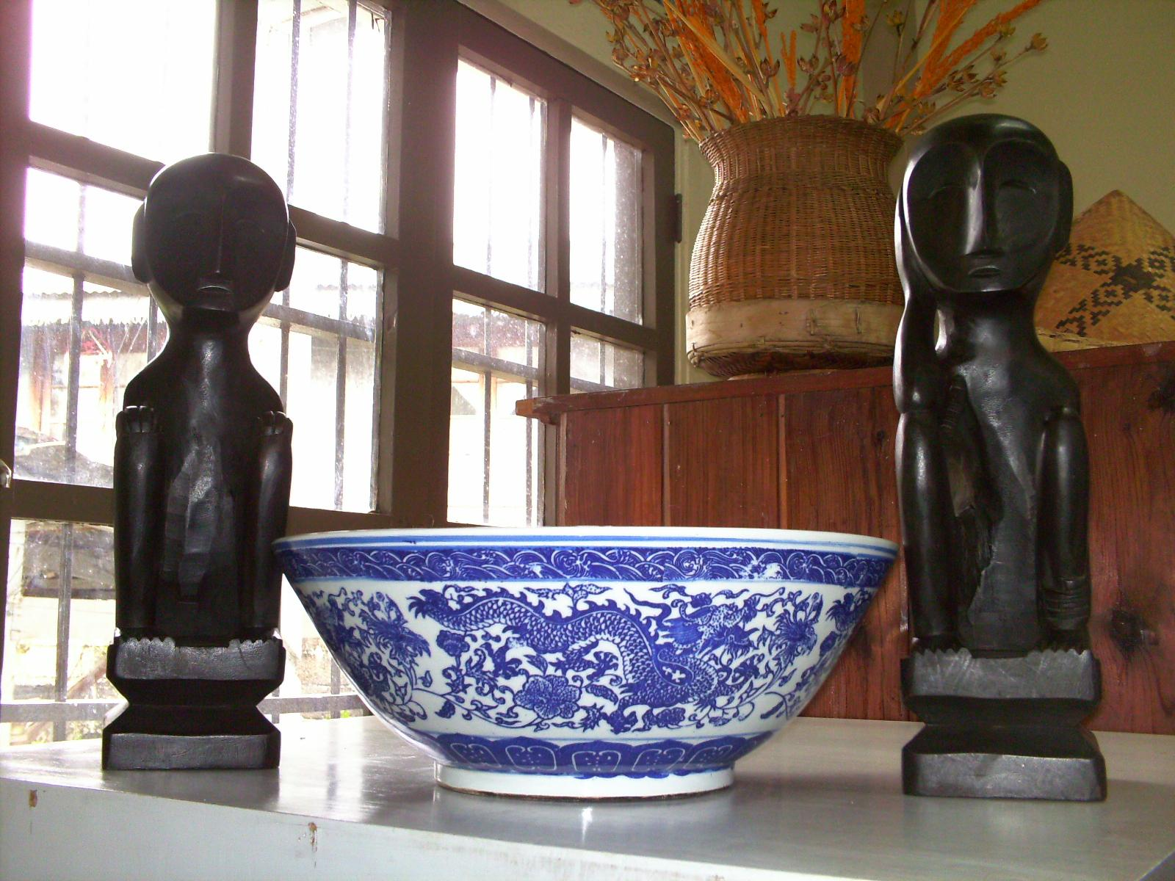
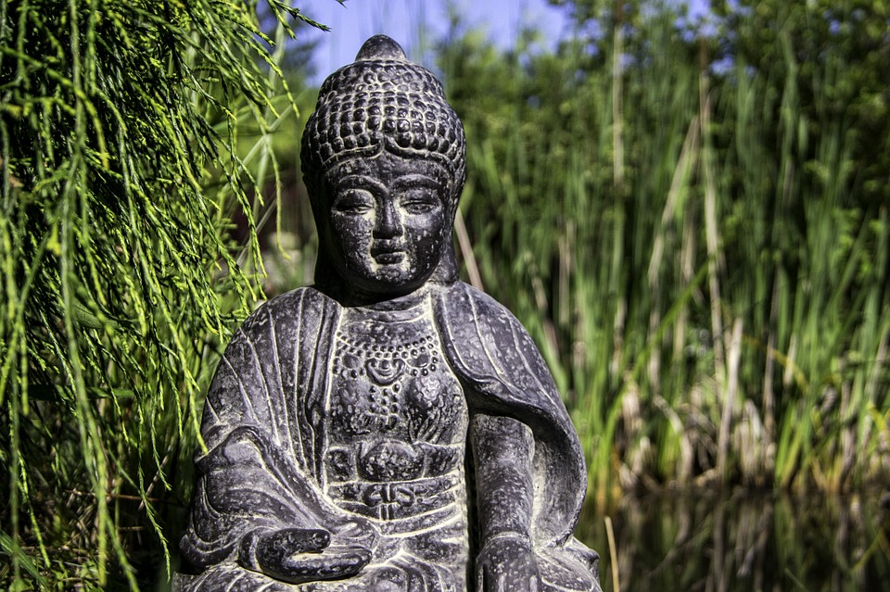
What problems did the Koreans have to overcome?
Korea was occupied by Japan at the time. One problem was that the Koreans did not have freedom to practice their own culture and religions. The Japanese were being very cruel to them.
Notes:
Taryn

Slide 11
Korea is full of unknown history and facts, but we hope that you have learned something from this presentation. There are also many ways to say thanks in Korean, but this is one way:
Gomawo
고 마 워
(Thanks)
Bibliography: “Wikipedia”
“Let’s ROK and Roll”
“Met Museum”
“Rosemont Patch”
“Korean History in Maps”
Notes:
Taryn - Words
Caitlin - Bibliography

