Slide 1
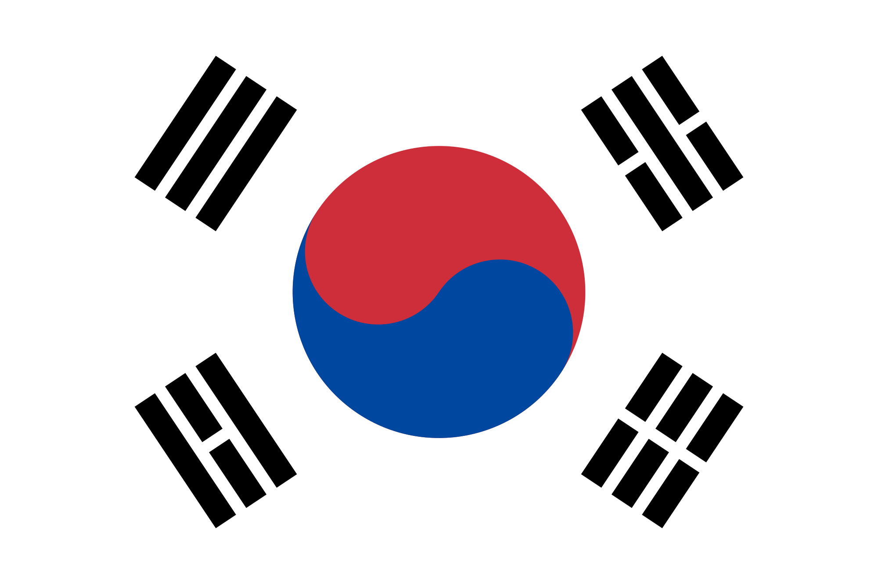
Korea, The Joseon Era
Korea is a country with a long history. These slides will help you to understand all that Korea has to offer.
By, Morgan , Kasey , Jane, Taylor

Slide 2
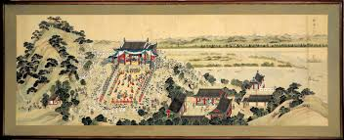
The Development of Korea-The Joseon Era
The Joseon Era had a huge impact on Korea, from the inventions to the religion. The Joseon Era lasted about five centuries. General Yi Seong-gye founded this era in July 1392, when he was crowned king. During this era, many things happened. Things such as, the capital was moved to Hanyang, and the Hall of Worthies was established. The Hangul alphabet was also created and announced by King Sejong the Great. This era ended in October 1897. Many other things happened in this era, some of which you will learn about in this slide.

Slide 3
The Social Structure of Korea
In Korea there is a social structure like most others. In this social structure there were many parts, these parts made up Korea and helped it grow. The first class was called the Yangban class. The Yangban class was made up of nobles and the ruling class. The Second class is referred to as the Chungin class. Chungin could also be spelled jungin, this meant middle people. So the second class was made up of people in between the first and third classes. The third and last class was named the Sangmin class. This class was made up of peasants, laborers, fishermen, craftsmen, and merchants. This class was very prone to high taxes and getting drafted for the military. This class made up 75% of Korea

Slide 4
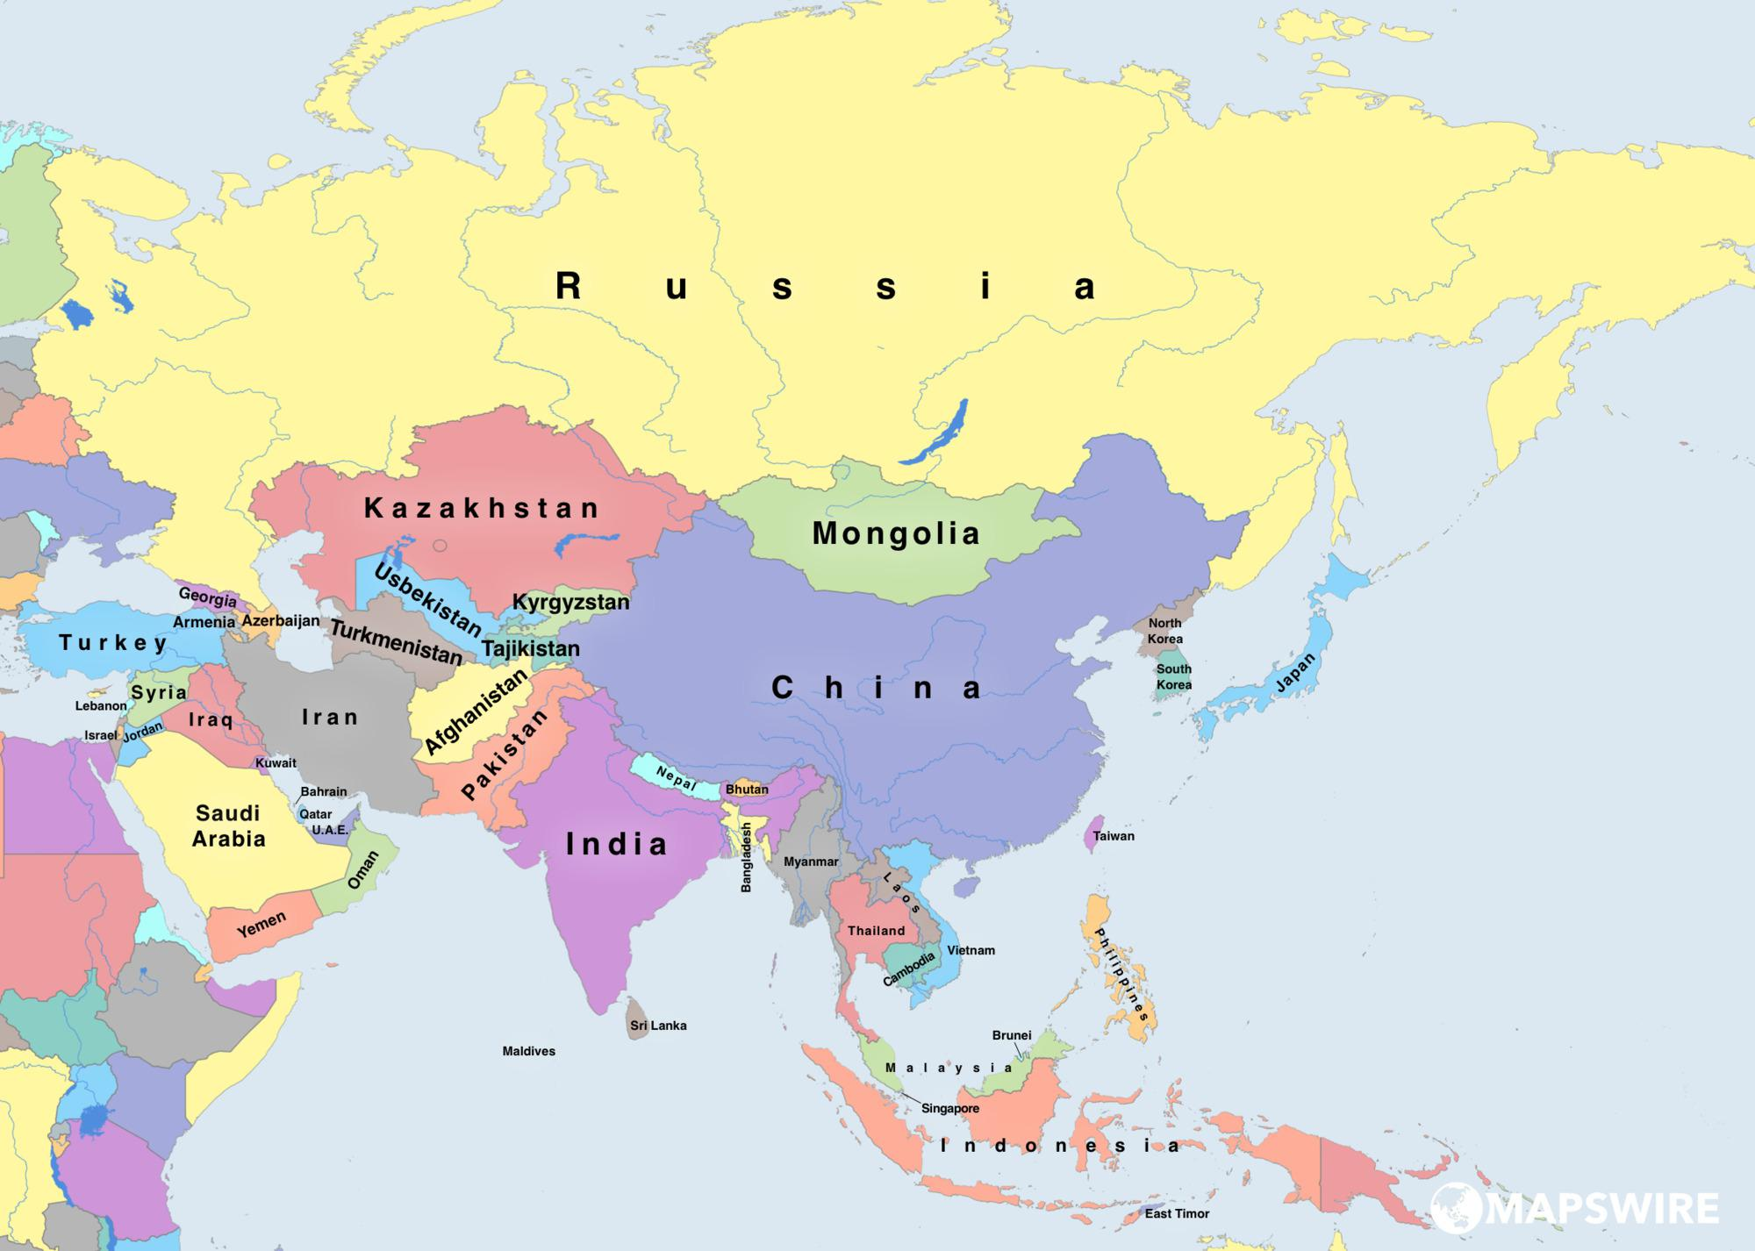
Influence of Foreign Countries
A foreign country that influenced Korea was China. China gave the Koreans a new painting technique which gave paintings a more realistic and natural look. This technique gave art more depth and beauty. Japan also influenced Korea’s development through many inventions that helped them with everyday life.

Slide 5
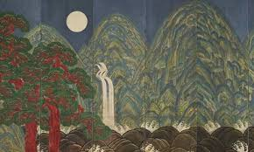
Arts, Music, and Literature
Korea had a special technique for their art, calligraphy, and pottery. They always made their colors very bold and bright. They painted beautiful designs on canvases and pottery. Their calligraphy was made to flow so that it was easily written but still looked beautiful.

Slide 6
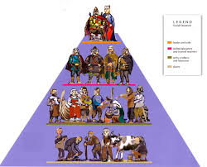
Korea’s Social Structure
The social structure of Korea was like most social structures, there was a first class, second class, and a third and last class. These classes had different names in Korea. The first class was named Yangban, and nobles and the rulers made up this group. The second class was called Chungin. Chungin can actually be called jungin also. The word Chungin means middle people. The third and last class was referred to as the Sangmin class. This group was made up of the common people, who made up 75% of Korea’s population, such as peasants, laborers, fisherman, craftsmen, and merchants.

Slide 7
Late 19th Century Korea
What was Korea like during the late 19th century? During the 19th century, Japan turned Korea into a colony to supply Japan with food. Due to Korea's lack of freedom Korean kids were not allowed to speak Korean.
Two thirds of Korea is hills and mountains.
Korean arts include traditions in calligraphy music painting and pottery often marked by use of natural forms surface decorations and bold colors or sounds.
kasey

Slide 8
Japanese Occupation
The Japanese Occupation lasted for 35 years. During this time period the Korean people lacked some rights. One right they lacked was, changing their names to Japanese names. This made Korean people more like the Japanese so that they were really part of Japan. They were also forced to learn Japanese characters, so that they could speak and write like the Japanese.
kasey

Slide 9
Liberation Period a.k.a, the Korean War
The Korean war started on June 25 1950 - July 27 1953.
North Korea had 75,000 soldiers. By July American troops had entered the war on South Korea behalf.
Five million soldiers and civilians lost their lives during the war
Nearly ten thousand North and South Korean soldiers lost their lives before the war even began.

Slide 10
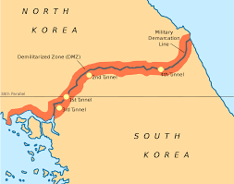
North and South Korea
Korea used to just be one whole country. It split and made North and South Korea. In North Korea they take the best from the past and discard things they want to forget. In this way they make themselves sound amazing. South Korea gives people all the information they want. They don’t hide from what they did. In this way South Korea is more honest than North Korea.

Slide 11
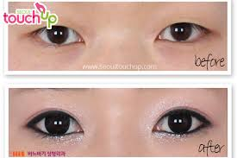
Fun Facts about Korea!
Did you know…
~ That Seoul,South Korea is the plastic surgery capital in the world. The most common surgeries done in South Korea is blepharoplasty, or also known as the double eyelid. It is supposed to make Asian look Asian. It cost between (1,000 to 3,000 dollars.) “Ladies want to have a beautiful defined look, Choi tells Tech Insider, 20% of his patients are males (want some beauty too.)

Slide 12
Fun Facts About Korea!
Did you know…
~ That the number 4 is the unlucky number in Korea. You won’t find it in any Hotel or house.

Slide 13
Thank You For Watching
I hope you learned a lot about Korea from this slide. If you would like more information there are a lot of websites you can go to. We got a lot of our information from Wikipedia, and a few other small articles.

