Slide 1
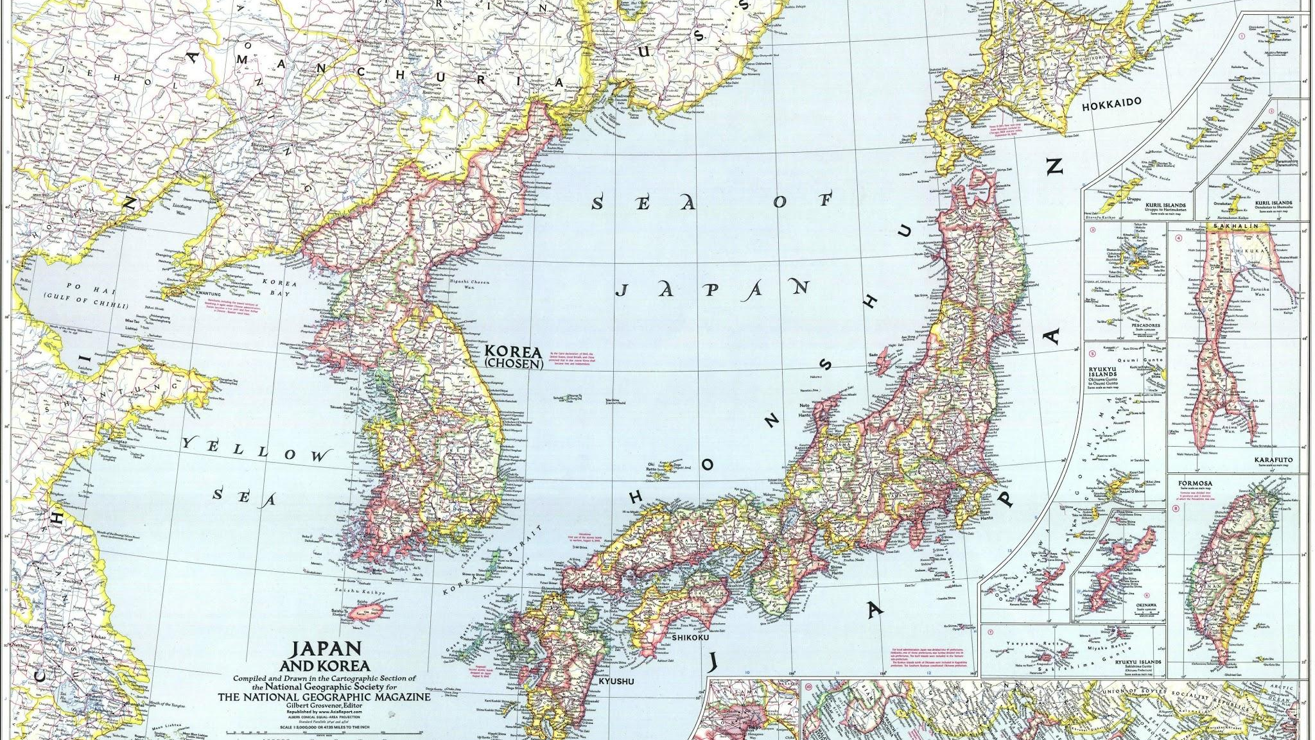
Korean History Through The Years
By: Ian, Kalyn, Lindsay, and Grace
Notes:
Kalyn will read this.

Slide 2
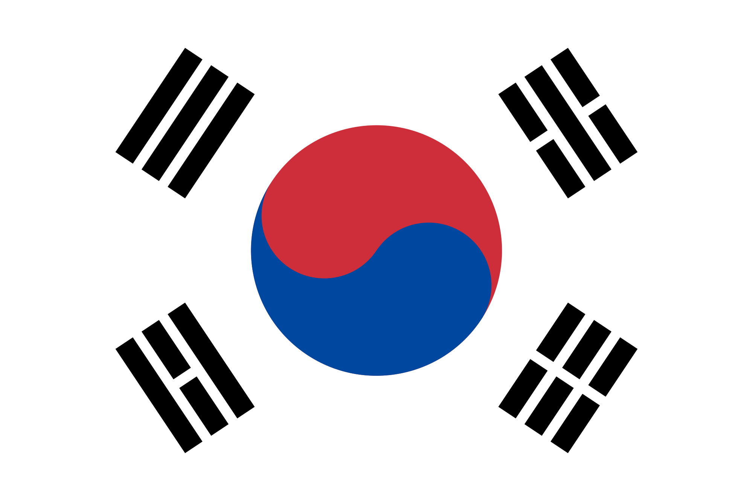
Korea has changed drastically through the years. It has changed from being owned by Japan to being one big country, then becoming two separate countries. We have chosen just two events from the past and more modern times so you can understand Korea a little bit more.
Notes:
Ian read first sentence, Grace read second sentence, Lindsay read third sentence.

Slide 3
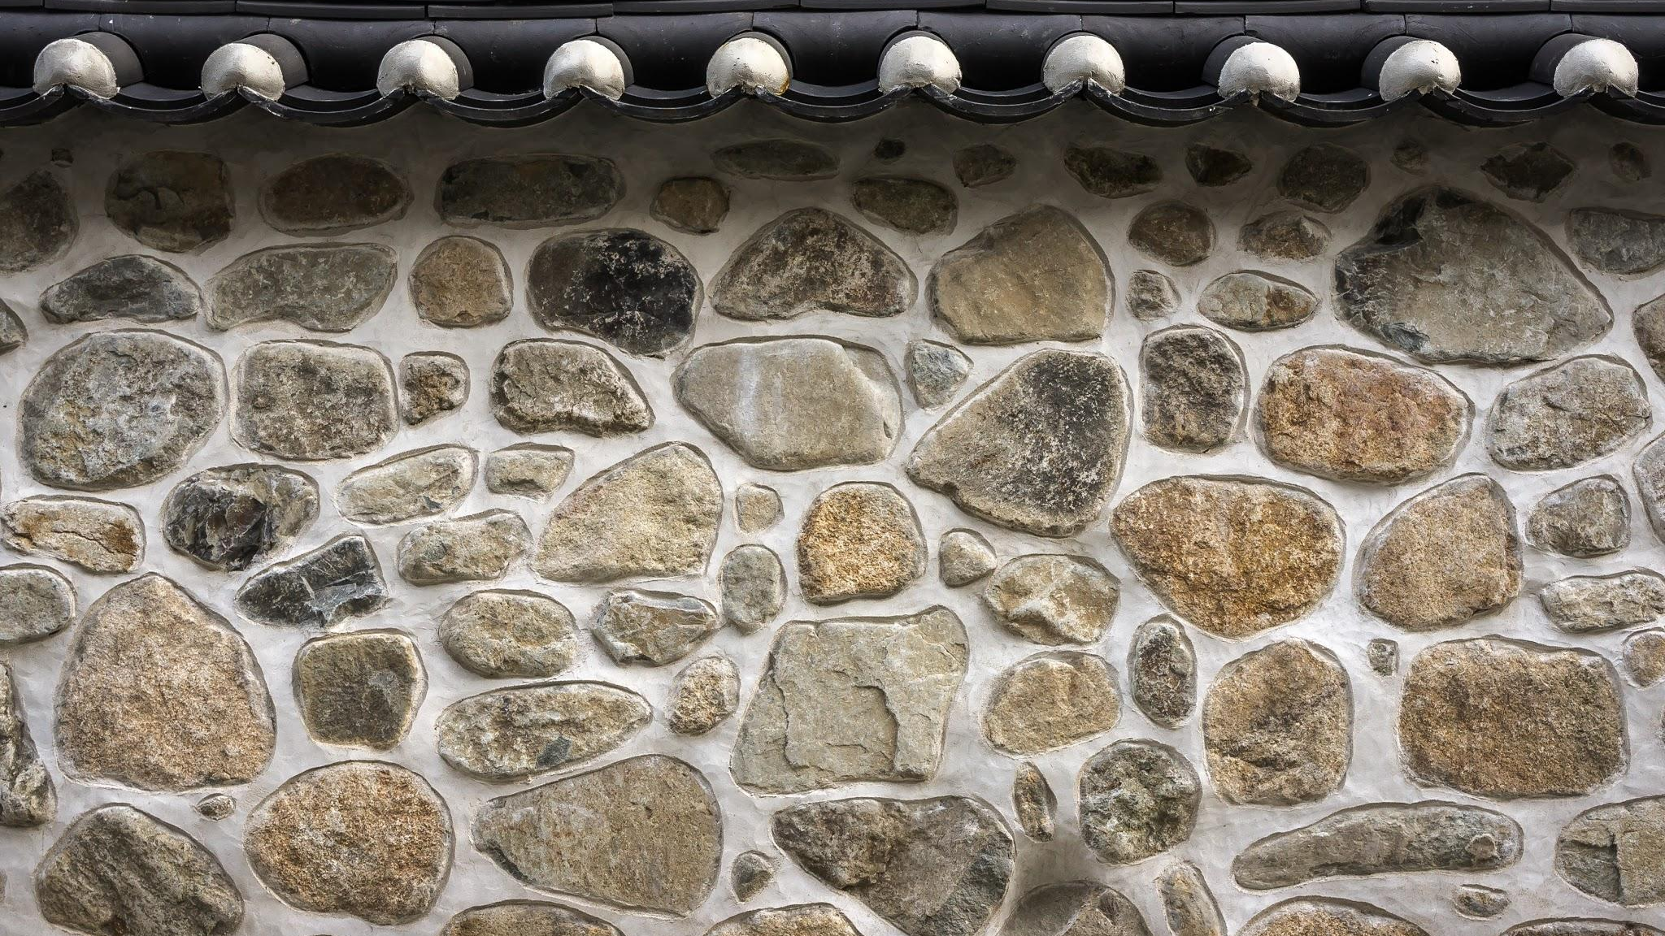
Ancient History
Goryeo Period
AD 918- AD 1392
Notes:
Ian will say this

Slide 4
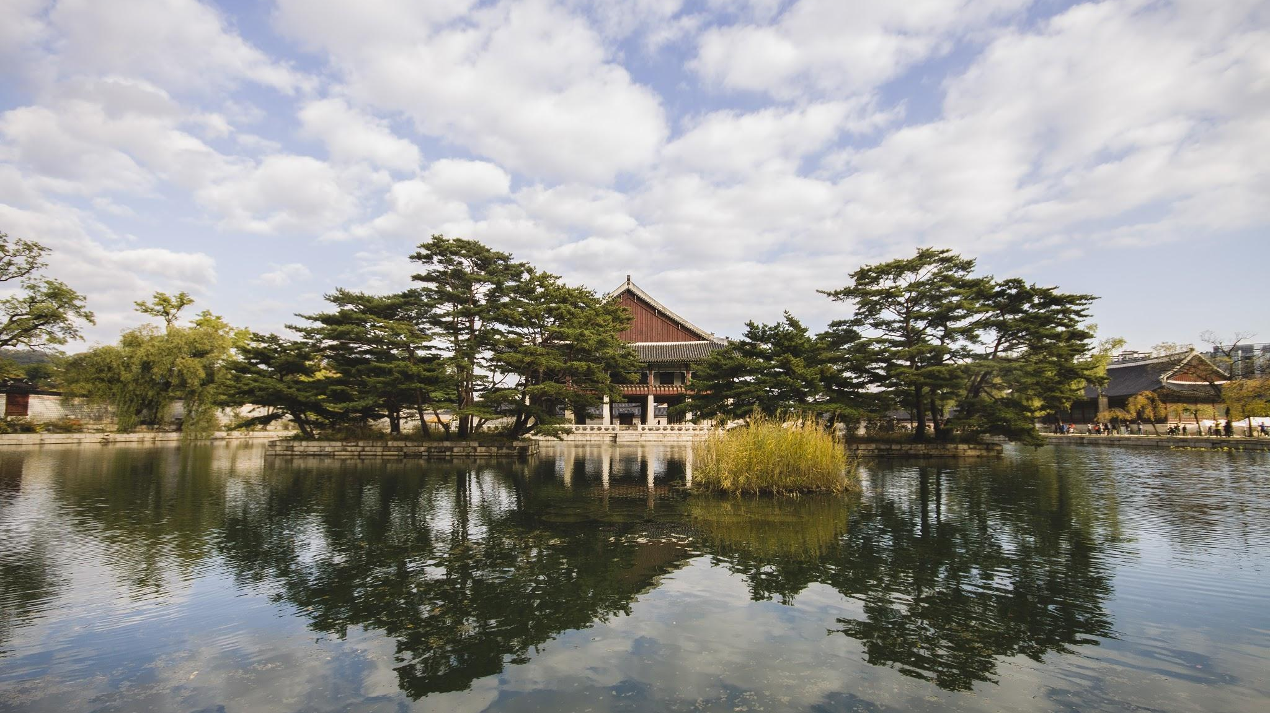
The Goryeo Period
The Goryeo Period was a time when Korea almost lost its control. It also was a time where it was covering the majority of the Korean penninsula until it was removed by Yi Seong-gye. It was a time of Buddhist temples and shrines.
Notes:
Ian reads this.

Slide 5
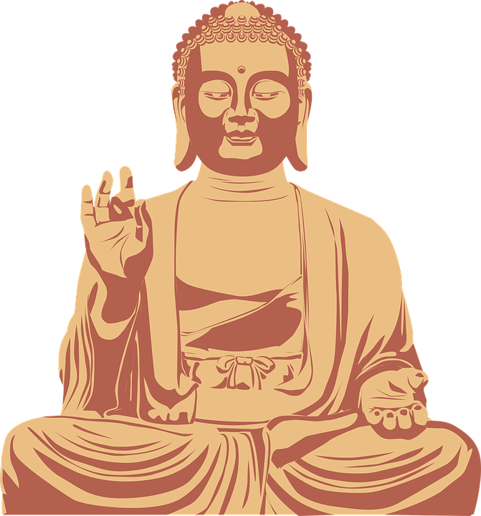
Religion
Buddhism was the main religion and started before the Three Kingdoms Period. It was continued all throughout the Goryeo Period
The founder of Buddhism was Buddha Shakyumani.
Kings establish temples so people can pray in the name of Buddha.
Notes:
Lindsay will read this

Slide 6
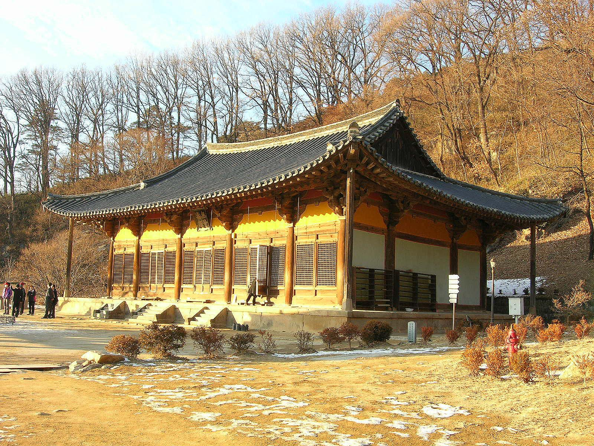
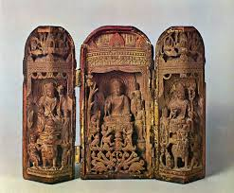
Art, Architecture, and Language
Artisan had to make outstanding pieces of pottery, called celadons, to meet certain standards of their
They also made Buddhist paintings to show their religion.
Koreans spoke Koryo-mar during the Goryeo Period.
The picture in the background is an example of Korean architecture. You may find buildings like this in Japan or China too. There was much architectural and art influence from those countries.
Notes:
Ian will read this

Slide 7
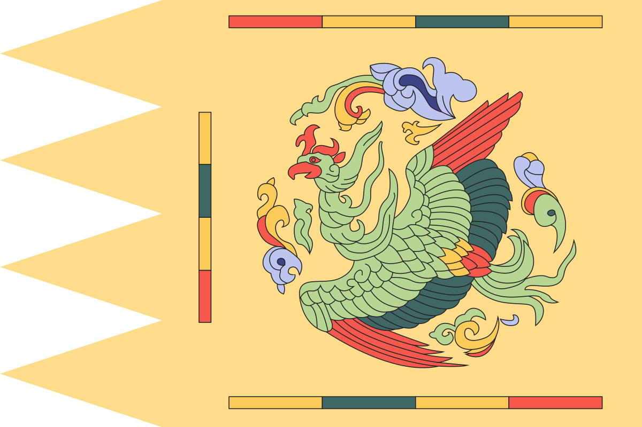
Government
Korea’s government during the Goryeo period was a monarchy.
There were 34 kings in the Goryeo period.
The first king was Wang Geon, and his name was changed, after death, to King Taejo.
Gongyang was the last king of Korea during the Goryeo period after being deposed of office.
This is the flag of the royals!
Notes:
Lindsay will read this

Slide 8
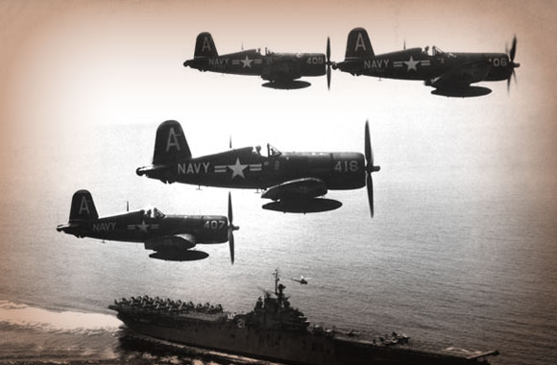
Modern History
Liberation/ Korean War
AD 1950- AD 1953
Notes:
Kalyn will read this

Slide 9
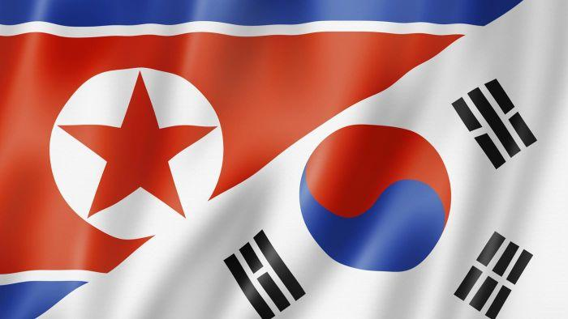
What Exactly Was the Korean War?
The Korean War was a war between North and South Korea. They were fighting over territory and what government to use. They eventually split and became North and South Korea.
Notes:
Grace will read this

Slide 10
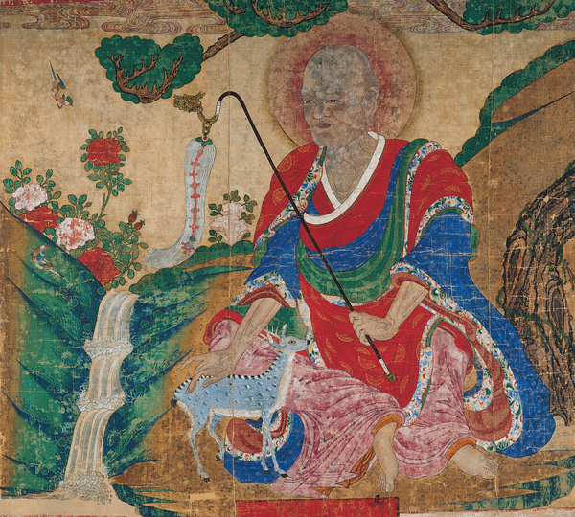
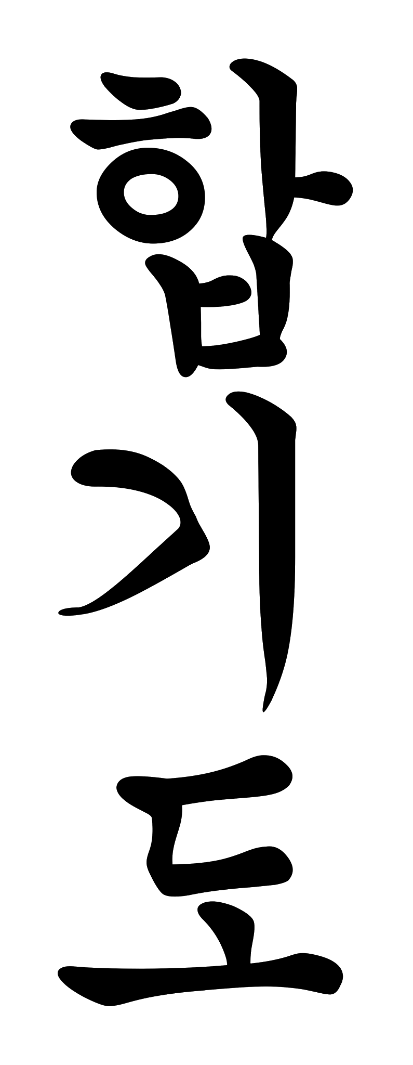
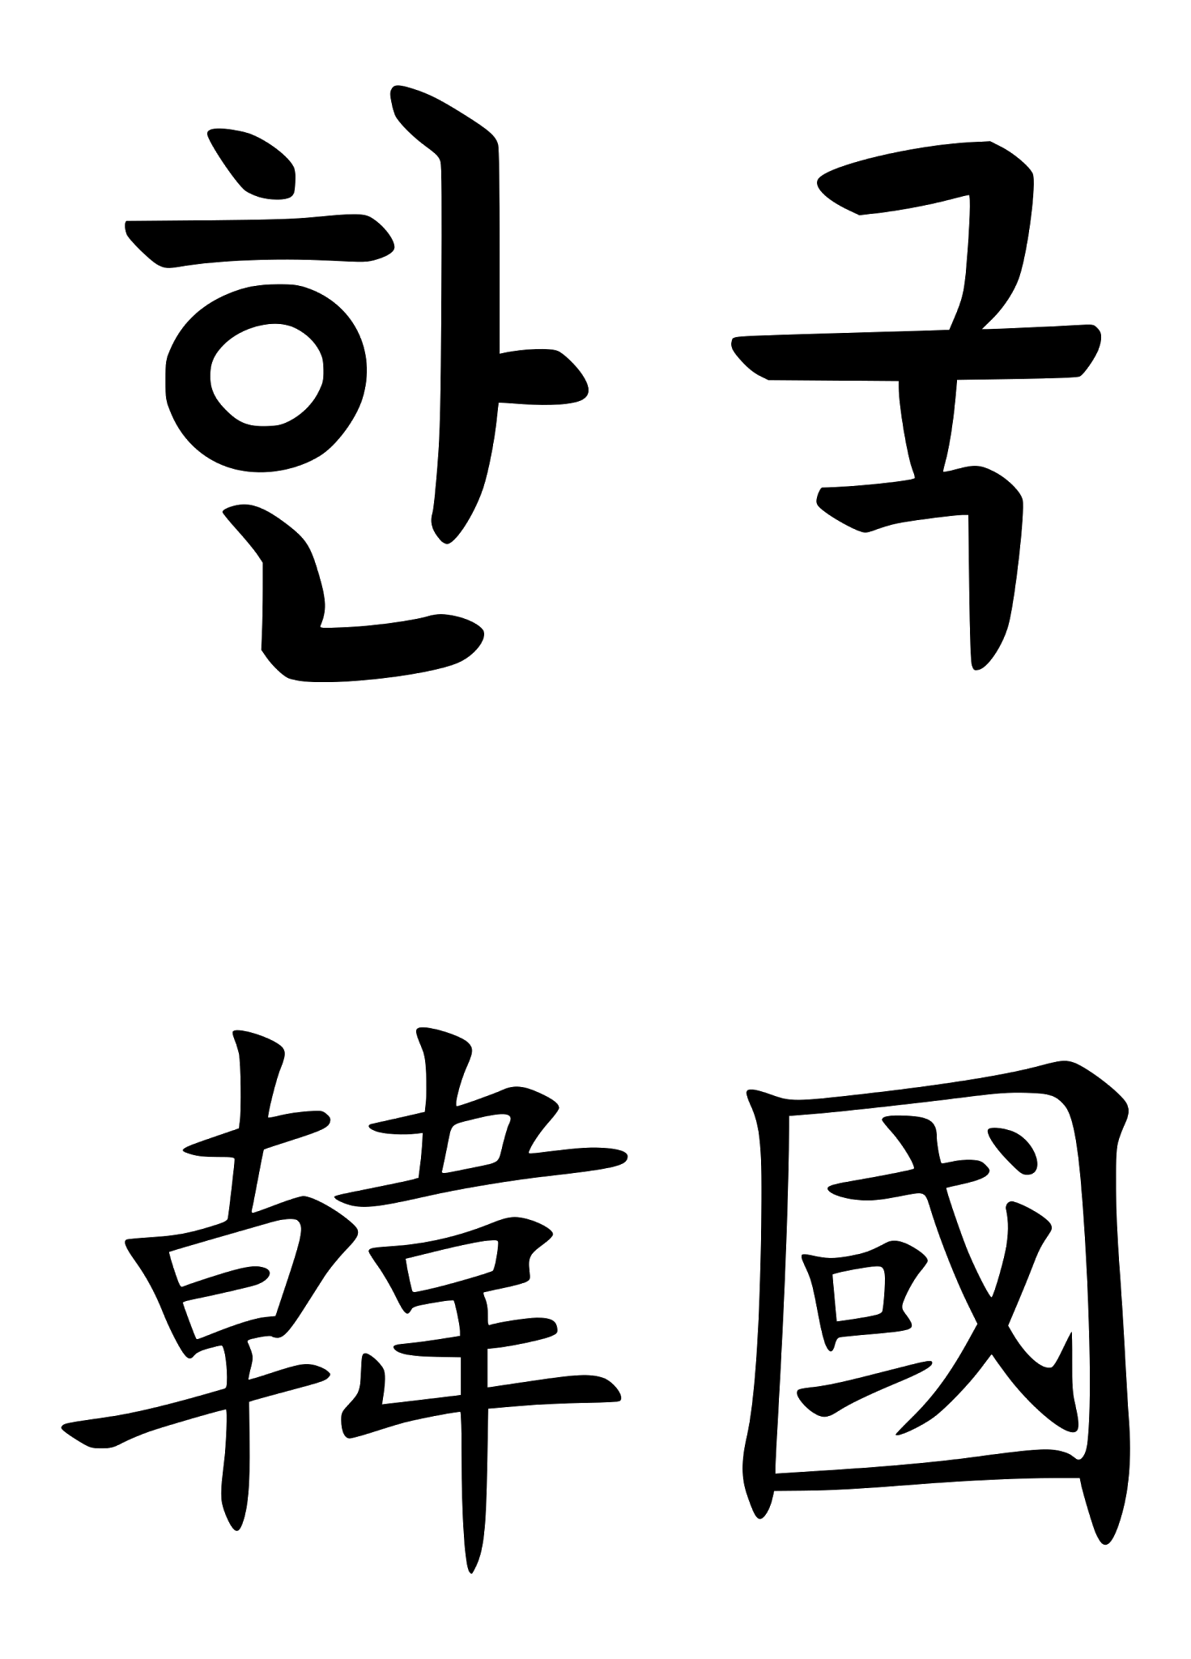
Art and Architecture
Korea has had many different types of art, music, agriculture, and literature.
Here are some examples of Japanese Calligraphy.
Pottery (raw with many nature elements)
Painting
Calligraphy
All of these had much Japanese influence
because Korea was so close to Japan.
Notes:
Kalyn will read this

Slide 11
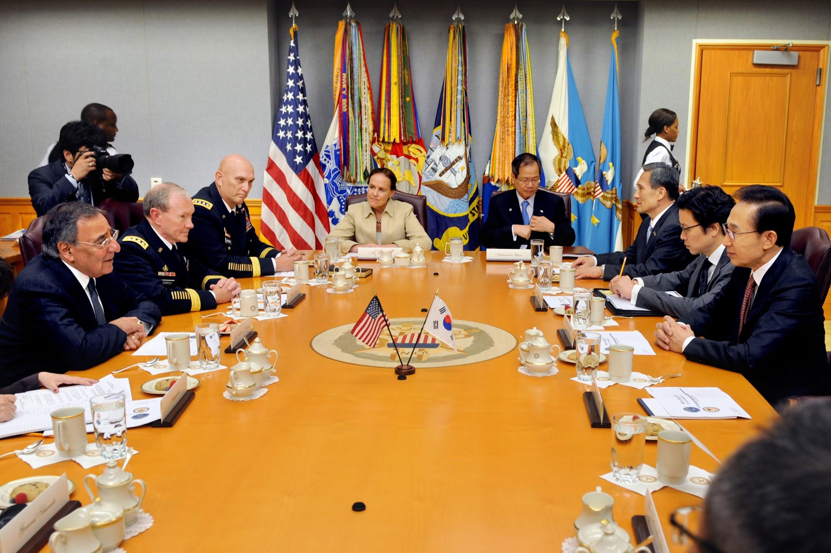
Government
During the Korean war, it was hard for Korea to keep its government. They had to figure out how to not have chaos during the splitting of Korea. In the end, North Korea became communist, and South Korea became a democracy much like the United States.
Notes:
Grace will read this

Slide 12
Problems that they Overcame
During the Korean war, there were many problems that the Koreans had to overcome. Some of them include :
Five million people including soldiers and citizens died.
After the war funding was low, so the military began to run out of money.
Due to their lack of money, they had to make cuts to some operations.
Notes:
Kalyn will read this

Slide 13
Our Favorite Facts!
These are our personal favorites out of all the things we learned!
Ian- “I liked learning about the history of Korea because I did not know much about Korea.”
Kalyn- “I liked learning about the different art that the Koreans used during the Liberation. It was very natural.”
Lindsay- “I liked comparing the USA to ancient and modern Korea.”
Grace- “I liked learning about how Korea overcame the problems that were put in front of them.”
Notes:
Each read your own Lindsay will read “intro” for it

Slide 14
Je Ne Sais Quoi
Korea has had its ups and downs through the years and is a very interesting place. Now, we understand a little more about a place that we have never had much information about! We hope you enjoyed our presentation!
If you have any questions, now is the time to ask them!
I’m confused.
Notes:
Ian will read this

Slide 15
Bibliography
https://www.wikipedia.org/
https://www.ancient.eu/
http://www.aboutbuddhism.org/
http://www.newworldencyclopedia.org/entry/Korean_architecture
http://www.visual-arts-cork.com/east-asian-art/korean.htm

