Slide 1
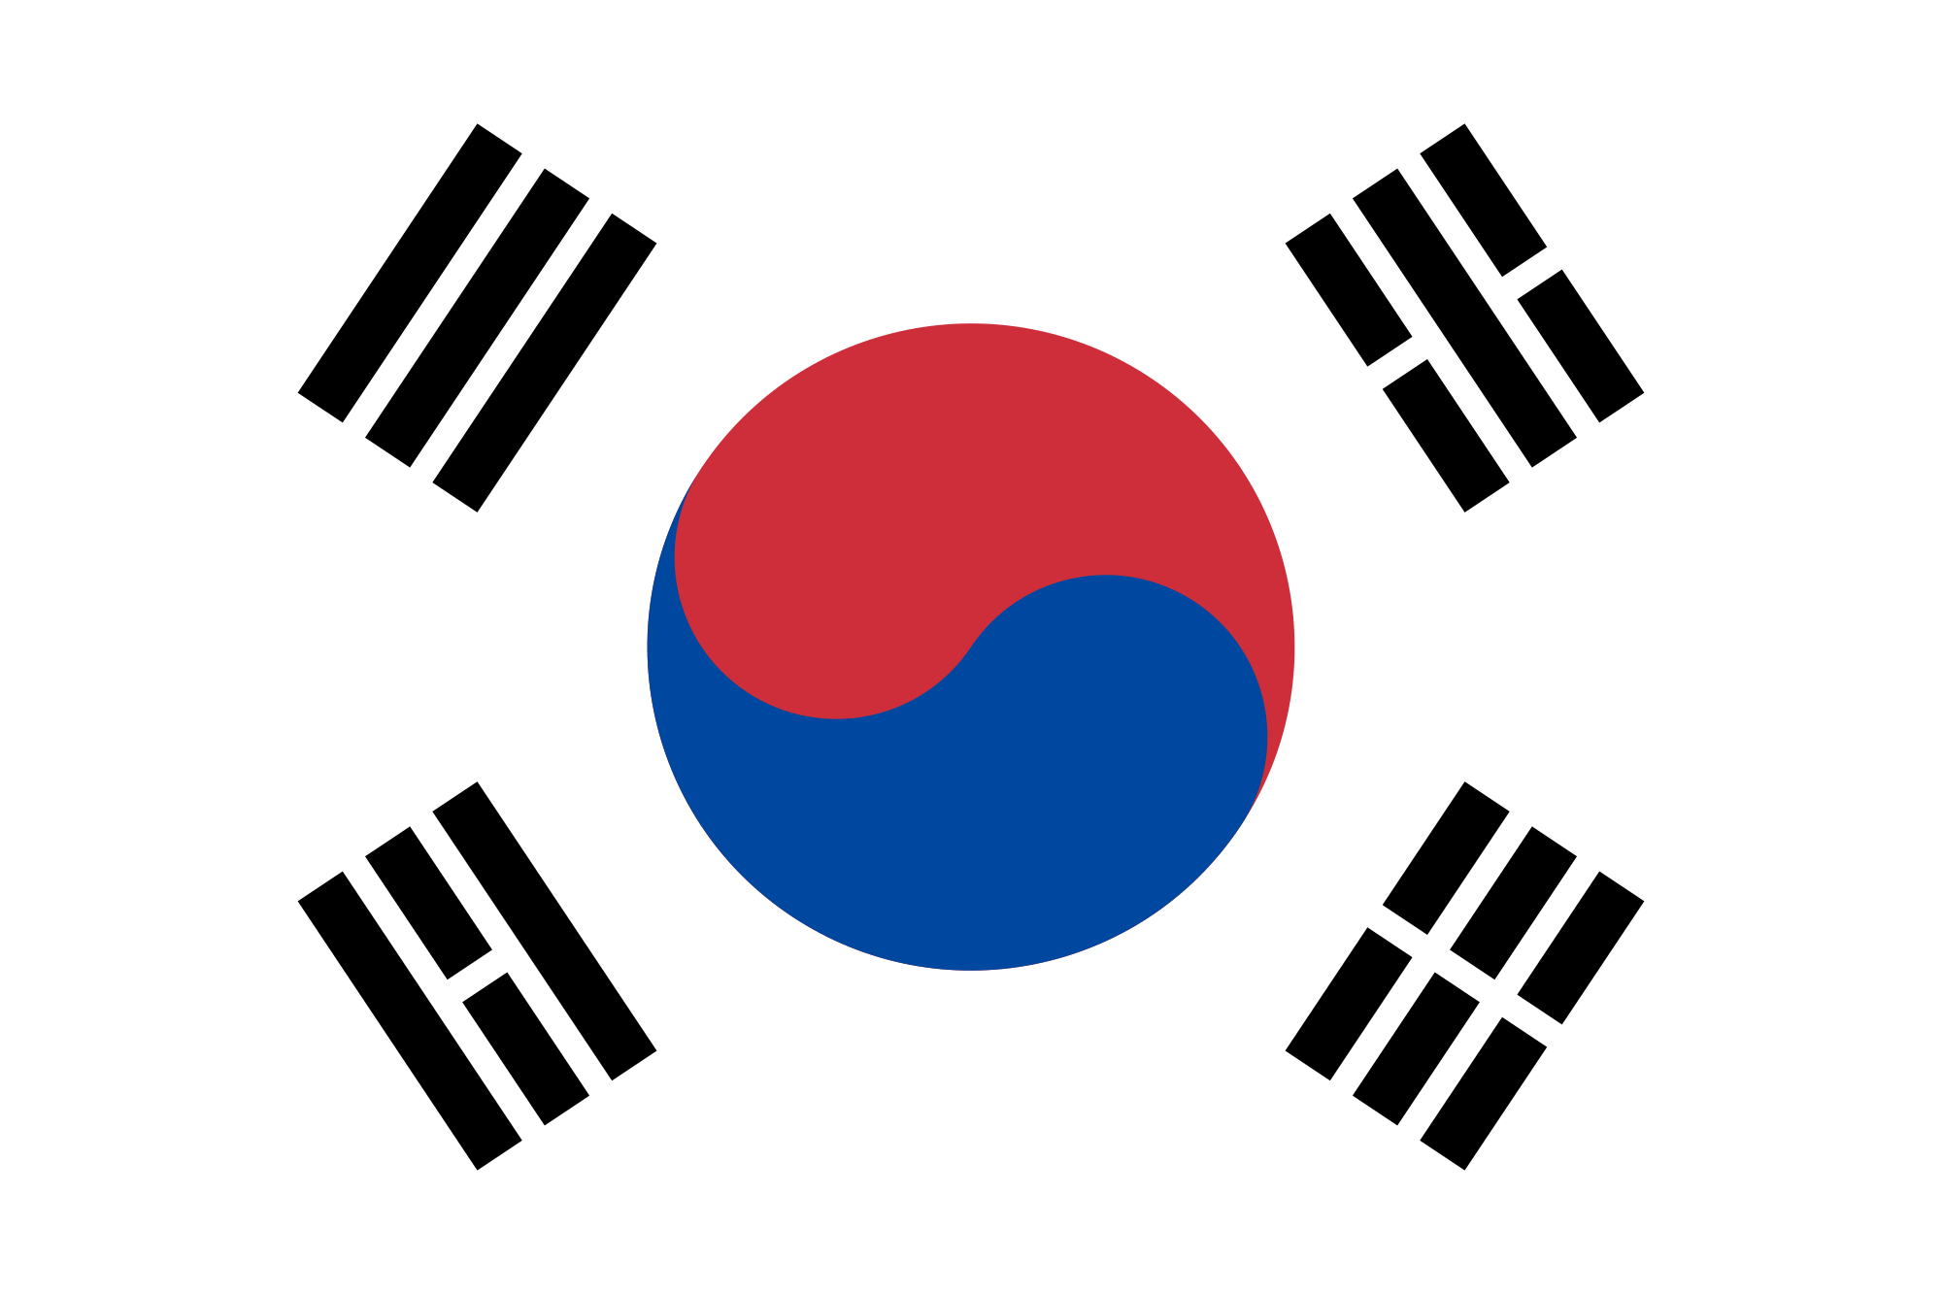
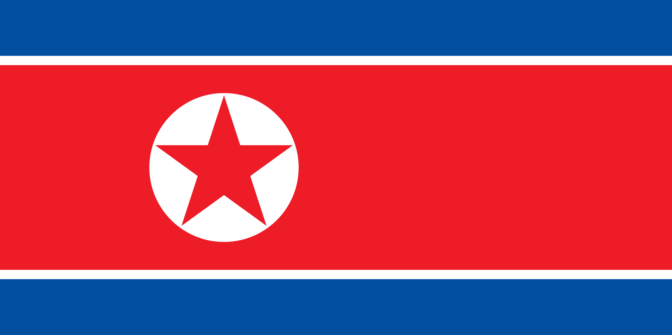
Korea’s History
Kaylee, Gadge, Emily, and Dina

Slide 2
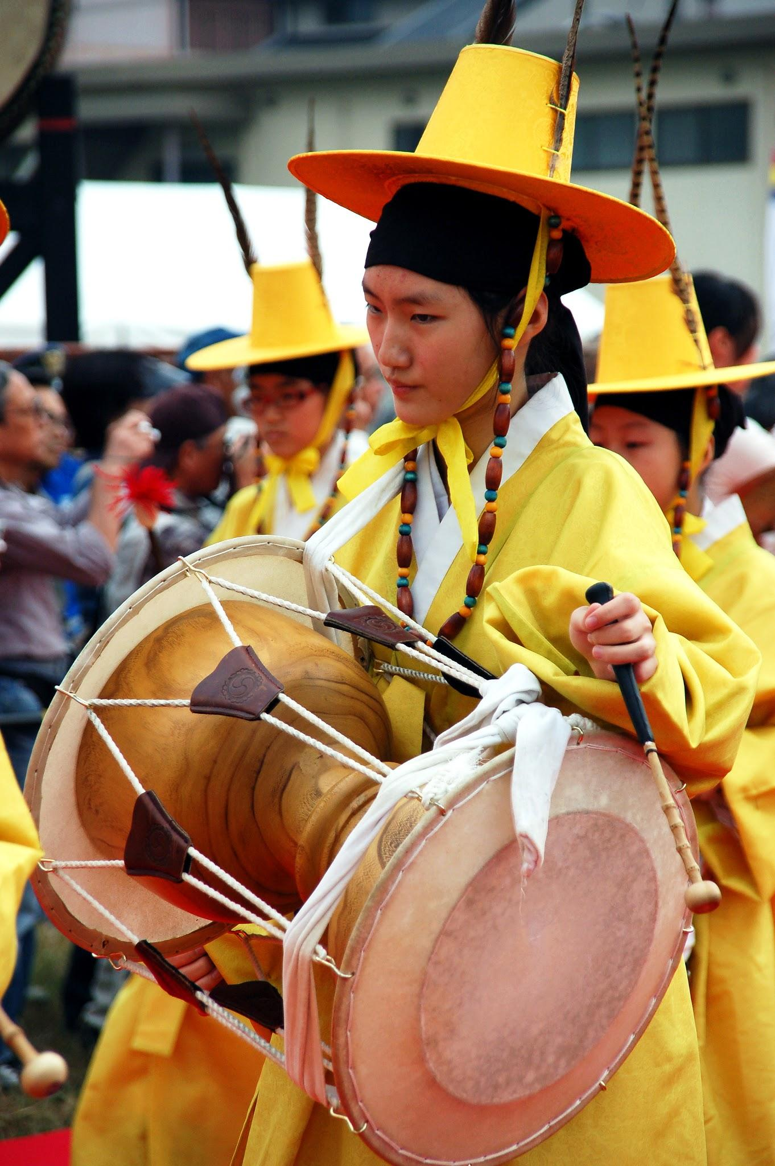
Culture, Art, and Language-
Joseon Era
Art- Koreans used traditional style painting in the early Joseon Era, but later on they started using the western style of painting to make it seem more real.
Culture- Koreans had many traditions religions, but the main two religions throughout this time period were Buddhism and Confucianism.
The Korean Tea Ceremony and Korean Gardens is also one of the culture changes during this period of time.
Language- Koreans had two languages throughout the Joseon Era, Hangul= normal Hanja= Rich.
Music- Music grew immensely with the help of inventions like the Janggu, a type of drum, and the gayageum, a traditional string-type instrument.
The Chinese influenced characters, symbols, mosaics, and glassware during this period.
Middle Korean was commonly spoken during this period and was based on the dialect of Kaesong.

Slide 3
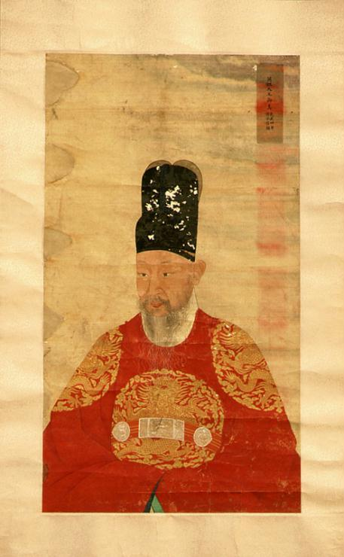
Politics and leaders
The government during the Joseon era was a monarchy
Leaders were divided into 18 ranks, from first senior to ninth junior.
One of the influential leaders was Taejo Lee Sung-gye who found Joseon dynasty in its ashes. He later repelled Wokou, and renamed goryeo to Joseon dynasty. He constructed the Gyeongbokgung palace as the seat of royal power.

Slide 4
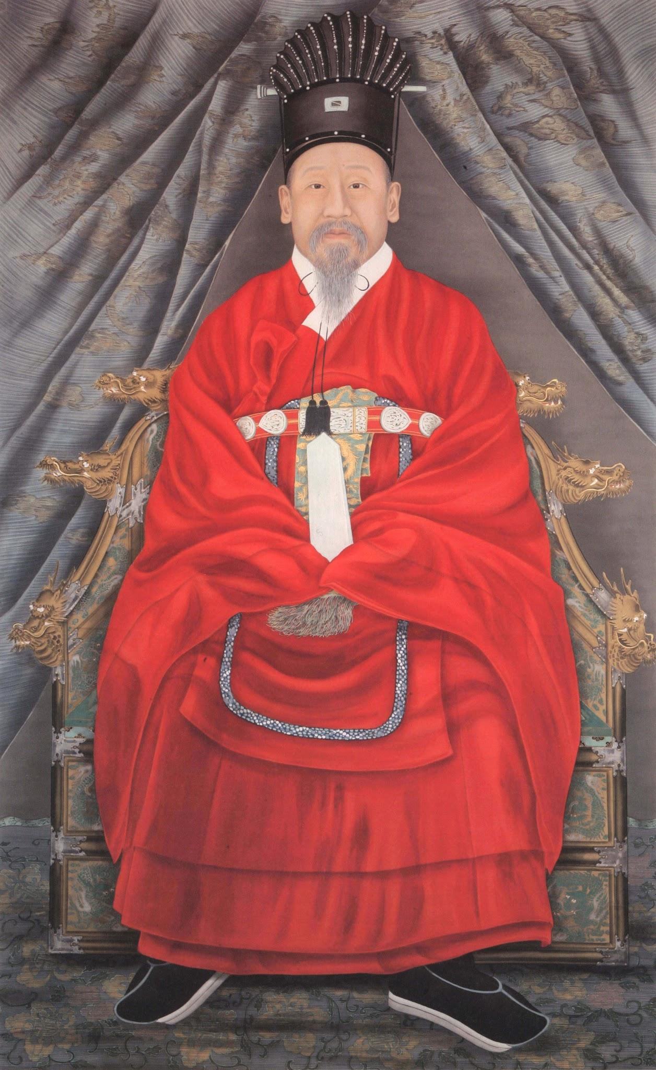
Social structure
During the Joseon dynasty, the social construct was mainly of 4 classes.
The highest class was the Yangban. This is mainly of scholars and military.
Next, was the Chungin. This consist of physicians, translators, and technicians.
Then, it is the Sangmin. This has merchants, peasants, and fishermen.
Last was the Chonin. They were public and private servants and entertainers.

Slide 5
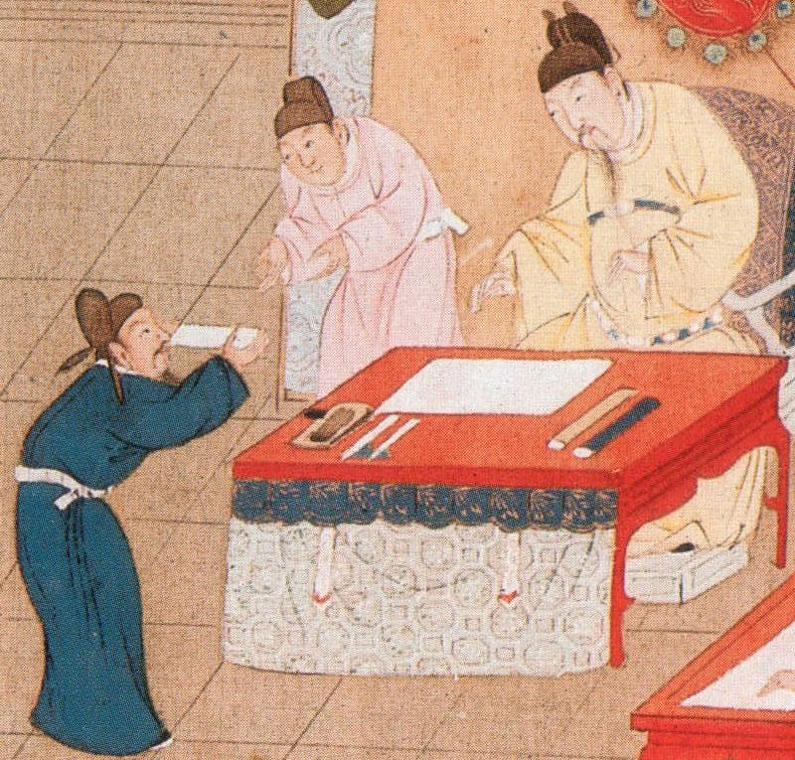
Inventions/ Industrial
The first rain gauge was invented in 1411 and helped with farming, weather, and also science.
The hwacha was a multiple missile launcher that helped progress Korea’s military.
Food delivery was also an important invention first recorded in 1768.

Slide 6
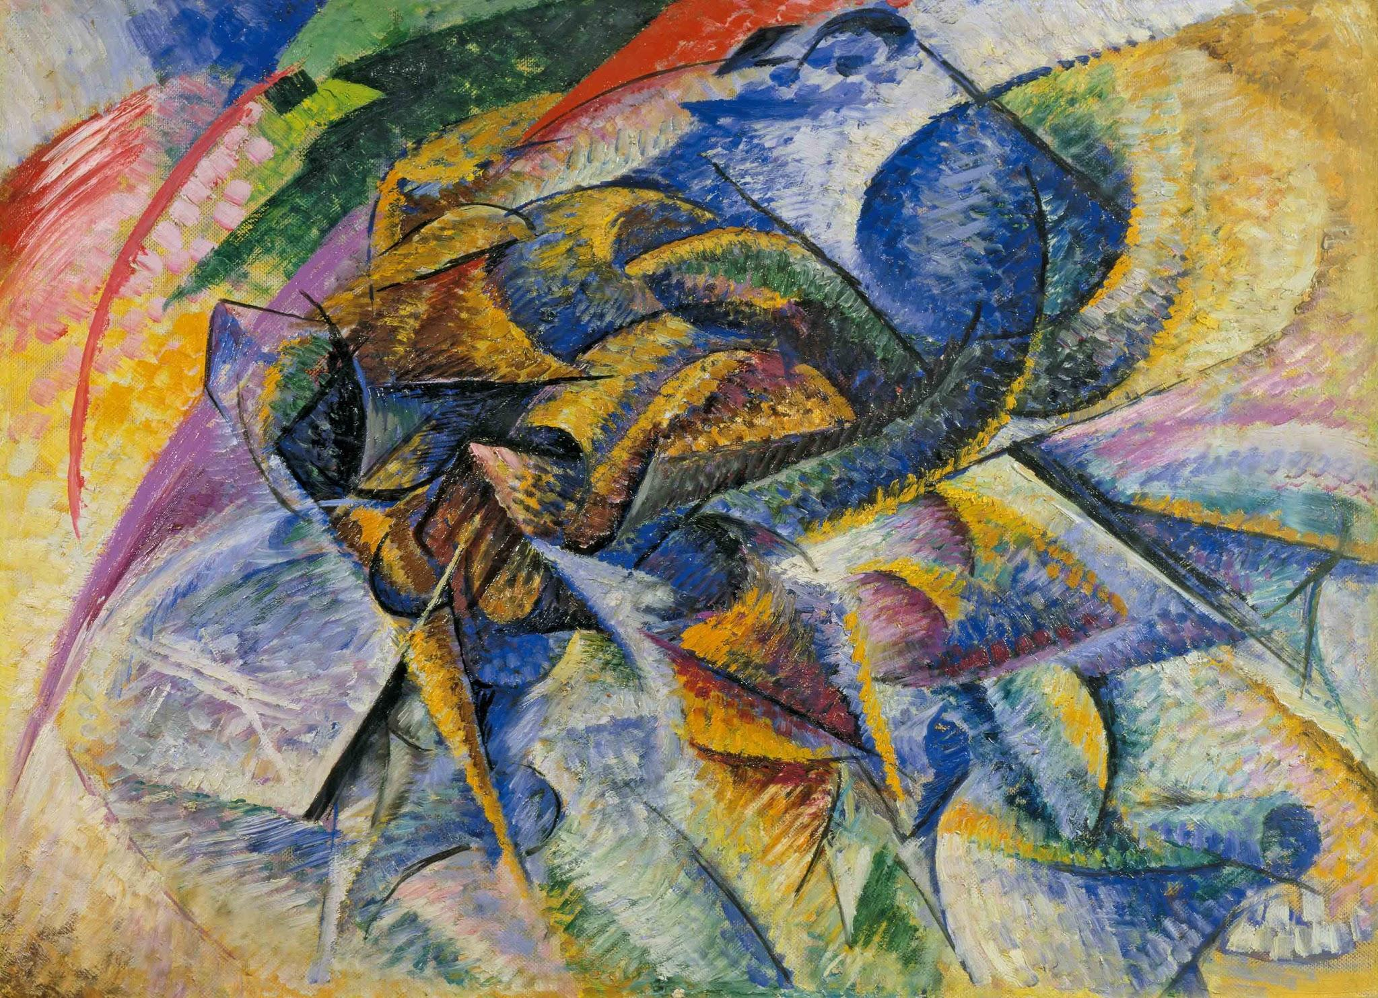
Culture, literature, and art-
Korean War
In the 1950’s, young artists started creating western abstract art.
Most music was based on patriotism, soldiers, and faith.
Abstract Art

Slide 7
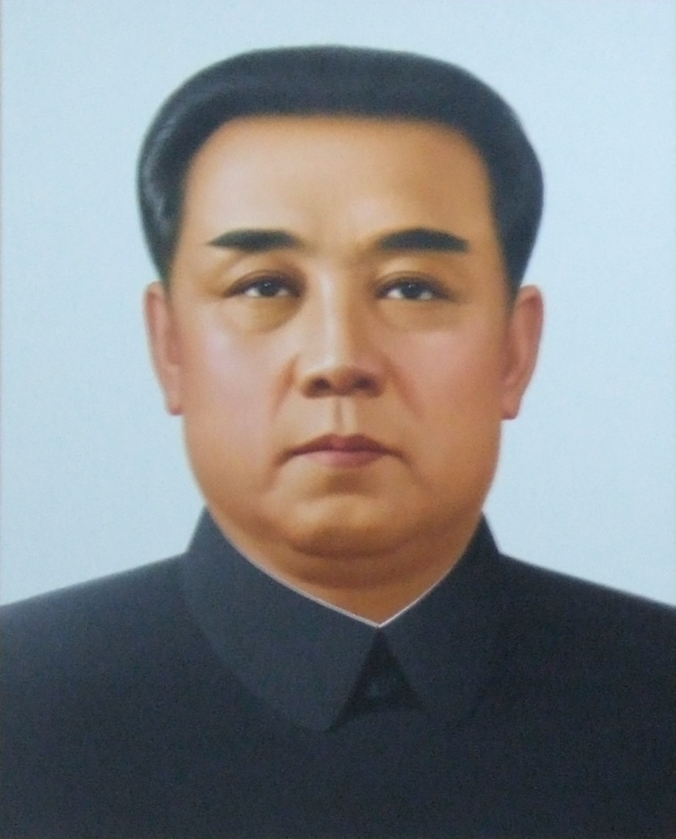
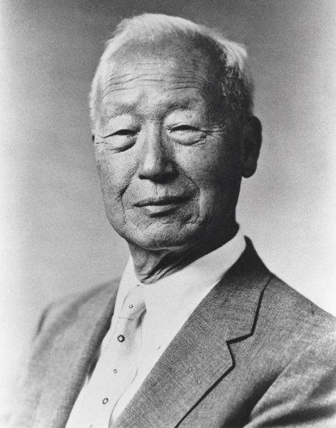
Politics and leaders
Kim Il-sung was the North Korean leader during the Korean War.
Syngman Rhee was the South Korean leader during the Korean War.
North Korea - Dictatorship
South Korea - Republic
Korea had to control their government as well as their employment rate so that they could be respectable.
North Korean Leader
South Korean Leader

Slide 8
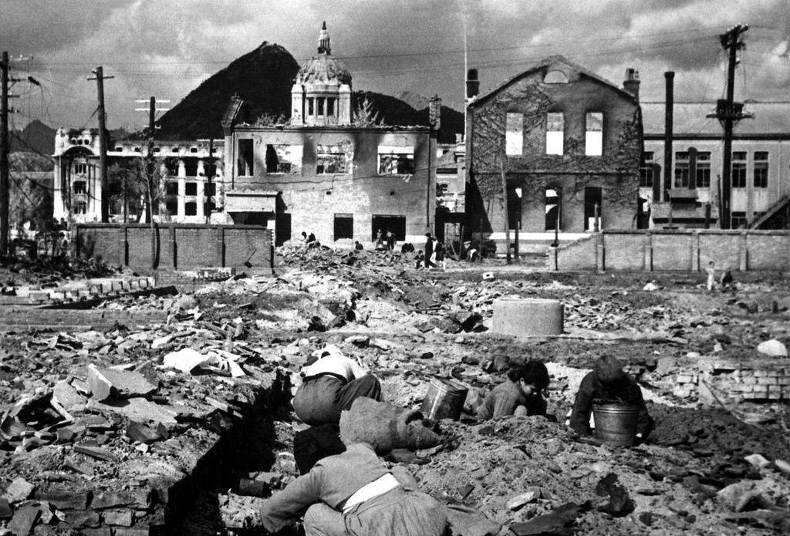
Freedom and Problems
During the Korean war some families had to stay safe and hidden.
Families had to gather enough food for the whole family, so they would sometimes beg for rice.
The North Korean leader had the war to try and set up South Korea into Communism. That decreases freedom for both North and South Korea.

Slide 9
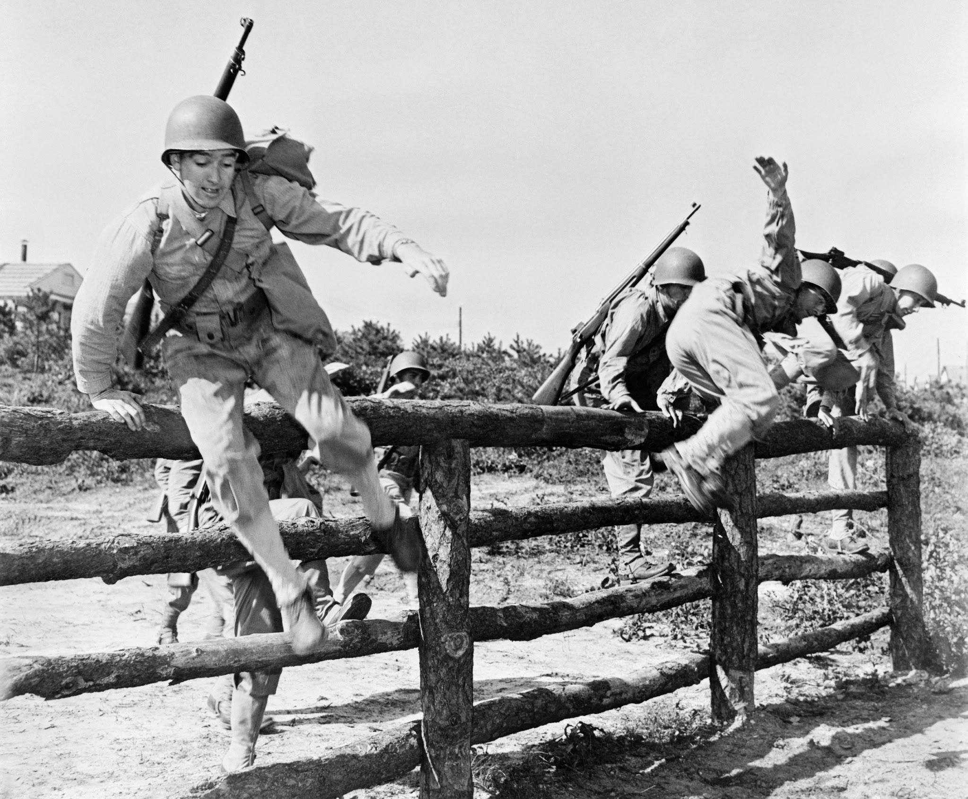
Inventions/ Industrial
During the Korean War, South Korea setup indigenous, or native, farms.

Slide 10
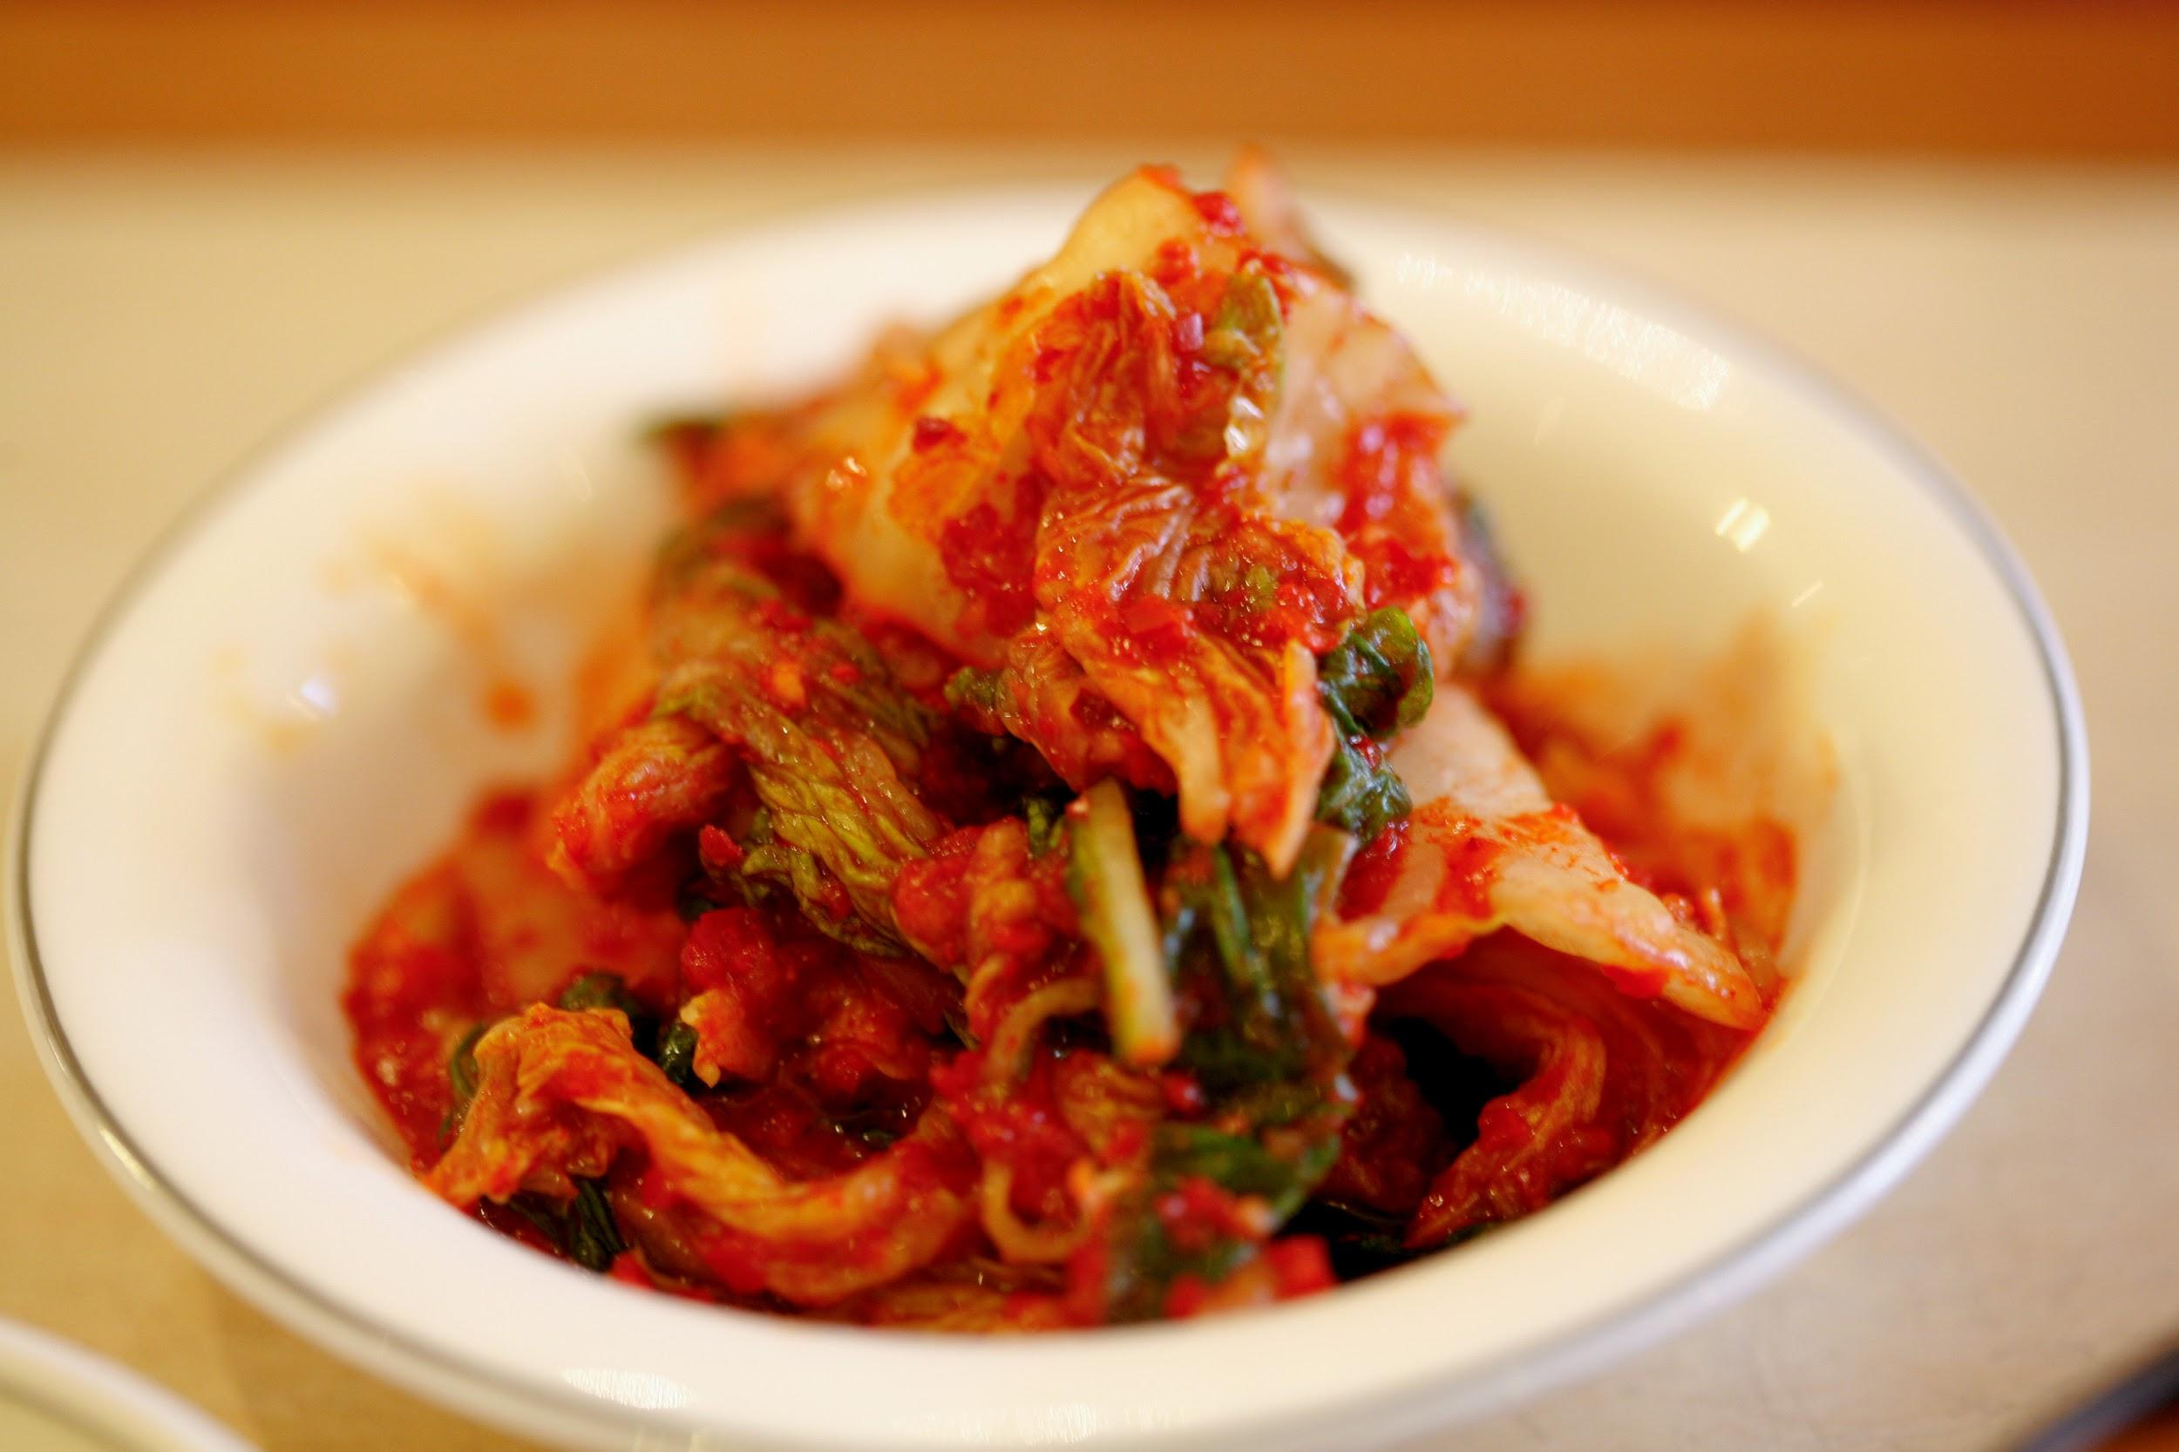
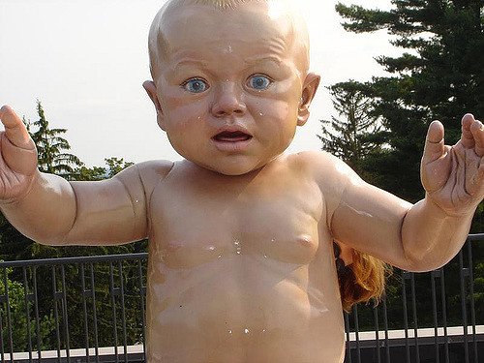
Thank You For Watching
나는 무엇을 모른다.
Je ne sais quoi in Korean
South Korea is the plastic surgery capital of the world.
Seoul is often considered to be one gigantic shopping mall.
Koreans eat Kimchi at nearly every meal (spicy pickled cabbage, the national dish of Korea).
An unmarried person is called a “Big Baby” in Korean slang.
In Korea, babies are considered one year old at birth.

Slide 11
Resources:
Korean History in Maps -
Lee Injae, Owen Miller, Park Jinhoon, Yi Hyun-Hae, and Michael D. Shin
New World Encyclopedia

