Slide 2
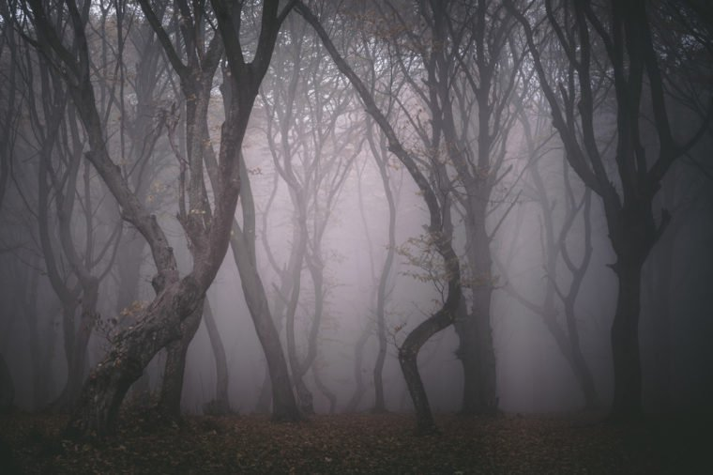
The Banderway
By Grace
Deep in the forest of Mirkanholm
Dwells the chival Banderway
Only seen by the rechus, roiling hobindrarves of Baskinnolm
He reeks of Nightinglade and bears talons of deathful Archinglay
The townsfolk came both far and wide
To catch a glimpse of the mighty Banderway
To see a stroke of his Mithriled- gold hide
But, alas!, they saw him not, and stayed only but a day.
As the tourists began to dwindle,
The mighty Banderway met his fate
With only the hobindrarves he would mindle
He would never see another creature glumph through the forest gate

Slide 3
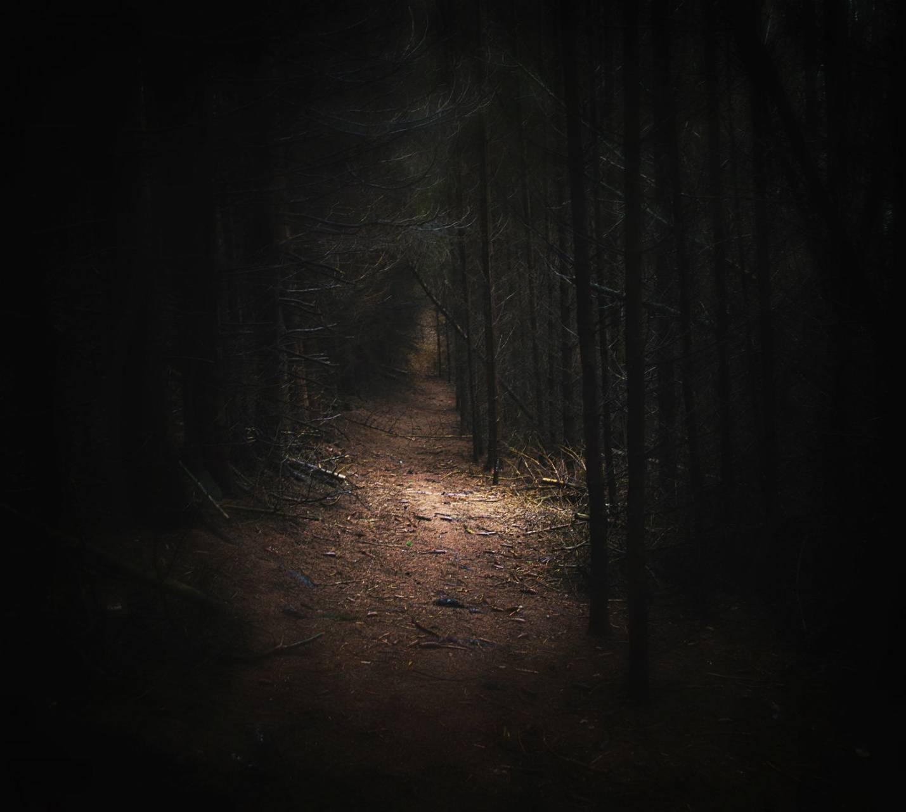
Gilwe gew
by Addison G.
Gilwe gew with plazke plong
Climbing climbing up the crolong
The rapito clinging an amonotom
Falling quile from the upitom
Hurry please go get help
We all heard the nasty welp
They should not have been alone
On that path of the unknown
But the children loved to play
Even if wewilly bonom is at stay
Broken blangs and crashing haws
Because they did not listen to what the climb would cause.

Slide 4
Walking to Skimbled
By Sydney
As I was walking I trimbled
Walking to skimbled
Snow falling on my feet
With my hands in my pocket with heat.
Slipping and falling on the floor
While eating my apple to the core
With me dressed in black
While holding a sack
I had arrived at skimbled
Once again I trimbled
While still dressed in black
Still holding a sack

Slide 5
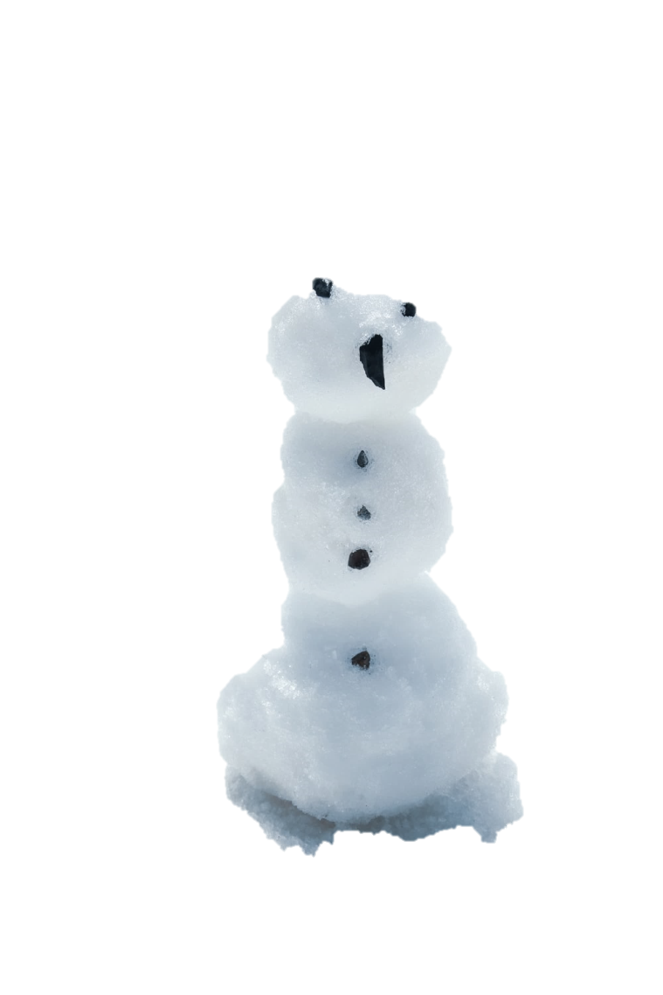
Jigity, Jokity Joe
By Sean
There once was jigity jokity Joe
Joe was not very nice he throws snow
Joe was once out playing with his sled
He fell out of the sled and there he was dead
The jigity jokity Joe was lying down not okay
The kids that were bulied by Joe chanted hurray
They thought the bullying by jigity jokity Joe was ended
The jigity jokity Joe was just playing Pretend
Joe got up and chased the boys around the yard
Joe didn’t know that one of them had a bodyguard
The bodyguard went after Joe and Joe ran
The bodyguard ran into a snowman

Slide 6
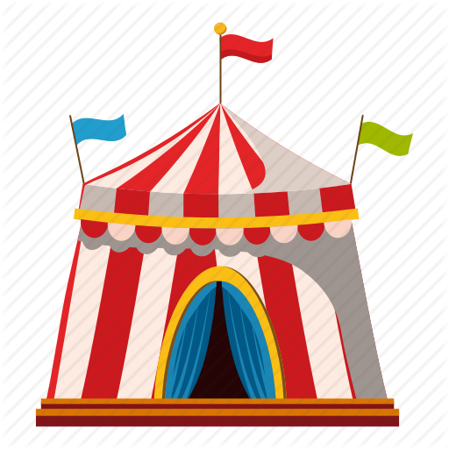
The Grenchals
By Mrs. Swaney
When the Grenchals came to Levencamp
The Fritzens blopped rechenly,
The dloops, the proops, and even the joops
Were chinging so trefrenly.
The circus came but once a year,
And the Grenchals were the best,
They floop and cloop and even moop,
Yes, better than the rest!
So when you blonk to Levencamp
Make sure you glomp the time
To see the dloops, the proops, the joops
Who loop, cloop, moop on flyme.

Slide 7
malack-achichi
Marissa
when the sound of the ocean starts to ring
the malack-achichi starts to sing
when the leaves on the trees fall
the malack-achichi starts to call
their big feet stand out
but don’t be fooled they like to pout
their big have really big ears
but they look small as it appears
you might imagine something big and scary
but their body’s are the size of a berry
when you are as small as me
they look the size of a tekelee

Slide 8
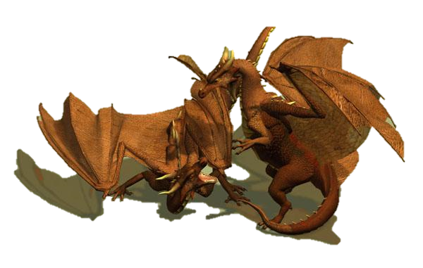
The War Dragons
By, Mason
The War Dragons were about to go outside to battle.
When they did they went boom, room, and doom.
They were firngerly, and tirngerly.
The 4 of them were not trying to mess up.
This battle came once a year.
The War Dragons weren’t the best.
They’ll always noot, scoot, whoop, and droop.
Still, they tried to do their best.
They would start war, and see how they do.
They made sure to gollup the battle plan.
They wanted to see them scom, tom, and don.
The War Dragons went onto nor, scor, and tor, to war.

Slide 9
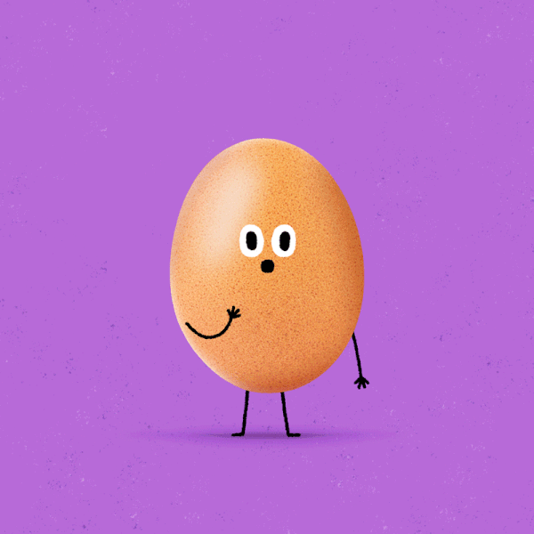
Hieu
Lily B.
I have an pet egg named Hieu,
He can’t see you,
Hieu likes to slumba*1,
Though he doesn’t tumba*2.
Hieu , my sweet little egg,
Accidentally rolled over and fell on my leg,
I then had to go clean up,
But I fell on a cup!!
I then felt sad,
So I went to dad,
I said Hieu had quied*3,
But he said that eggs moied*4.
1.Slumba- sleep for days
2.Tumba- fall over
3.Quied- to die
4.Moied-getting old

Slide 10
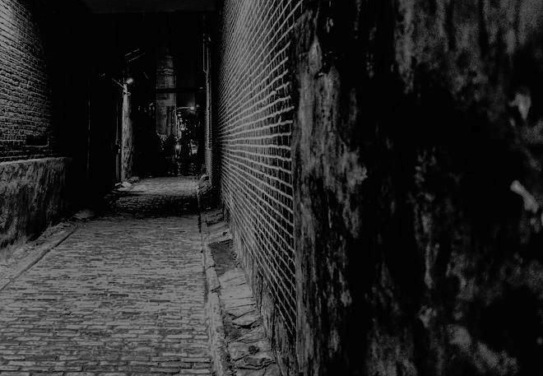
Lights flashing down the alley
I turn ready to go down the alley
But than a wise man comes
He tells me that there is somebody back there
However I didn’t listen
I was young and immature
As I walked slowly farther down the alley
There was a deep scary voice
Sredle Thgir
Gnol Daor Tsomal Erehtoice
Then I went further and further
The alley was very long
Next I got close enough to see something
It was a huge shadow
Now I finally made it to the end of the alley
And I saw a very tall man with scars on his face
But he was very nice he just looked scary
That day I learned a lesson Reven Egduj a Koob
By it’s revary
Beware of the Alley
Jace

Slide 11
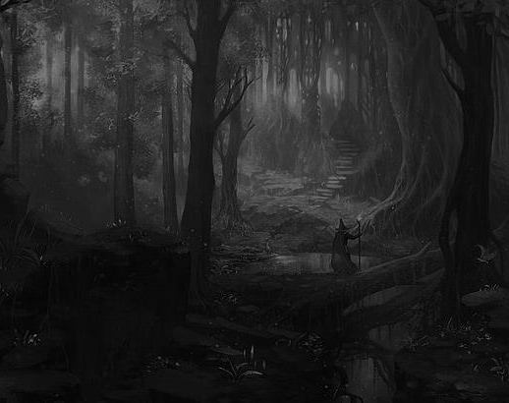
Willabee, Wollaton, and Qwen
by Aubree
I skipped through the turning trails
Beside the bright green grass
Through the forest of the great wizard tales
Which I had heard as a young lass
My parents were both goldsmiths
They’d told these stories again and again
I didn’t believe these bizarre myths
Not now and certainly not then
From generation to generation these wonky stories spread
Tales of wizards named Willabee, Wollaton, and Qwen
One story I remember was a story of a shed
Where Willabee and Wollaton found a wild Walzian

Slide 12
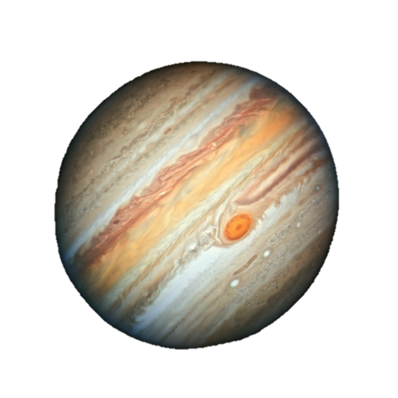
Ode to Glorbok Ghunk
By Will
The Glorbok squinkle the Jupiter
Ode to glorbok ghunk the cat
Glorbok dis ‘tis stupider
Came to Jupiter that’s that.
Nambiba dis the glorbok doe
Nambiba rule magnum vans
Glorbok hate like foe
Ode to da nambiba sans
Hyperdawg like glorbok bro
Glorbok tragic against bat
Nambiba Is dab tho
Glorbok is like tac

Slide 13
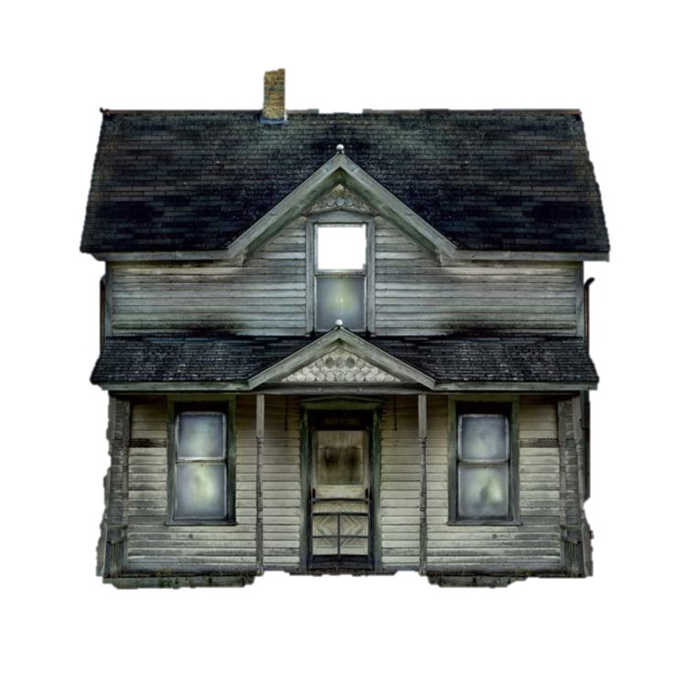
The Crockel
by Bryce
The Crockel came thrumping
Down Sorgalback Lane
To see someone krumping
A big yellow frame
He said in a voice
As soft as a mouse
Lad what are you doing
There by that old house?
The Crockel stood there in such delight
Crinking and Cracking in the cold cold night
He said to me with the eyes burning low
Am I with you now or are you alone?

Slide 14
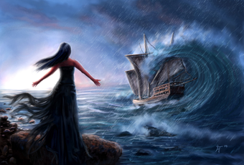
The Siren
By Kaden M There is a treacherous creature known as “The Siren”,
The monstrous creature is as tall as a tree.
Beware little ones for its prey is children,
If it catches you it will not let you free.
The creature mainly travels at night,
Some say the creature is fake.
But it is indeed real and will give you a mighty exceltight,
Every non-believer was not awake.
The Siren can pick up any broadcast,
It can be extremely sinydroud.
And is very snekalast,
Wittinesses advise to stay in a crowd.

Slide 15
The Crobater
Mara
You’re on a big cruise at night
Then the Crobater starts to fight
He biggles his claws
And he meaks his maws
You then start to scream
But he starts to beam
He lets out a roar
your ears go sore
You hide under the covers
You start to quake and shover
He says “ I’m crobater, I’m not mean”
And finally, you became shein

Slide 16
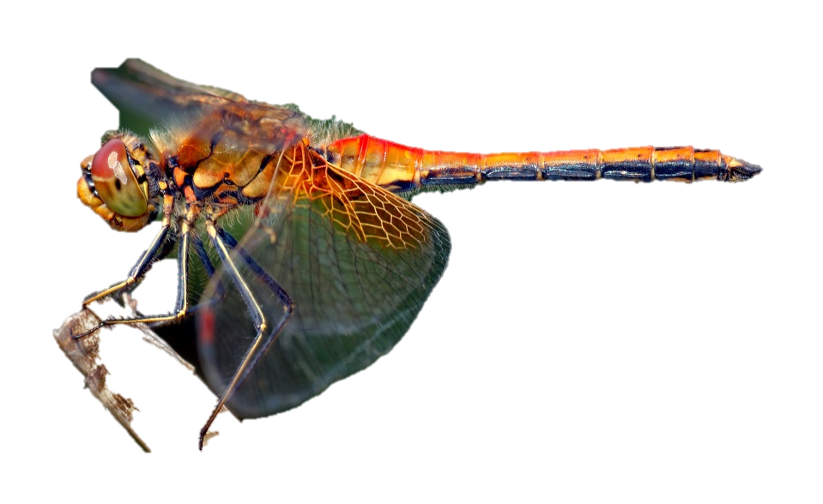
The Dragon Fly
Jackson
There was a little old dragon fly.
He went bump bump bump.
They soon found out.
That his head was a rump.
He flew round and round.
But not without a bang
That little old dragon fly
Was quite a tang.
That little dragon fly never gave up
He fought through thick and thin
There was something that nobody knew.
That he was tough as gin.

Slide 17
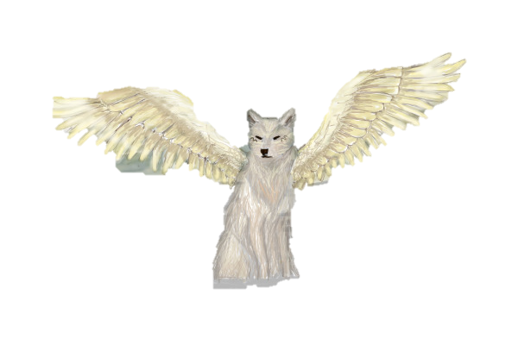
The owolf
An attempt of a poem
by Dillan C
Beware the owolf, a terrifying creature.
It has an owl’s wings and a wolf’s every feature.
It will swoop down on squirrelny and in a flash.
Pick it up it’s prey and upon which, it will snack.
The owolf sleeps in a trave
Once a tree, became a cave
When it comes out at night
You can hear it's who-owl just out of sight
So beware of this beast of fiction
Or is it real, just outside your field of vision?
Nobody can say
But if it's true, we can safely say
It never would come out in the day

Slide 18
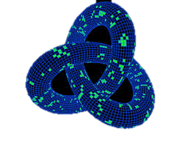
The Loops
by Kyra
Oh, how the loops floop scoop and goop
They never stop cause their made to loop
Oh, but the loops bop dop and wop
They never stop cause their made yop
Oh, but the loops rell dell and yell
They never stop cause their made to gell
Oh, but the loops tou sou and qou
They never stop cause their made to zou
Oh, but the loops rin kin and zin
They never stop cause their made to xin
Oh, but the loops tet net and fet
They never stop cause their made to het

