Slide 2
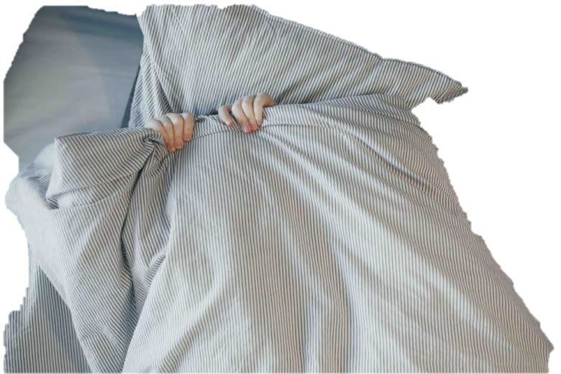
Jules
Alone the little boy lay, in his bed skizzle and soft
While in the room the heat pipes will cough.
He hears a pair of feet helumphing down the hall,
Then the scurrying of something small.
The boy got slightly frightened and ducked under his sheet,
As the footsteps got closer, with a wazzasofting beat.
The little boy did not know what to do,
He couldn’t stay focused or think anything through.
Then he remembers something his mother told him.
A story of a monster tall and slim.
“This is the Momowey that walks through the halls,
Making an odd sound, like some sort of call.”
“He will enter your room and watch you in bed,
And by the morning, he will have fled.”
“OH NO,” cried the little boy knowing that the monster was fozzockling there.
“PLEASE DONT COME IN,” he shouted with a blare.
His mother entered the room and said “my son, are you okay?”
The little boys mind then went grey
“I thought...I thought that the Momowey was after me.”
“Oh silly boy, the Momowey isn’t real you see.”

Slide 3
The Thinkemido
Maddie M.
There’s this Machine I made
And it’s called a thinkemido
The name may seem silly
But for a kid named Billy
It’s pretty helpful
The thinkemido is a wonderful machine
It helps you think when you cannot
Or when you have writer's block
The best part is when you need it
Just flip a switch and it will read it
This is a wonderful amazing thing I have made
Even for my friend named Jade
ForJjade is the smartest
And may have no use for the thinkemido
But even the smartest face the hardest
Challenges in their way
So next time you're stumped you know what to do
Just flip the switch for your thinkemido!

Slide 4
Hubbas’ Glob
Trent
The Hubbas spoofed some wacky glob
It was a spicky spocky job
Hubbas whook the glob for days
Until there was a loopy laze
Hubbas’ glob was the best
It was chewier than the rest
They blew bubbles all day, all night
It was really such a sight
Hubbas’ glob was well known
People would spalk about it on the phone
Far or near you know this glob
Because it was the best in Pob

Slide 5
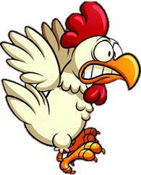
The Joinkers
By Wesley
The day was nunsy and the sky was luboo.
The joinkers sose with the dorning mew.
Creating humbagers is a therious sing.
Each joinkers had spumthing secial to shring
Along the way was a bload rock ahead
A dashamagoo was teprending to be dead
It’s syes we’re doselec as it laid on the road.
Beside it doots an sounarone toad.
As the joinkers rame cear
They saw what was true
The dashamagoo bad hen kcurts with fear
It was deracs of toads!

Slide 6
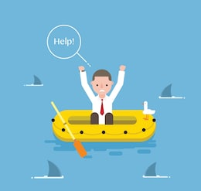
The Sea Sharks
by Isabella
As the Sea Sharks start to fall
The Fishers begin to call
As the Sea Sharks swim up to the boat
The gengerea start to croke.
The Sea Sharks eventually swim away
But one of the fishers refused to stay
As one of the sharks heard a splash
They turned out and started to dash
As the fisher swims away
The shark gets in its way
The fisher knew today was the day
That the gengera was going to bite the shark and make it run away

Slide 7
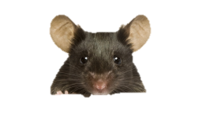
The Lerkim
by Casey
There was a story once told by a man so old
The man was a lerkim and didn’t speak much but what he told was not bold
The story was about a tootche who haunted a house
The tootches were very sneaky and as quiet as a mouse
People were scared people were nervous and some were even sad
The lerkim old man was very surprised the tootches came back but was glad
The lerkim got out of his house and praised the tootches
The people said stop but the lerkim wanted smooches
The kids were hiding not very happy the lerkim betrayed
The lerkim old man took one of the kids to the tootche and yelled “hey”
The lerkim put down the kid and started to grumble and he sounded like a kootch
The lerkim old man turned to the town and yelled I AM A TOOTCHE!

Slide 8
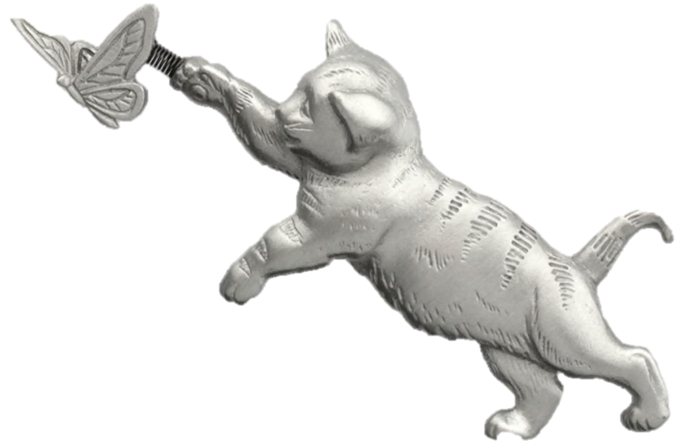
Amos the Cat
By Cael
Once there was a cat named Amos
Who loved chasing flutterbyes.
He dreamed of going outside
In the wind chasing birds and flutterbyes.
He stands in the window frame
Waiting for his time.
He sees other cats
Chasing after fringlehoppers.
He thinks about all the animals he can chase
Like flutterbyes, fringlehoppers, tinglewoppers,
And, if he can find one, even a ringletopperds.
That’s what the cat named Amos loved and wanted to do.

Slide 9
Elijah M
Crack, thump, cadum, cadum.
Squeak, creak, crackaladoo.
Pitter, poggle, patter, poggle.
Yelp, yoo, yack, clack.
Strike, boom, bash, dash.
Dash.
Dash.
Dash.
Here we go again.
Step, walk, stride, stride.
Open the gate wide.
It starts to rain.
Quick get inside.

Slide 10
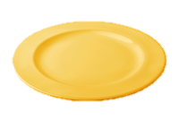
The Humplesnackers
By: Hailey
One niverlla I ended up at Humple Subble
The subble right down my gerzap
They shavoovled me right azerd the chaichle
And thugled me to the shurblap.
They tossed me a plate
And a napkin and a coke
It is time to eat they said
The Humplesnackers spoke.
For lunch I had a sniperbaf
And then a fump or two
I was already full I said
The Humplesnackers knew.

Slide 11
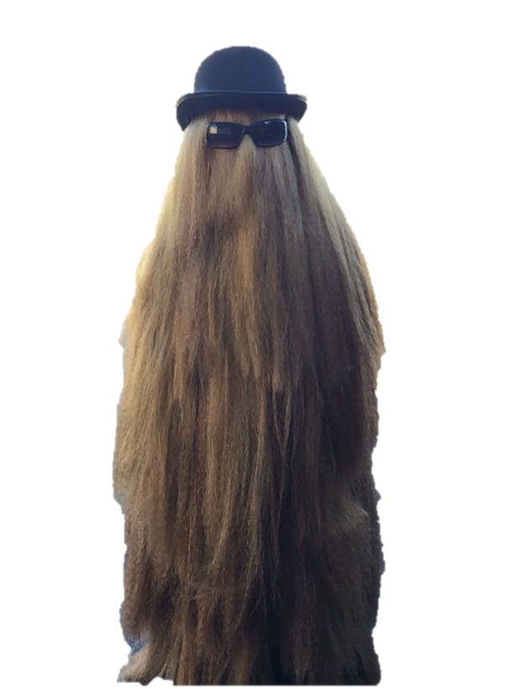
Kelan
Globbys family is so scared.
Big and fluffy oh so scarce.
They haven’t seen Globby’s
Hair like this in years.
They asked Globby what did you do?
Your hair is so weird
Sticking up everywhere
And you smell like a bear.
I stuck my claw in the wall.
They giggled and said,
you electrocuted yourself with your claw?
Only one claw.
I giggled back and said, I wanted a new hair due.
Fluffy and big,
then they went on with day
talking about his hair
and how fantastic it looked.

Slide 12
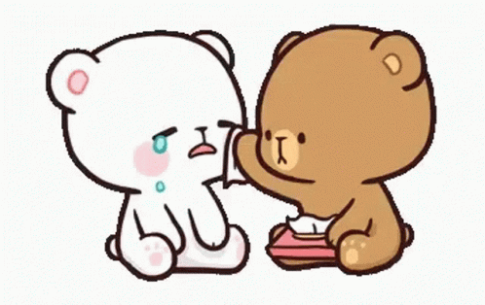
Addy T.
When you meet a kalabala,
You see the balabala.
The worst of meeting a balalalaa
Is that you can’t tell the awful things of the kalalalaa.
They are quite violent,
That is if you resent.
Just allow the qauntiminity
And they will be hapoininity.
They can sense your toafalan,
Just stop the crying and the erafalan
“You will be safe”, says the zerofine
Just follow along the rollerfine.

Slide 13
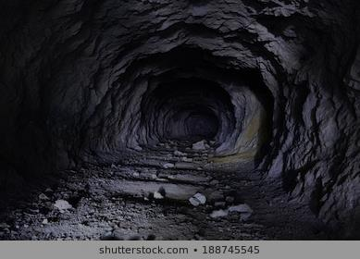
The Pittsmith bazerk
By Kylie K
In his cave bazerking and perking
Was the Pittsmith bazerk eating his sherking
No one would get near him for the fear of being shaboodled
But the Pittsmith bazerk was scared of them out of fear of being kaboodled
Neither of them would cross into the others land
Because man were scared of bazerks and bazerks afraid of man
One day the Pittsmith bazerk decided to make peace and leave his cave
He started to head north to the village with his tail held brave
The people went to his cave to give him a peace offering of sherking
They expected to see him but when they got there no one was lurking
While they were sad, the bazerk had somehow ended up in the city cottonmouth!
Then bazerk was sad that he accidentally went north and not south!

Slide 14
Preston
There once was a hyper piper
Who lived in the old farmhouse
Hyper piper always wanted friends but she never seemed to fit in
She would get as lost as a possum would be trying to find friends
One day she wanted to play catch but she didn’t know she had to fetch
Hyper piper was told to get lost so she got tossed
Then she got chilly on the very cold day
So she got frostbite while she was being taught to not get caught
Hyper piper wanted friends not pretends
She wanted to have a family not a fantasy
Even though she didn’t have family she had me
Yes it might be tough to be in the rough but it is not close to hyper piper

Slide 15
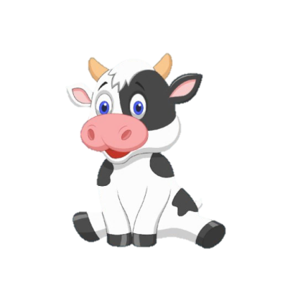
Kenzley
Gangkong are quite the sight
They can run, fly, and most can Skype
Don’t be scared they fly at night
This special gandkong can even type
Broviac was a normal dog
He was a special dog he hopscotch and jump roped
But one day he woke up with a something in his throat a frog
Broviac learned to cope with the doped
He sounded like a true Gandkong
He’s fast prong now
He learned not to eat things that sounds like a dong
Ps. He sounds like a cow

Slide 16
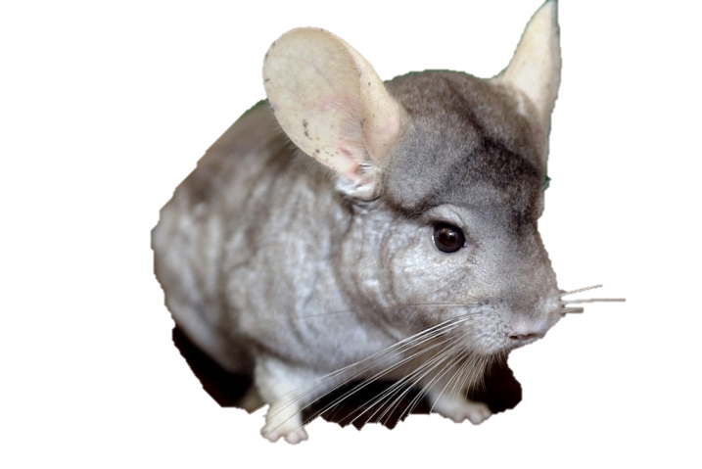
Ayden
She comes to the cage
To beg for treats
Her perch is like her stage
Upon the place we meet
“Tasseled whoopie gong!” we call
She runs around and around
Gardner Menchu don’t you fall,
He’ll hide until he is found.
As we go to sleep,
They do not rest.
To their games they keep,
A very long night to test.

Slide 17
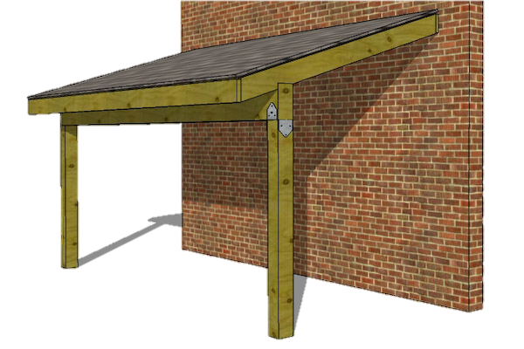
The Floopers
McKinley
When the floopers arrived in Rukeydo, Adamana
The scrapers were angry and threw a fit
Floopers flopped and scrapers had a fradamana
Then the groppel-dingers got a big hit
The groppel-dingers had harpalantas
Then the scrapers himlaned and jumped off the roof
The floopers cried and played the paralantas
The groppel-dingers gave up and went poof
The groppel-dingers left the scene
Then the floopers when and found a bean
The bean was big and the scrapers were mad
But then everyone was fine because they realized they were being bad

Slide 18
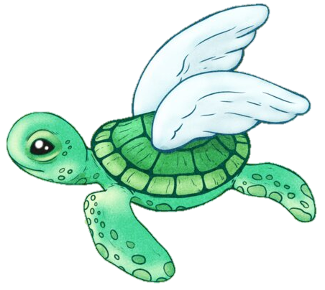
The TurkTurtle
By Spencer
The TurkTurtle lurks in the evening.
It has a turtle’s shell and head with a turkey’s legs and wings.
Beware of the TurkTurtle as it can fly like banshee.
It will holler like a screaming baby.
The TurkTurtle preys upon noodles
When the kids are doing doodles
When it comes out to feed
Don’t take your dog out on its lead
Steer clear of this creature
Unless you don’t believe in the dark?
Believe if you want or sit on a bleacher
As for me, I’ll sing like a lark

Slide 19
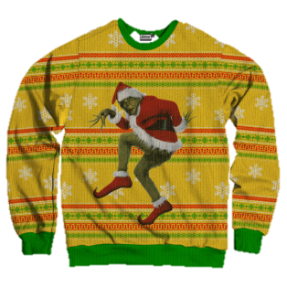
Zoomyroomy- likaboo
Julianne
Don’t go near a wild zoomyroomy- likaboo
They are dangerous like a kangaroo’s
Zoomyroomy- likaboo’s are baby pupadinaboos
Zoomroomy- likaboo’s like to cuddle when they are tiredaroo
Zoomyroomy- likaboo’s don’t like to be without you
Zoomyroomy- likaboo’s like to lick you
Zoomyroomy- likaboo’s like to race you
Zoomyroomy- likaboo’s like to sleep too
Zoomyroomy- likaboo’s like to wear sweaters
Even though it's not the middle of winter
Zoomyroomy- likaboo’s love to get letters
Zoomyroomy- likaboo’s like to use your printer

Slide 20
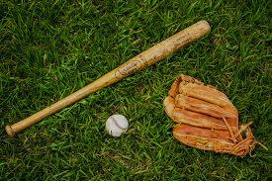
The Changlers life
Lathan
Has been a real zife
It hasn’t been the best
But he’s moving to the west
He plans to be a hunter
But might be a bunter
Maybe playing baseball
But also be a real fall
But if it doesn’t work out
The Changler will bout
If he does get caught though
He shall go below.

Slide 21
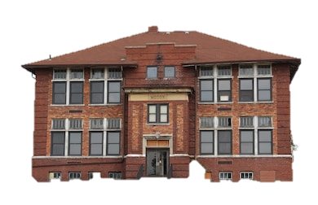
Drew N.
Silly willy was running down the hall,
Until she had fallen on a ball,
Silly willy wasn’t tall,
But at aw she wasn’t small,
Although she wasn’t tall,
She still thinks that she is small,
Jilly Willy is her sister,
So silly gave her a blister,
Mister. Lakes was their teacher,
Jilly found him sitting in the bleachers,
He had his hands over his head, jilly thought he was sad,
But he was just mad,
Because his students were making him frustrated,
He waited patiently for his students to stopping talking,
When he started walking to the office,
When he got to the office he cried,
He tried his best to make them be quiet,
But they wouldn’t listen.

Slide 22
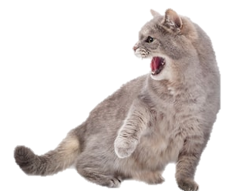
The First Restaurant Menu
Anna
There were oak dillies and tarts
And marshmallow farts
Pints of pink panters
And large yellow thanters
A big purple bullseye made of eggplants
And pies upon pies served inside pants
Something grey and gooey
Beside something that went mooey
A lot of little canterbats
Being eaten by large cats
Everything was on its way out
And all the food was wiggling about

Slide 23
Cryzalbalz
by Camden
Cryzalbalz falling from high
Cryzalbalz falling from the sky
Ploppity plop ploop on the ground
Whippity dip droop on the mound.
Cryzalbalz turn into pluff
Cryzalbalz make a lot of fluff
Pfoof whoof pfoof through the air
Whoosh moosh floosh everywhere.
Cryzalbalz go away
Cryzalbalz pick another day
Wham blam outta here!
Pow pachow no more fear!

Slide 24
The Dinglesnart
Caleb
The dinglesnarts are absurd creatures
But they have a lot interesting features
One can look like Servious Snape
And the other may wear a cape
I came across a dinglesnart one day
He held up a sign that said “please stay away”
So I moved my feet in a backwards motion
But then I smelled a smell that smelled so potent
It was the dinglesnart that smelled so bad
It smelled like a sweaty skater that says “that was rad”
So I plugged my nose and ran away
And I haven’t seen another dinglesnart to this day.

Slide 25
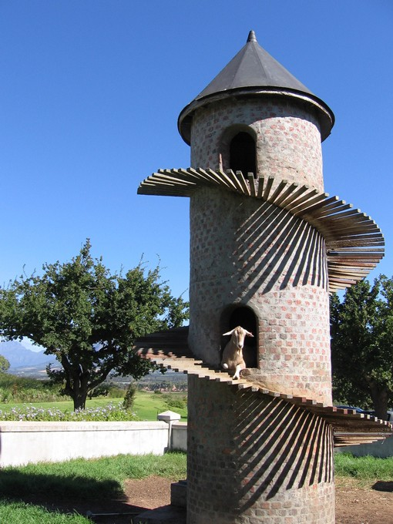
Nonsense Poem
By Michael
There once was goat
He liked to loat in a moat
He was a kind king
He liked to sing
The goat was shrong
The goat was also tong
Till one blueish day
He swam with his buday
Then the goat was eaten by a lion
The goat was really cryin
His castle was drowning with sorrow
And then they waited till tomorrow
The next day was the funeral
The people created a mural.

