Slide 1
Plagiarism
What’s the big deal?

Slide 2
It’s a school rule
with consequences.
D. Plagiarism – Representing the words or ideas of another as one’s own in any academic exercise. This may include direct copying, but it may also be more complex. Plagiarized material may appear in a student’s paper as word-for-word copying, a summation, or a paraphrase of another’s ideas. A student has plagiarized whether the material from another source has been taken in whole or in part without properly citing the source of the material.
Pleasant Middle School Handbook

Slide 3
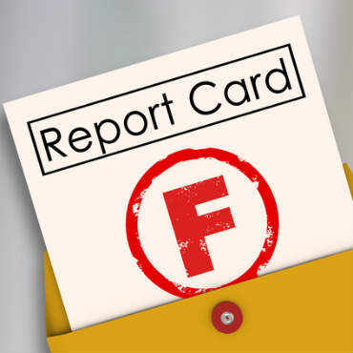
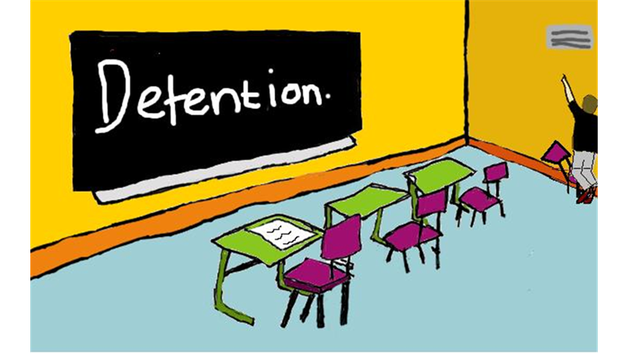
CONSEQUENCES

Slide 4
You could lose your job.

Slide 5
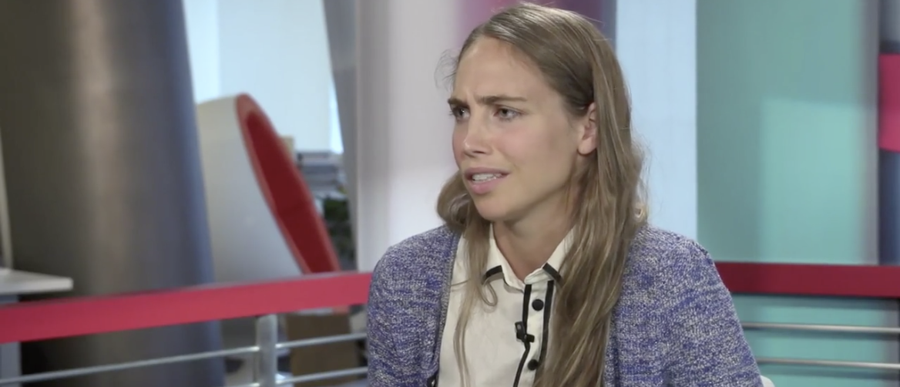
Lizzie Crocker was forced to resign after she copied and pasted several paragraphs from an article from the Weekly Standard without citation or attribution.
As the investigation continued, there were other examples of plagiarism.
CROCKER ARTICLE
NBC NEWS COLUMN
No one wants to think of someone they love, or anyone they know and respect, as a monster. But in the wake of the Weinstein allegations, as more and more people have come forward to detail their stories of harassment and assault…more and more people are having to ask themselves, as … “Can you love someone who did bad things?”
No one wants to think of someone they love, or anyone they admire and respect, as a monster. But as more and more people come forward with stories of harassment and assault, more and more people are having to reckon with this conflict.
The Daily Caller

Slide 6
It’s Theft!

Slide 7
https://www.youtube.com/watch?v=hJipA52LOms
https://www.youtube.com/watch?v=5aC6qT8WB8c

