Slide 1
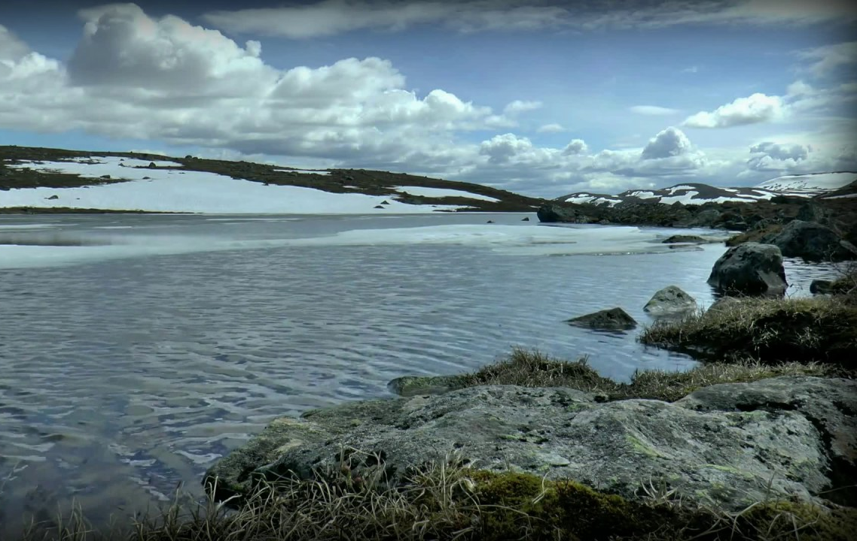
Some poems
I like

Slide 2
This first poem is a poem I learned from my mom.

Slide 3
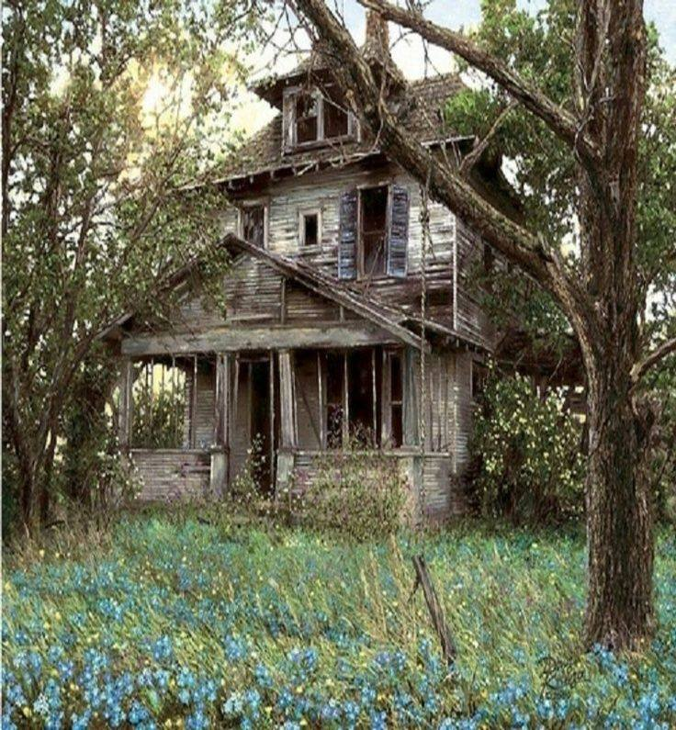
The House with Nobody in it
by Joyce Kilmer
https://www.youtube.com/watch?v=lI4TULIXHbY

Slide 4
Now try to read it yourself with expression.

Slide 5
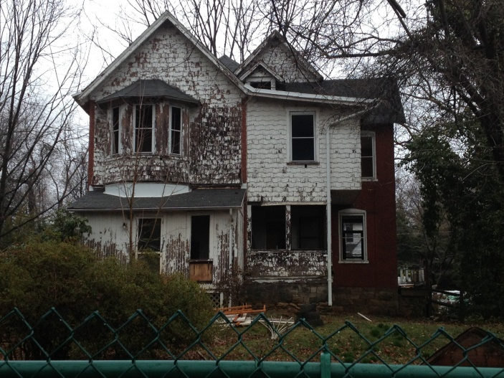
The House with Nobody in It
Whenever I walk to Suffern along the Erie track I go by a poor old farmhouse with its shingles broken and black. I suppose I've passed it a hundred times, but I always stop for a minute And look at the house, the tragic house, the house with nobody in it.
The House with Nobody in It
by Joyce Kilmer (He’s a guy.)
Whenever I walk to Suffern along the Erie track I go by a poor old farmhouse with its shingles broken and black. I suppose I've passed it a hundred times, but I always stop for a minute And look at the house, the tragic house, the house with nobody in it.
I never have seen a haunted house, but I hear there are such things; That they hold the talk of spirits, their mirth and sorrowings. I know this house isn't haunted, and I wish it were, I do; For it wouldn't be so lonely if it had a ghost or two.
This house on the road to Suffern needs a dozen panes of glass, And somebody ought to weed the walk and take a scythe to the grass. It needs new paint and shingles, and the vines should be trimmed and tied; But what it needs the most of all is some people living inside.

Slide 6
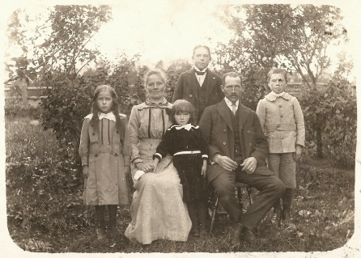
If I had a lot of money and all my debts were paid I'd put a gang of men to work with brush and saw and spade. I'd buy that place and fix it up the way it used to be And I'd find some people who wanted a home and give it to them free.
Now, a new house standing empty, with staring window and door, Looks idle, perhaps, and foolish, like a hat on its block in the store. But there's nothing mournful about it; it cannot be sad and lone For the lack of something within it that it has never known.
But a house that has done what a house should do, a house that has sheltered life, That has put its loving wooden arms around a man and his wife, A house that has echoed a baby's laugh and held up his stumbling feet, Is the saddest sight, when it's left alone, that ever your eyes could meet.

Slide 7
So whenever I go to Suffern along the Erie track I never go by the empty house without stopping and looking back, Yet it hurts me to look at the crumbling roof and the shutters fallen apart, For I can't help thinking the poor old house is a house with a broken heart.

Slide 8
This poem fascinates me because with all man’s technology, inventions, and innovations, what could be more magnificent, more beautiful, more phenomenal than a tree?
I love natural beauty.

Slide 9
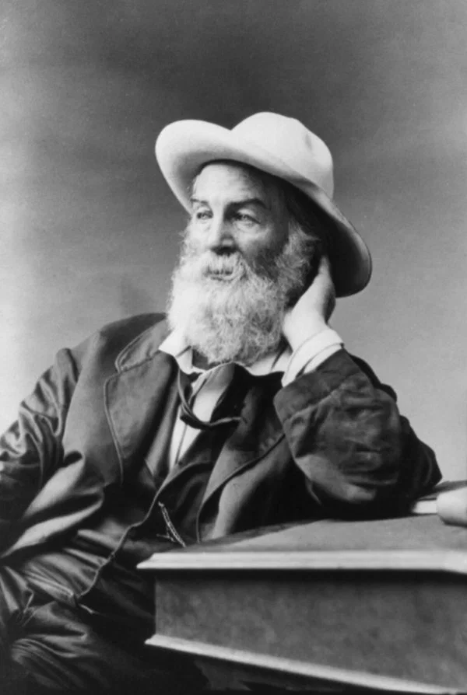
This next poem is closely linked to our Gettysburg unit. Walt Whitman wrote this poem about the death of Abraham Lincoln. I took a course from Harvard University about Walt Whitman. He was really involved in the anti-slavery movement, and he was a big fan of Abraham Lincoln.
He expressed his emotions, as well as the emotions of a nation, in this poem.
The following video has a few errors. I think they used speech to text instead of writing the poem. But I think it really portrays the poem and makes it understandable. I will include the complete poem at the end, so you can see the poem without mistakes.

Slide 10
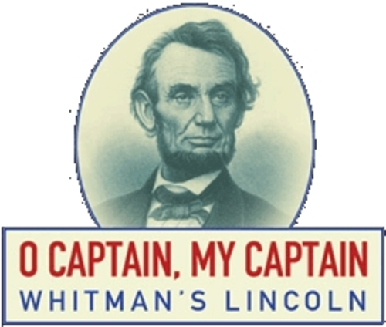
https://www.aristoiclassical.org/apps/video/watch.jsp?v=141849

Slide 11
O Captain! My Captain!
BY WALT WHITMAN
O Captain! my Captain! our fearful trip is done,
The ship has weather’d every rack, the prize we sought is won,
The port is near, the bells I hear, the people all exulting,
While follow eyes the steady keel, the vessel grim and daring;
But O heart! heart! heart!
O the bleeding drops of red,
Where on the deck my Captain lies,
Fallen cold and dead.

Slide 12
O Captain! my Captain! rise up and hear the bells;
Rise up—for you the flag is flung—for you the bugle trills,
For you bouquets and ribbon’d wreaths—for you the shores a-crowding,
For you they call, the swaying mass, their eager faces turning;
Here Captain! dear father!
This arm beneath your head!
It is some dream that on the deck,
You’ve fallen cold and dead.

Slide 13
My Captain does not answer, his lips are pale and still,
My father does not feel my arm, he has no pulse nor will,
The ship is anchor’d safe and sound, its voyage closed and done,
From fearful trip the victor ship comes in with object won;
Exult O shores, and ring O bells!
But I with mournful tread,
Walk the deck my Captain lies,
Fallen cold and dead.

Slide 15
(A great poem for procrastinators.)
Tomorrow
He was going to be all that a mortal should be
Tomorrow.
No one should be kinder or braver than he
Tomorrow.
A friend who was troubled and weary he knew,
Who'd be glad of a lift and who needed it, too;
On him he would call and see what he could do
Tomorrow.
Each morning he stacked up the letters he'd write
Tomorrow.
And thought of the folks he would fill with delight
Tomorrow.
It was too bad, indeed, he was busy today,
And hadn't a minute to stop on his way;
More time he would have to give others, he'd say
Tomorrow.

Slide 16
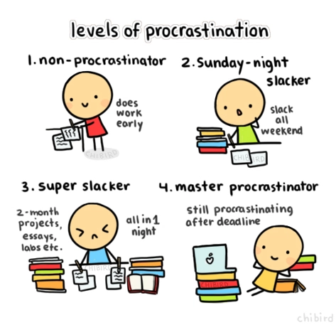
The greatest of workers this man would have been
Tomorrow.
The world would have known him, had he ever seen
Tomorrow.
But the fact is he died and he faded from view,
And all that he left here when living was through
Was a mountain of things he intended to do
Tomorrow.

