Slide 1
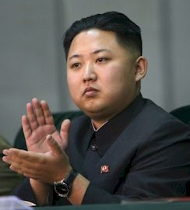
The History of Korea
By Joscelyne, Riley, Brookes, Brenden

Slide 2
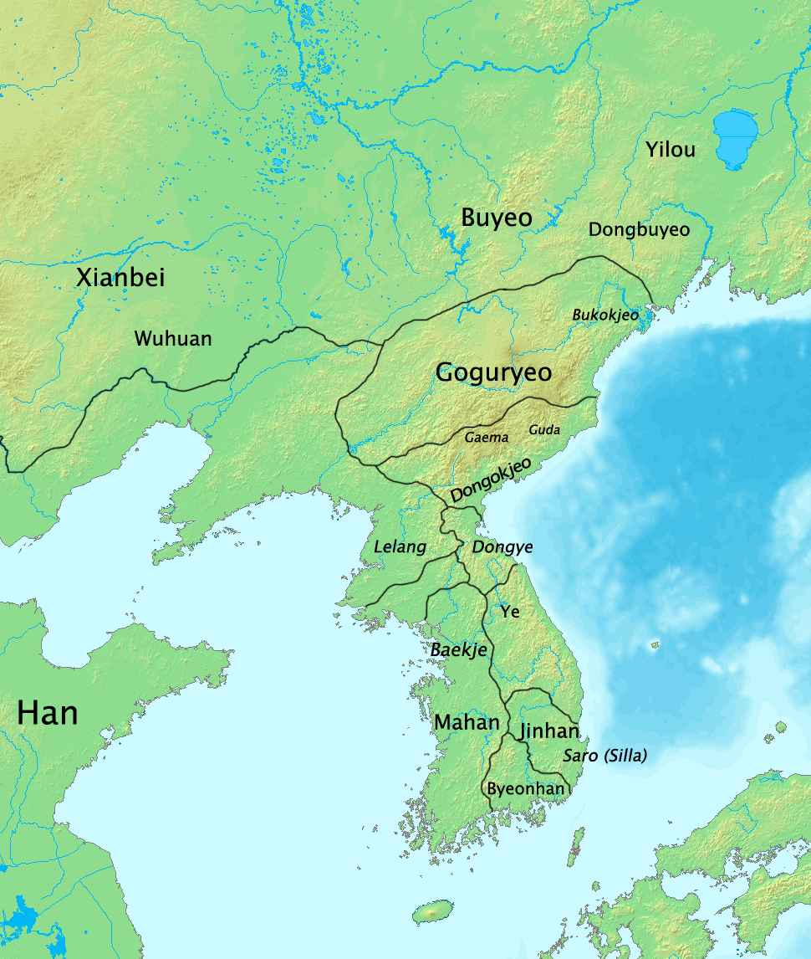
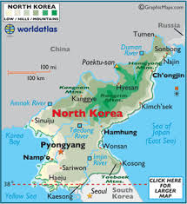
Korean History
Korea was influenced by many different cultures and countries.
We will be focusing on the Three Kingdoms Era (57 BCE-AD 668) and North Korea (1948-Present)

Slide 3
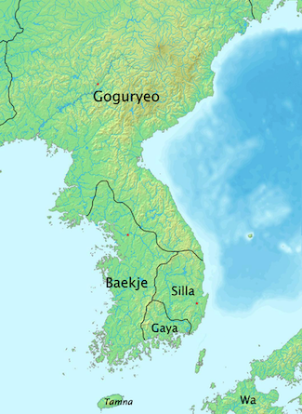
The Three Kingdom Era
Chinese dynasty was not unified-this gave Korea a chance to develop their own civilization.
During this era, Korea developed into a nation of THREE separate kingdoms:
Goguryeo (Koguryo)- Forest hunting culture
Baekje (Paekche)- Agricultural and maritime based culture
Silla-Warrior bands that later conquered all of Korea
Goguryeo’s King T’aejo changed the passing of the throne
From brother/brother to father/son. Established many things
Considered “Korean”
Baekje’s King Koi began code of law in AD 250. In 346,
Baekje becomes an Aristocratic state.
Silla grew out of walled state of Sara in the S.E. King Naemul
Changed name to Silla in AD 356.
China is a great influence on Korea-
legal institutions, Buddhism, Confucianism, and Chinese written language.
Type of government-Monarchy (ruled by kings)

Slide 4
Governments and Social Classes
The social classes in Korea have changed over the years
The social class consists of slaves and criminals at the bottom, then the rest was determined by the Silla Sacred(wealthy),and True Bone(poor)Rank System
The Bone Rank Systems were determined by birth and dictated work possibilities and clothes/utensils they could use
Life for the wealthy was good and they were well treated
while the poor were treated harsh and suffered from poverty
The government was a monarchy
This monarchy was aided by senior administrative officials

Slide 5
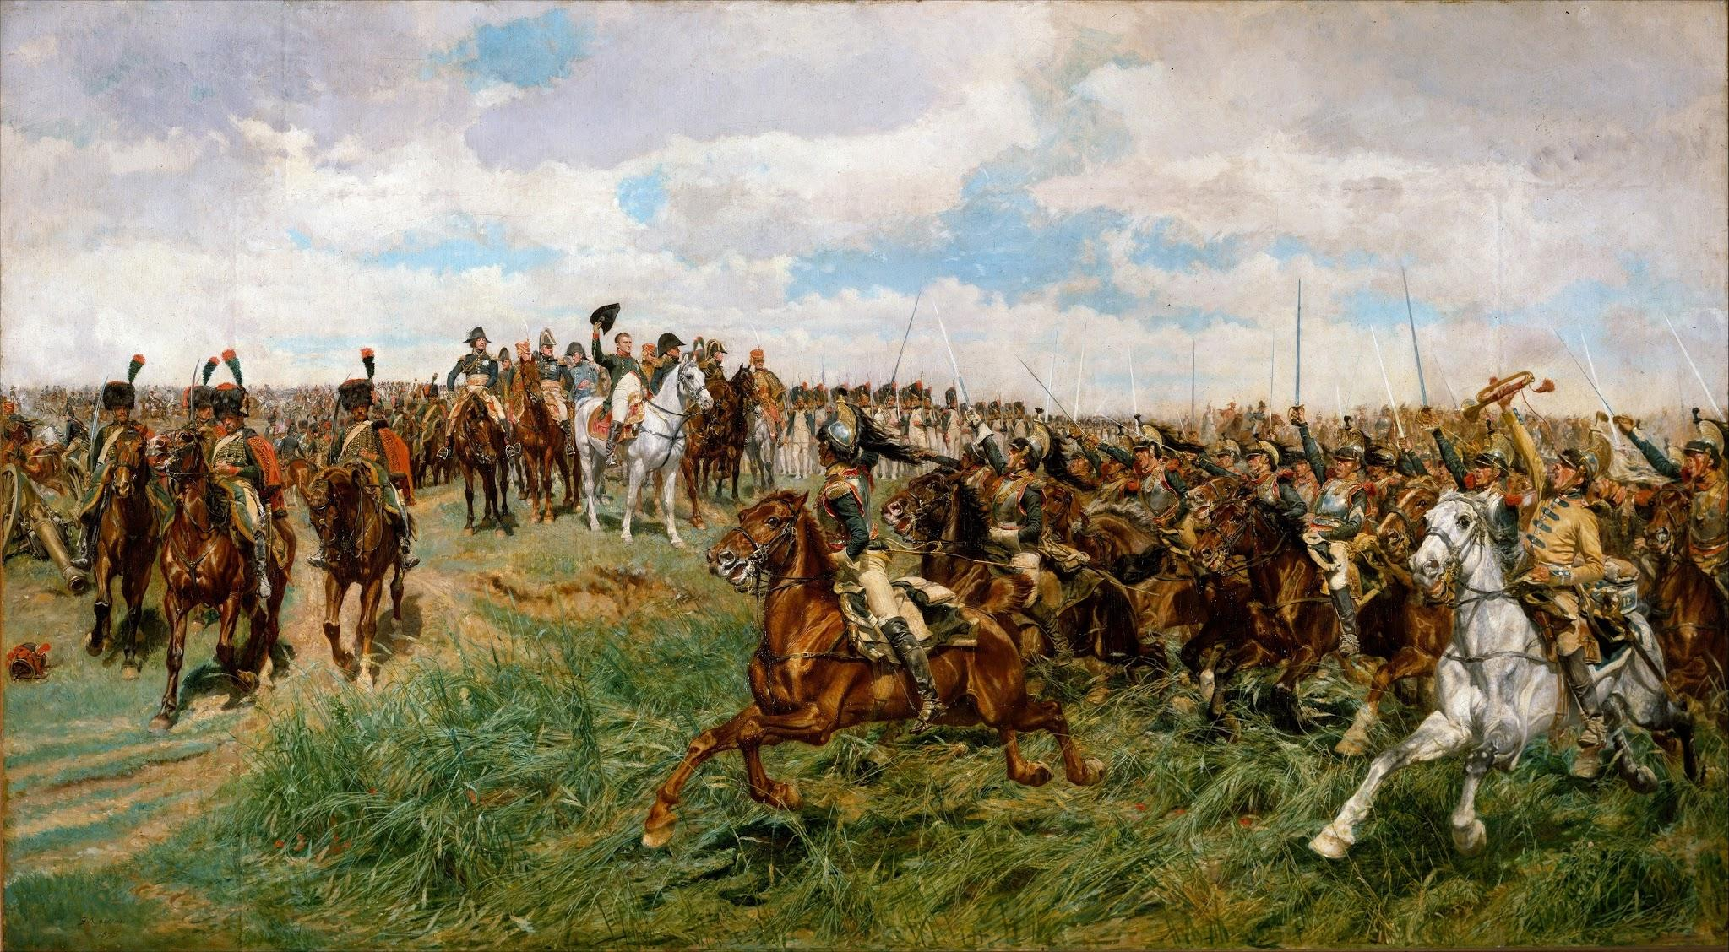
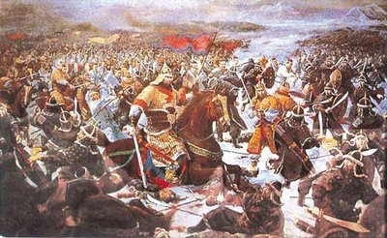
Battles
One of the most important battles in Korean history was Salsu
The battle at Salsu was important because it slowed the invading Chinese Sui army
This incredible stand was lead by Ulchi Mundok
This shaped the time because Korea was able to stay its own and not be swallowed by the Chinese to be forced into their culture

Slide 6
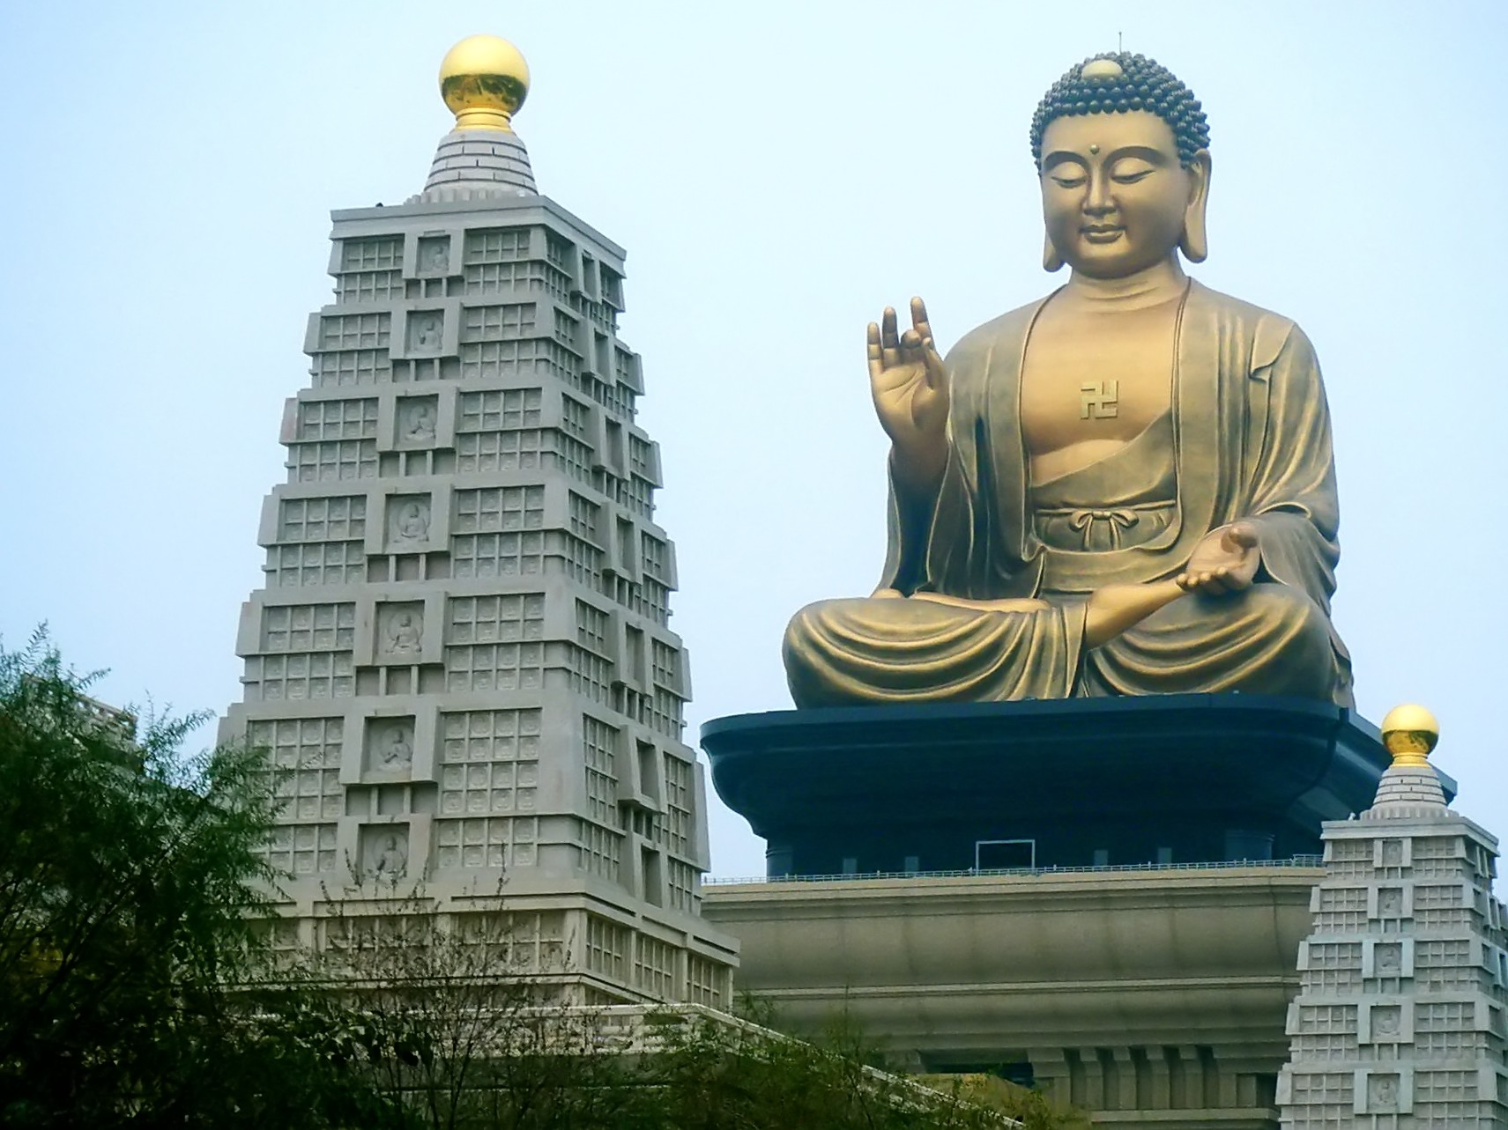
Religion and Language
Religions: Buddhism, Confucianism, Daoism, and Shamanism.
Arrived around the fourth century
Profound impact on art, music, and literature
Inspired magnificent sculpture and architecture
Peaks in 10-12th centuries
The spoken language was the Sillian
The Koguryo, Paekche, and Silla kingdoms were a common race sharing a common language

Slide 7
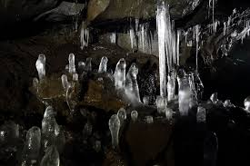
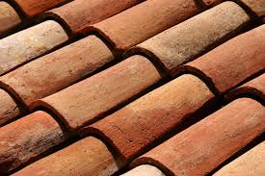
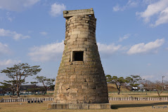
Inventions and Advancements
Stone pagodas were first built during The Three Kingdoms Era.
Silla created refrigeration-Seokbinggo
Used subterranean chambers with ice and food.
Hard-fired stoneware ceramics
Roof Tiles
Cheomseongdae-built between AD 632-647
Star-gazing platform
Oldest observatory on Earth
366 cut granite pieces-for 366 Lunar days
12 base stones-for 12 months in a year
Thought to be influenced by Buddhism

Slide 8
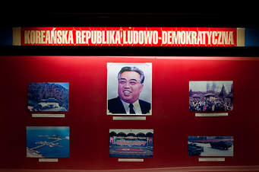
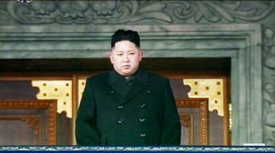
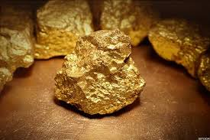
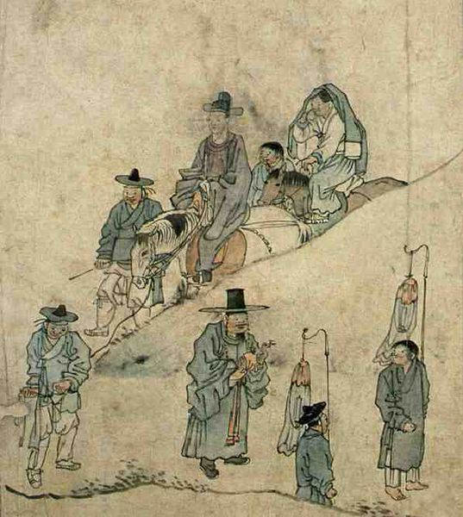
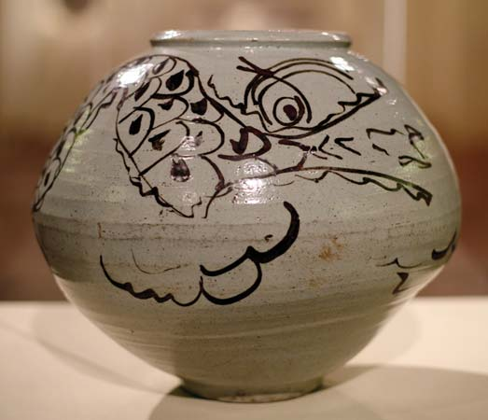
North Korea- 1948 to Present
Freedoms: NONE-No human rights!
All resources controlled by government
Schools, lodging, marriage, jobs
Mainly Industrial 80-90% of mineral wealth in North Korea
Gold, iron ore, coal, uranium, copper, silver, tungsten, and zinc.
Used to rely on South Korea for agriculture before 1945-became self-sufficient
Still suffers from severe food shortages
Art-Most art shows Socialist realism
People happy doing their work-some pastoral views.
Music-Mainly patriotic songs
Mostly sung by females
March-like style
Self-reliance ideology

Slide 9
North Korea has Overcome Many Problems
They broke free of the Chinese military to make their own military
The Chinese have tried to take over Korea which would make them lose their government and religion
China has influenced North Korea in their government
This government is a communist rule
They don’t need to rely on South Korea for agricultural goods

Slide 10
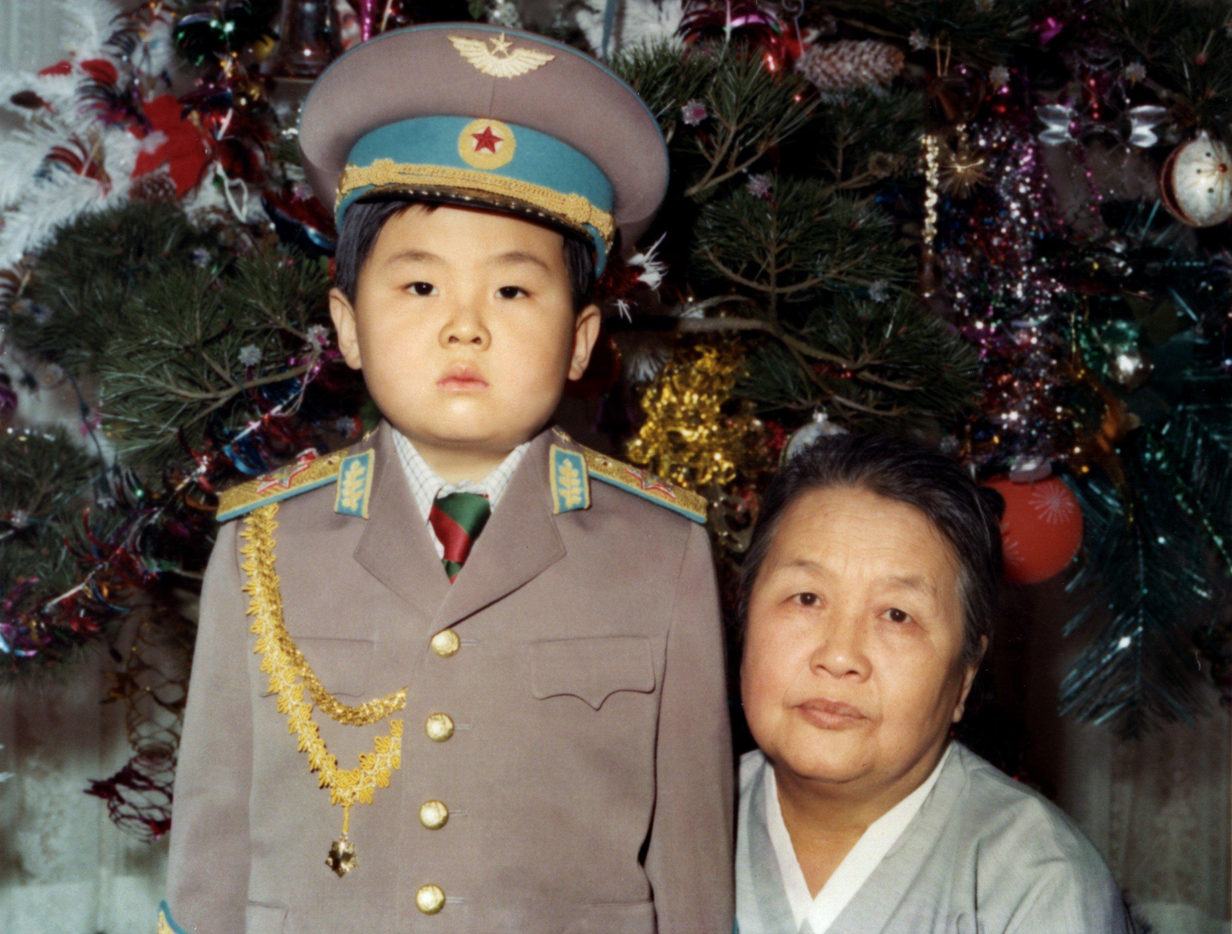
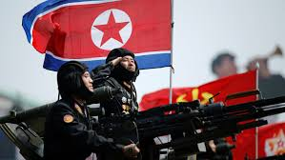
Korea is changing
Korea has kept many origins, but it has changed as well.
Korea did have their own language, but China changed their language. China also changed Korea's number system.
They made the women prostitutes for the Chinese army.
Korea is home to the Chinese military.
Korea maintained strong cultural ties to China.

Slide 11
Bibliography
http://academic.mu.edu/meissnerd/3kingdom-korea.html
https://en.wikipedia.org/wiki/Music_of_North_Korea
https://www.britannica.com/place/North-Korea/Cultural-life
https://www.ancient.eu/Three_Kingdoms_Period_in_Korea/
https://en.wikipedia.org/wiki/Three_Kingdoms
https://www.ancient.eu/Bone_Rank_System/
https://en.wikipedia.org/wiki/History_of_science_and_technology_in_Korea

