Slide 1
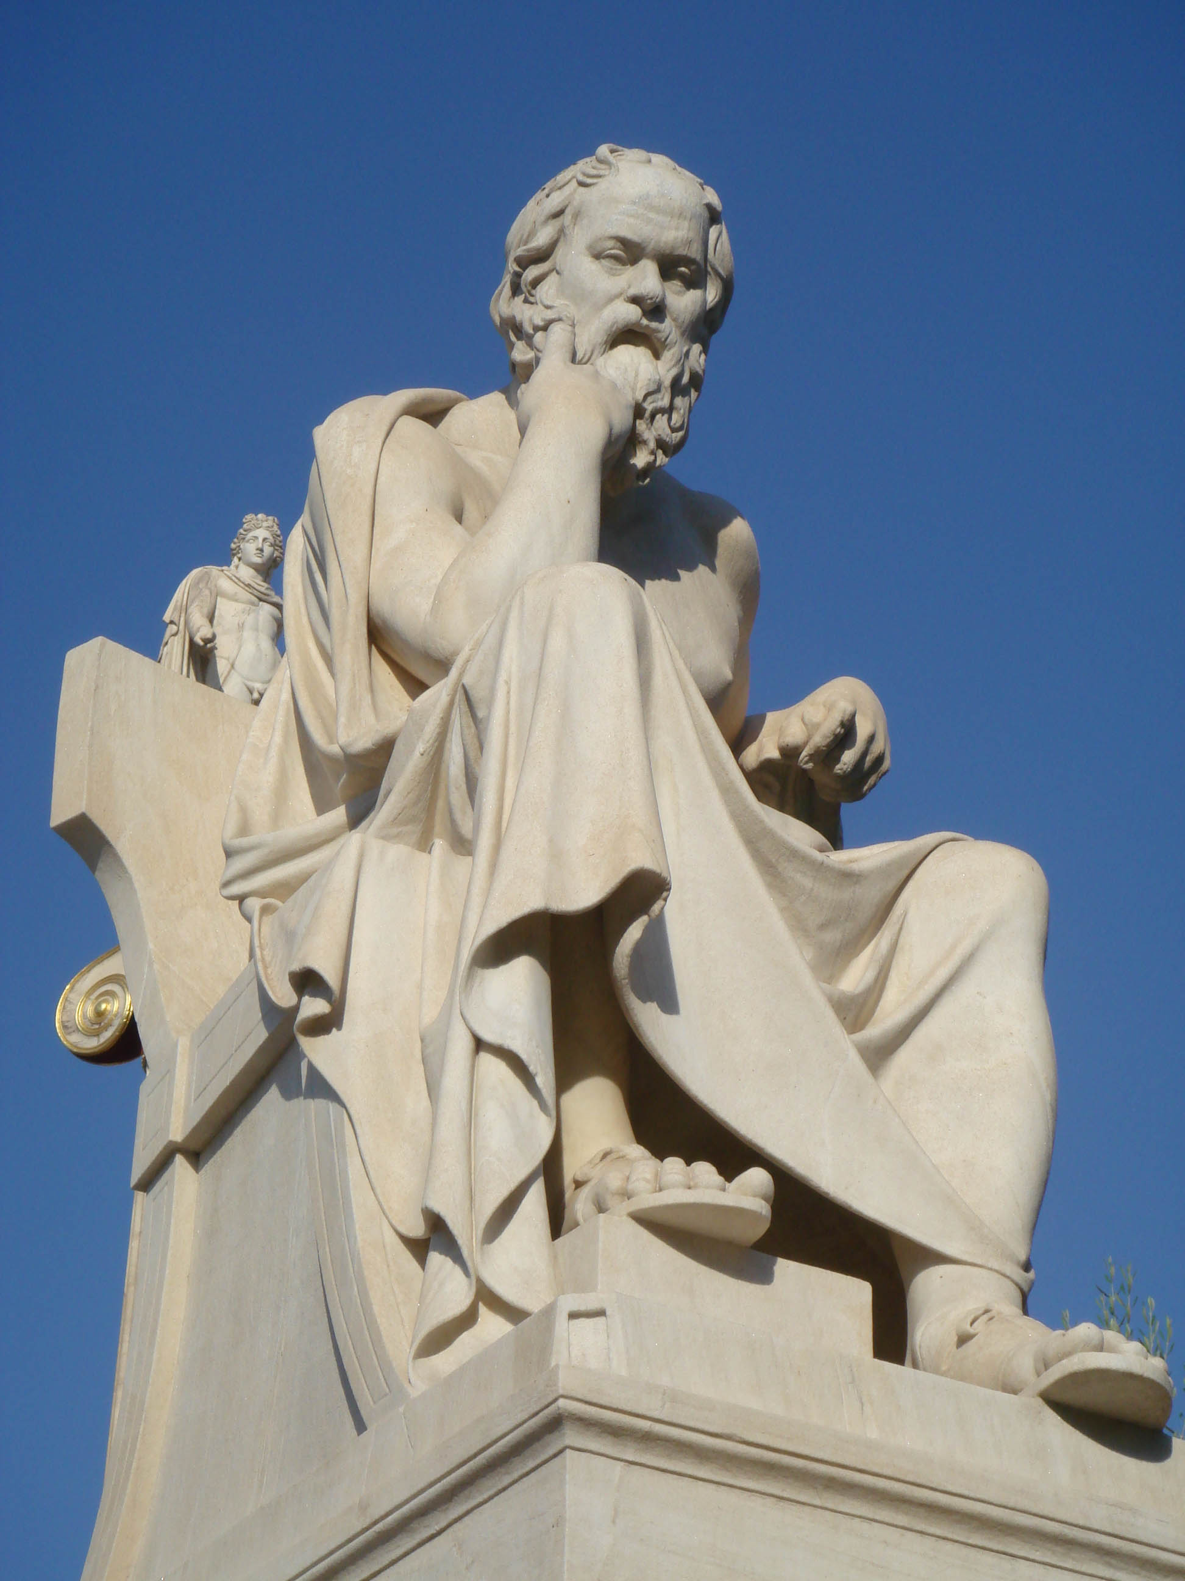
SOCRATES

Slide 2
Socrates is one of those people identified by only one name like Elvis, Adele, Bono, Drake, LeBron, etc. He was a Greek philosopher who lived in the 5th century B. C.
Bored yet?

Slide 3
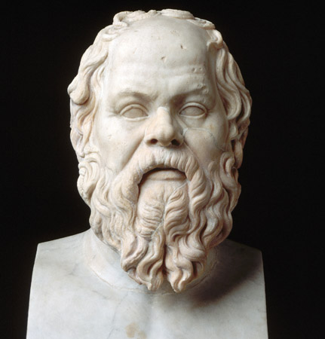
When Socrates was in his forties or so (old right?), he began to feel an urge to think about the world around him, and try to answer some difficult questions.
He asked, "What is wisdom?" and "What is beauty?" and "What is the right thing to do?”

Slide 4
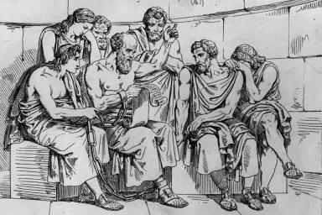
He knew that these questions were hard to answer, and he thought it would be better to have a lot of people discuss the answers together, so that they might come up with more ideas.

Slide 5
So he began to go around Athens asking people he met these questions, "What is wisdom?" , "What is piety?", and so forth. Sometimes the people just said they were busy, but sometimes they would try to answer him.

Slide 6
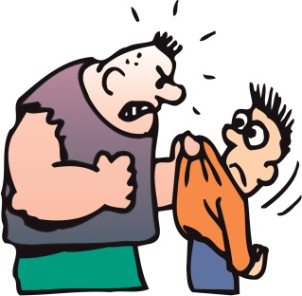
Then Socrates would try to teach them to think better by asking them more questions which showed them the problems in their logic. Often this made
people angry. Sometimes
they even tried to beat him up.

Slide 7
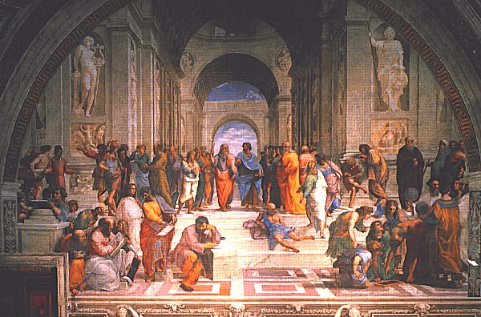
Socrates soon had a group of young men who listened to him and learned from him how to think. Plato (yeah, just one name) was one of these young men. Socrates never charged them any money. But in 399BC, some of the Athenians got mad at Socrates for what he was teaching the young men.

Slide 8
.
They charged him in court with impiety (not respecting the gods) and corrupting the youth (teaching young men bad things). People thought he was against democracy, and he probably was - he thought the smartest people should make the decisions for everyone.

Slide 9
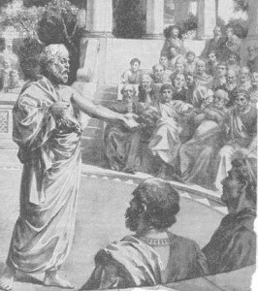
Socrates had a big trial in front
of an Athenian jury.

Slide 10
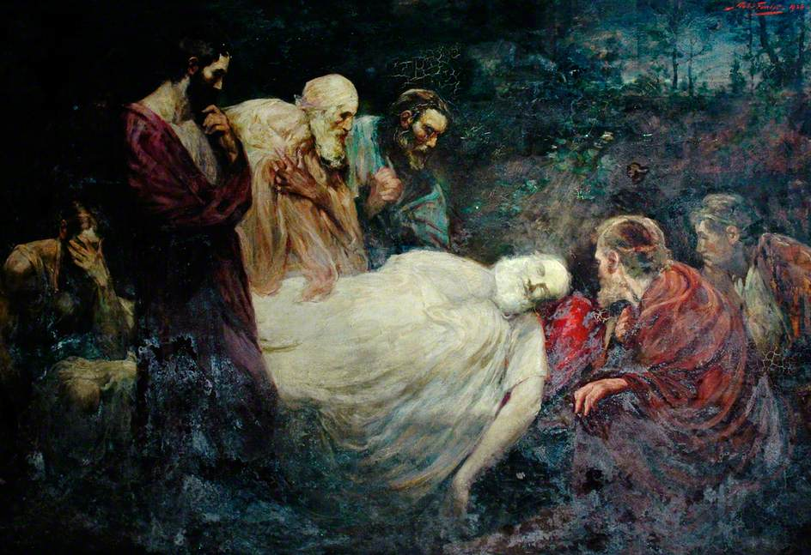
.
He was convicted of these charges and sentenced to death. he died soon afterwards, when the guards gave him a cup of hemlock (a poisonous plant) to drink.

